Slide 1
The Toffoli gate & Error Correction
Sophie Chauvin and Roman Patscheider

Slide 2
Topics
Toffoli gate
As a circuit element
A physical implementation
Quantum Error Correction
Bit-flip error correction
Phase-flip error correction

Slide 3
Introduction
Presence of noise requires error correction
General idea:
Toffoli gate for information recovery
Add redundant information
Noise
Recover original information
Information to be preserved
Notes:
Shortly explain classical „majority vote“: 0->000, 1->111 if one bit flipped: 000->100 majority wins ->0
For qubits: 3-qubit entangled state -> Information recovery using 3 qubit gate

Slide 4
The Toffoli gate
As a circuit element

Slide 5
Toffoli gate or CCNOT gate
|000>
|001>
|010>
|011>
|100>
|101>
|110>
|111>
|000>
|001>
|010>
|011>
|100>
|101>
|111>
|110>
1 0 0 0 0 0 0 0
0 1 0 0 0 0 0 0
0 0 1 0 0 0 0 0
0 0 0 1 0 0 0 0
0 0 0 0 1 0 0 0
0 0 0 0 0 1 0 0
0 0 0 0 0 0 0 1
0 0 0 0 0 0 1 0
Circuit Symbol
Truth Table
Matrix Representation

Slide 6
CCPhase to CCNOT
is equivalent to
H
H
Notes:
As seen in the excercise class last week: transforming |0> / |1> into |+> / |-> thus CCPhase flips states and after transforming back, the target is flipped

Slide 7
The Toffoli gate
A physical implementation

Slide 8
A superconducting circuit
Microwave transmission line resonator
3 transmon qubits
Fedorov, A.; Steffen, L.; Baur, M.; Wallraff A. Implementation of a Toffoli Gate with Superconducting Circuits arXiv:1108.3966 (2011)

Slide 9
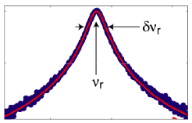
Resonator features
Bare resonator frequency: ν_{r} = 8.625 GHz
Quality factor: Q = 3300
Transmission (dB)
Frequency
Fedorov, A.; Steffen, L.; Baur, M.; Wallraff A. Implementation of a Toffoli Gate with Superconducting Circuits arXiv:1108.3966 (2011)

Slide 10
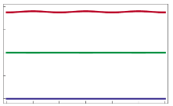
Qubit features
E_{n}
n_{g}
Some numerical values:
Maximum transition frequencies: ν_{A,B,C} = {6.714, 6.050, 4.999} GHz
Charging energies: E_{C}/h = {0.264, 0.296, 0.307} GHz
Coupling strengths: g/2π = {0.36, 0.30, 0.34} GHz
Energy relaxation time: T₁ = {0.55, 0.70, 1.10} μs
Phase coherence time: T₂*= {0.45, 0.6, 0.65} μs
Use states ⎢0〉, ⎢1〉 (computational states) and ⎢2〉
anharmonicity
Fedorov, A.; Steffen, L.; Baur, M.; Wallraff A. Implementation of a Toffoli Gate with Superconducting Circuits arXiv:1108.3966 (2011)

Slide 11
Simplification of Toffoli gate
Using quantum levels ⎢0〉 and ⎢1〉: 6 CNOT gates and several single qubit operations
Using quantum levels ⎢0〉, ⎢1〉 and ⎢2〉: half duration of precedent schemes
Trick: hide qubit in the 3rd level

Slide 12
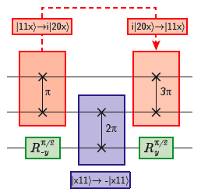
Circuit diagram
Aim: achieving ⎢001〉 → - ⎢001〉
Red: « hide » the third qubit in non-computational state (π-SWAP and 3π-SWAP)
Green: single qubit rotations
Blue: CPHASE gate
Fedorov, A.; Steffen, L.; Baur, M.; Wallraff A. Implementation of a Toffoli Gate with Superconducting Circuits arXiv:1108.3966 (2011)

Slide 13
Circuit diagram
Aim: achieving ⎢001〉 → - ⎢001〉
Initial state | After π-SWAP | After CPHASE | After 3π-SWAP
⎜011〉 | ⎜011〉 | - ⎜011〉 | - ⎜011〉
⎜110〉 ⎜111〉 | i ⎜200〉 i ⎜201〉 | i ⎜200〉 i ⎜201〉 | ⎜110〉 ⎜111〉
⎜x0y〉 ⎜010〉 | ⎜x0y〉 ⎜010〉 | ⎜x0y〉 ⎜010〉 | ⎜x0y〉 ⎜010〉
Fedorov, A.; Steffen, L.; Baur, M.; Wallraff A. Implementation of a Toffoli Gate with Superconducting Circuits arXiv:1108.3966 (2011)

Slide 14
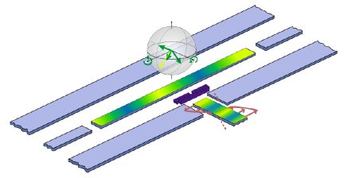
Rotating single qubits
Apply microwave pulses
Frequency controled by flux pulses through the SQUID loop (few nanoseconds long)

Slide 15
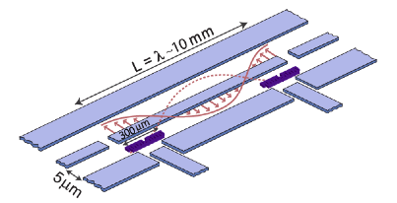
Coupling Qubits
Transmission line resonator used as quantum bus
Microwave pulses

Slide 16
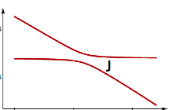
The SWAP gates
⎜20x〉or ⎜x20〉
ν
⎜11x〉or ⎜x11〉
Φ/Φ₀
Qutrit tuned non-adiabatically
Evolution: U ⎟11x〉 = cos(Jt) ⎟11x〉 – i sin(Jt) ⎟20x〉
Choose t such as to perform π, 2π and 3π gates
Interaction times: t = { π, 2π, 3π } / 2J_{11,20} = { 7, 23, 20 } ns

Slide 17
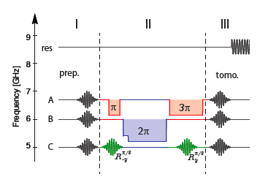
The whole pulse sequence
Flux pulses
Microwave pulses
Fedorov, A.; Steffen, L.; Baur, M.; Wallraff A. Implementation of a Toffoli Gate with Superconducting Circuits arXiv:1108.3966 (2011)

Slide 18
The Toffoli gate
Performance Evaluation

Slide 19
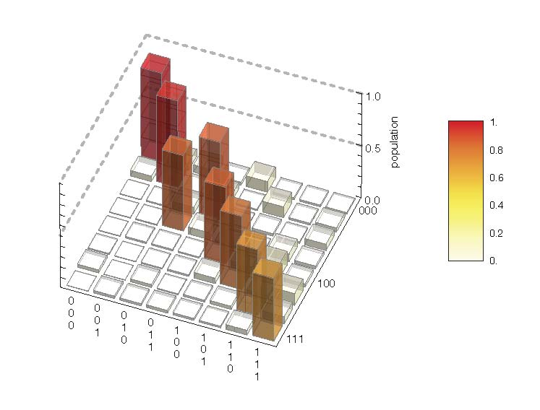
Fidelity and total gate time
Fidelity of the measured truth table:
F=(1/8)TR[U_{exp}^{T} U_{ideal}]=76%
Total gate time: 90 ns
Fedorov, A.; Steffen, L.; Baur, M.; Wallraff A. Implementation of a Toffoli Gate with Superconducting Circuits arXiv:1108.3966 (2011)

Slide 20
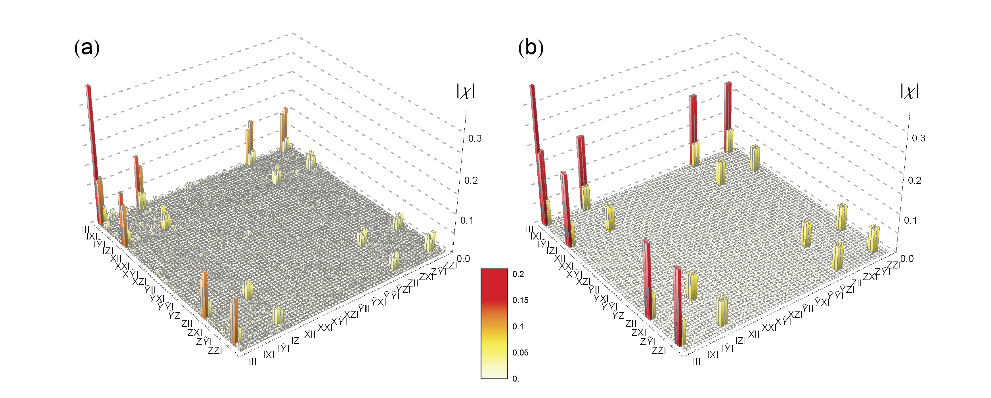
Full Process Tomography
Include non classical features of the Toffoli gate F=Tr[χ_{exp}^{t} χ_{ideal}] =69%
Fedorov, A.; Steffen, L.; Baur, M.; Wallraff A. Implementation of a Toffoli Gate with Superconducting Circuits arXiv:1108.3966 (2011)
Notes:
Apply 64 distinct Input states and perform a state tomography on output states.
On the right: ideal process matrix
On the left: measured process matrix

Slide 21
Quantum error correction

Slide 22
About quantum error correction codes
Classical idea: make the input signal redundant
Detect an error without measuring the actual state
correct witout destroying coherence
Correct errors on ONE qubit only

Slide 23
Quantum Error Correction
Bit-flip Correction

Slide 24
Bit flip correction
Correct errors of type σ_{X} |Ψ〉 (σ_{X} Pauli operator)
Bit-flip errors
|0>
|Ψ>
|0>
1
2
3
4
Initial state: Qubit 1: |0〉 Qubit 2: α|0〉 + β|1〉 Qubit 3: |0〉
3-qubit-state: α|000〉 + β|010〉
Reed, M. D; DiCarlo, L.; Nigg, S. E; et al. Realization of Three-Qubit Quantum Error Correction with Superconducting Circuits arXiv:1109.4948 (2011)

Slide 25
Bit flip correction
Correct errors of type σ_{X} |Ψ〉 (σ_{X} Pauli operator)
Bit-flip errors
|0>
|Ψ>
|0>
1
2
3
4
Entanglement: α |000> + β |111>
Reed, M. D; DiCarlo, L.; Nigg, S. E; et al. Realization of Three-Qubit Quantum Error Correction with Superconducting Circuits arXiv:1109.4948 (2011)

Slide 26
Bit flip correction
Correct errors of type σ_{X} |Ψ〉 (σ_{X} Pauli operator)
Bit-flip errors
|0>
|Ψ>
|0>
1
2
3
4
Bit flip with probability p:
Diven by rotation angle θ introduced by y-rotation (p=sin²(θ/2))
Reed, M. D; DiCarlo, L.; Nigg, S. E; et al. Realization of Three-Qubit Quantum Error Correction with Superconducting Circuits arXiv:1109.4948 (2011)

Slide 27
Bit flip correction
Correct errors of type σ_{X} |Ψ〉 (σ_{X} Pauli operator)
Bit-flip errors
|0>
|Ψ>
|0>
1
2
3
4
Reverse process: « desantanglement » α|000〉 + β|010〉
If no error occured!
Reed, M. D; DiCarlo, L.; Nigg, S. E; et al. Realization of Three-Qubit Quantum Error Correction with Superconducting Circuits arXiv:1109.4948 (2011)

Slide 28
Bit flip correction
Correct errors of type σ_{X} |Ψ〉 (σ_{X} Pauli operator)
Bit-flip errors
|0>
|Ψ>
|0>
1
2
3
4
Toffoli gate:
Correction if and only if the two ancilla qubits are in an excited state
Reed, M. D; DiCarlo, L.; Nigg, S. E; et al. Realization of Three-Qubit Quantum Error Correction with Superconducting Circuits arXiv:1109.4948 (2011)

Slide 29
Quantum Error Correction
Phase-flip Correction

Slide 30
Phase Errors
Phase errors are errors of the form Z |ψ> (Z is Pauli operator)
Errors with probability p are modeled by Z-gates with known rotation angle θ with p=sin²(θ/2)
Projecting the systems state onto the possible error syndromes causes the system to „decide“ if a full phase flip error occured or not

Slide 31
Phase Error Correction Circuit
H
Phase errors
H
|0>
|Ψ>
H
H
|0>
H
H
1
2
3
4
5
6
Initial state: Qubit 1: |0> Qubit 2: α|0> + β|1> Qubit 3: |0>
3-qubit-state: α|000> + β|010>
Reed, M. D; DiCarlo, L.; Nigg, S. E; et al. Realization of Three-Qubit Quantum Error Correction with Superconducting Circuits arXiv:1109.4948 (2011)

Slide 32
Phase Error Correction Circuit
H
Phase errors
H
|0>
|Ψ>
H
H
|0>
H
H
1
2
3
4
5
6
After two CNOT operations: α |000> + β |111>
Reed, M. D; DiCarlo, L.; Nigg, S. E; et al. Realization of Three-Qubit Quantum Error Correction with Superconducting Circuits arXiv:1109.4948 (2011)

Slide 33
Phase Error Correction Circuit
H
Phase errors
H
|0>
|Ψ>
H
H
|0>
H
H
1
2
3
4
5
6
Changing the basis to |+>=1/sqrt(2)(|0>+|1>) |–>=1/sqrt(2)(|0>–|1>)
results in: α |+ + +> + β |– – –>
Reed, M. D; DiCarlo, L.; Nigg, S. E; et al. Realization of Three-Qubit Quantum Error Correction with Superconducting Circuits arXiv:1109.4948 (2011)

Slide 34
Phase Error Correction Circuit
H
Phase errors
H
|0>
|Ψ>
H
H
|0>
H
H
1
2
3
4
5
6
If a relative phase error of π is inserted on the second qubit, the 3-qubit-state gets: α |+ – +> + β |– + –>
And after returning to the original basis:
α |010> + β |101>
Reed, M. D; DiCarlo, L.; Nigg, S. E; et al. Realization of Three-Qubit Quantum Error Correction with Superconducting Circuits arXiv:1109.4948 (2011)

Slide 35
Phase Error Correction Circuit
H
Phase errors
H
|0>
|Ψ>
H
H
|0>
H
H
1
2
3
4
5
6
Again after two CNOT operations: α |111> + β |101>
Applying a CCNOT operation on the second qubit results in:
α |101> + β |111>
Thus the ancilla qubits are now both |1> and the second qubit is in its original state |Ψ>= α|0> + β|1>
Reed, M. D; DiCarlo, L.; Nigg, S. E; et al. Realization of Three-Qubit Quantum Error Correction with Superconducting Circuits arXiv:1109.4948 (2011)

Slide 36
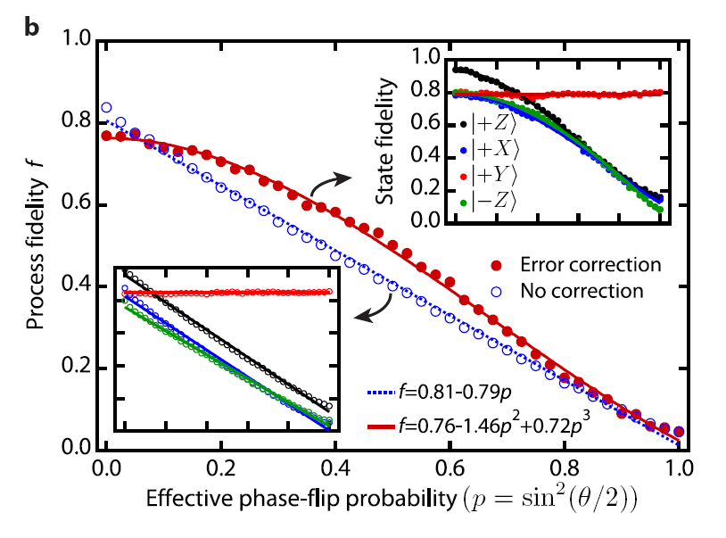
Process Fidelity
f=(0.76±0.005) – (1.46±0.03)p² + (0.72±0.03)p³
Since the code corrects only single qubit errors, it will fail, for two or more errors. -> linear dependence on p suppressed!
Reed, M. D; DiCarlo, L.; Nigg, S. E; et al.; Realization of Three-Qubit Quantum Error Correction with Superconducting Circuits arXiv:1109.4948 (2011)
Notes:
Implemented by Reed et al. in Superconducting circuits.
Z gates with known rotation applied on all 3 qubits -> every qubit has probability p to have the phase flipped.
-> probability of more than one flip:3*(1-p)*p^2+p^3= 3p^2-2p^3
->fidelity ideally: 1-3p^2+2p^3
Due to limited gate fidelity: smaller coefficients

Slide 37
What to remember
Codes to detect and correct errors without destroying coherence
Implemented in superconductor circuits, using Toffoli gate
Use an interaction with the third excited state

Slide 38
Sources
Fedorov, A.; Steffen, L.; Baur, M.; Wallraff A. Implementation of a Toffoli Gate with Superconducting Circuits arXiv:1108.3966 (2011)
Reed, M. D; DiCarlo, L.; Nigg, S. E; et al. Realization of Three-Qubit Quantum Error Correction with Superconducting Circuits arXiv:1109.4948 (2011)

Slide 39
Outlook
Shor code: protects against arbitrary error on a single qubit
To be presented by Dezeure Ruben & Schneider Manuel on Dec 19

