Slide 2
Outline
Introduction
Basics of Classical Error Correction
Classical Repetition Code and Error graphs
Basics of Quantum Error Correction
Error Propagation and Identification
Experimental Setup
Results

Slide 3
Introduction
Quantum error correction as protection of a quantum state from environment-induced errors
Experiments have demonstrated 1st order tolerance against one error type (NMR) or multiple types (ion traps, superconducting circuits) in a single round
Need for preservation of quantum information throughout computation: multiple cycles of correction.
Reference paper Kelly et. al., 2015 :
All figures are taken or adapted from Kelly et. al., 2015 , if not denoted otherwise.
Notes:
From paper

Slide 4
Basics of Classical Correction
Protect code against noise by introducing redundancy with encoding
Simplest redundancy: repetition code
Send over binary symmetric channel with crossover probability p (independent for each bit)
Majority voting: 3-bit failure probability
encoding
channel
Nielson and Chuang, 2000
channel
(000) (110), (101), (011), (111)
Notes:
Transmission more reliable by encoding provided that pe < p

Slide 5
Definitions, Notation
Fault-tolerance: good success probability, even if all operations involved are imperfect (channel and gates)
N-th order fault tolerance: Logical state is preserved for up to n qubit errors (with high probability)
Fidelity: “Measure of distance between probability distributions or quantum states” (Nielson, Chuang 2000)
Error suppression factor: characterizes how rapidly errors are suppressed as qubits are added to the system by comparing different orders of fault-tolerance.
Ancilla measurement qubit: measurement qubit, used to perform operations. Prepared in a standard state.
Pure state
Any state
Logical error rate
Error suppr. factor
Notes:
Maybe skip?
Maybe add?
Communication, parallism (from Steane)
Stabilizer, syndrome
…
…

Slide 6
Basics of Classical Correction
Trusted supervisor
n identical copies of a bit, each with independent bit-flip probability p
hypothetical perfectly reliable supervisor checking each bit of data
Majority vote success grows with large n, small p
Arbitrarily reliable storage of single bit with repetition code and majority vote
Notes:
XOR: exclusive or = Binary modulo 2 addition.

Slide 7
Basics of Classical Correction
Secret data
Supervisor can only check is two given bits are the same: XOR operator
Independent errors
Correct decoding for < [n/2] errors per time interval, again:
Access to only parity information, same decoding success!

Slide 8
Classical Repetition Code
Processing perfect parity measurements:
Identical copies of unknown bit
Bit-flip error
Perfect parity measurement of neighbors
Conversion of parity string to graph problem
Simplest solution
Inverse solution
Detection event = positive parity check between neighbors = red vertex
Notes:
(c) If no error were introduced, all pairwise parity measurements would yield zeros
(d) Each vertex = one parity measurement. Red vertex = error, located at the end of error chains. Error pattern with less errors are more likely (independent errors).
(e) Goal: Connect colored vertices using the smallest number of edges

Slide 9
Classical Repetition Code
Large example:
Weight 8
Weight 7
Decoding with “minimum-weight perfect matching”
shortest total weighted path length when connecting detection events (multi-round analysis)
Detection event = positive parity check between neighbors
Notes:
15 Identical copies of an unknown bit with errors at unknown locations. Specific pattern of pairwise parity measurements.
Corresponding graph problem with colored vertices
Non-optimal solution: 8 edges. Restauration of original state with optimal graph solution and Bit-Inverse of the original with non-optimal solution.
Optimal solution: 7 edges.
General: Recovery leads to either original state or its inverse.

Slide 10
Classical Repetition Code
Imperfect parity measurements:
Weight 12
Weight 3
Detection event = positive parity check between neighbors
Notes:
15 identical copies of an unknown bit, error-free. A parity measurement reports an error nevertheless.
Single red vertex
Non-optimal weight 12 graph solution
Optimal weight 3 graph solution, corrupts 3 data bits !
General: Recovery leads to neither original state nor its inverse.

Slide 11
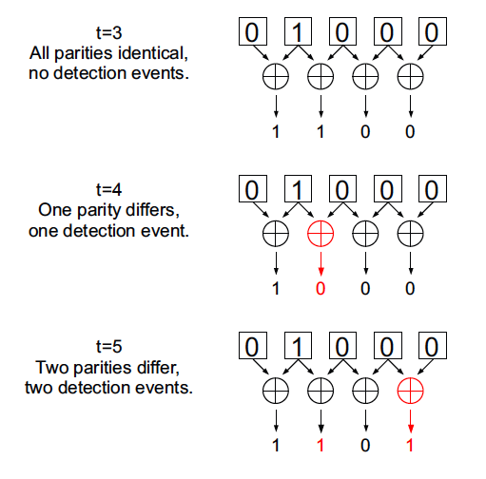
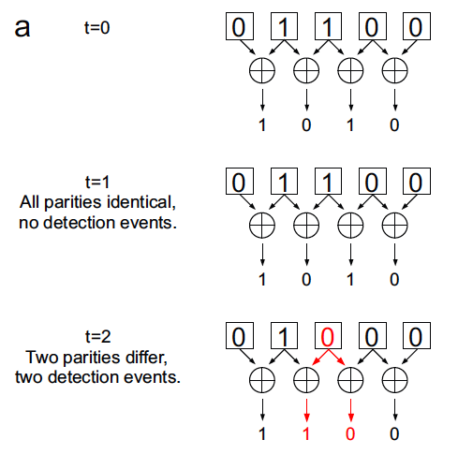
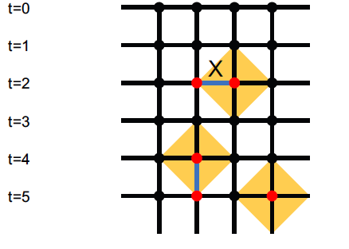
Classical Repetition Code
Processing imperfect parity measurements
Initialization of bit string to 01100. Parity measurement.
Detection event = differing parity check result between two cycles:
t = cycle, m = measurement qubit, b = parity result, D = detection event
Notes:
Six rounds of imperfect parity measurement. Generation of detection event if parity differs from previous round.
T1 different bits, correct parity measurement
T2 identical parities
T3 one data error, two detection events
T4 data remains the same, correct parity measurement, no detection event
T5 parity measurement error, one detection event
T6 first detection event: no data error, no measurement error but the parity differs -> Vertical lines in the corresponding graph indicate measurement error (instead of data measurement).
second detection event: measurement error .
Graph problem. Red dots = detection events.

Slide 12
Classical Repetition Code
Complete processing of imperfect parity measurements
Same as before:
t=0 Initialization, parity measurement
t=1 No change, no initialization errors
t=2 Data error, 2 detection events
t=3 No detection events
t=4 Measurement error, detection
t=5 Correct measurement, change in parity, detection
Now:
t=6 Direct measurement of bits:
Even for imperfect physical measurements no errors remain undetected: Treat measurement errors as data errors.
Final parities are generated from resulting parities.
Not matched to an edge, but correctly identified
Notes:
Direct imperfect measurement of bits: to check if storage has been successful
* explain….
EVTL:
-Ändere so, dass mehrere Folien mit selbem Bild (untersch. Text) gezeigt werden
- Evtl. Minimal weight matching algorithm (Def) (…)

Slide 13
Basics of Quantum Error Correction
Most important differences QEC v.s. CEC
No cloning
Continuous errors
Measurement destroys quantum information
Notes:
-No cloning: The quantum state cannot be dublicated for a repetition code (See also p.532 in Nielson and Chuang). Even if that were possible, measuring and comparing the three cloned quantum states after output isn’t possible*
QM Solution: Cnot gate introduces entangles states (see later)
-Continuous errors: continuum of errors may occur on a single qubit (phase and bit). Error determination therefore requires infinite precision. (Bsp: random rotations of the qubit around the z-axis P(e*phi)= cos(e*phi) I + I sin(e*phi) *sigmaz –> (3) in Steane Script)
-Measurement destroys quantum information: In a classical channel one can look at the output and decide on error correction. Observation in QM destroys the quantum state (collapse to measurement basis)* and makes recovery impossible

Slide 14
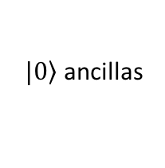
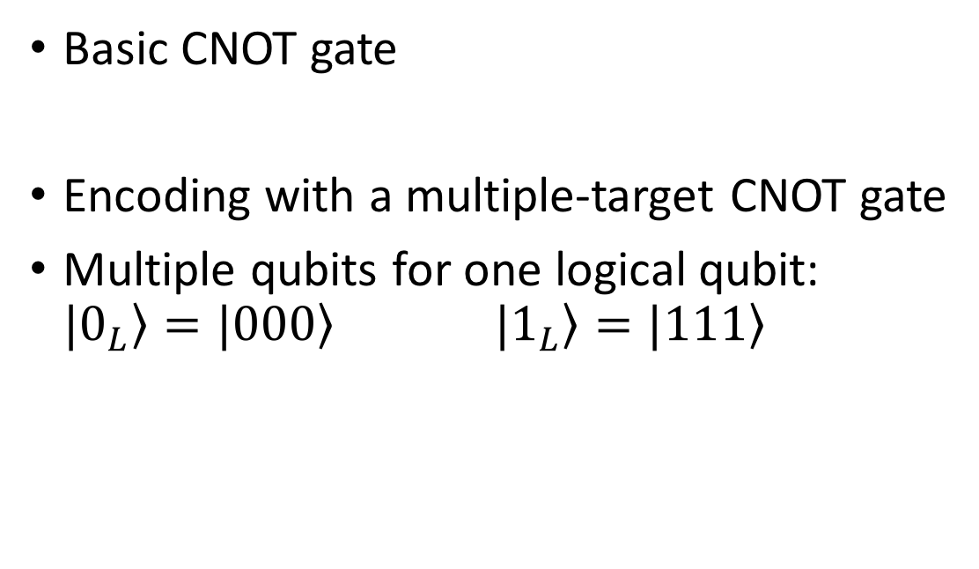
Basics of Quantum error correction
Basic CNOT gate
Encoding with a multiple-target CNOT gate
Multiple qubits for one logical qubit:
$|\left.0_{L}\right\rangle =|\left.000\right\rangle |\left.1_{L}\right\rangle =|\left.111\right\rangle$
$|\left.0\right\rangle$ ancillas

Slide 15
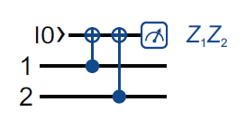
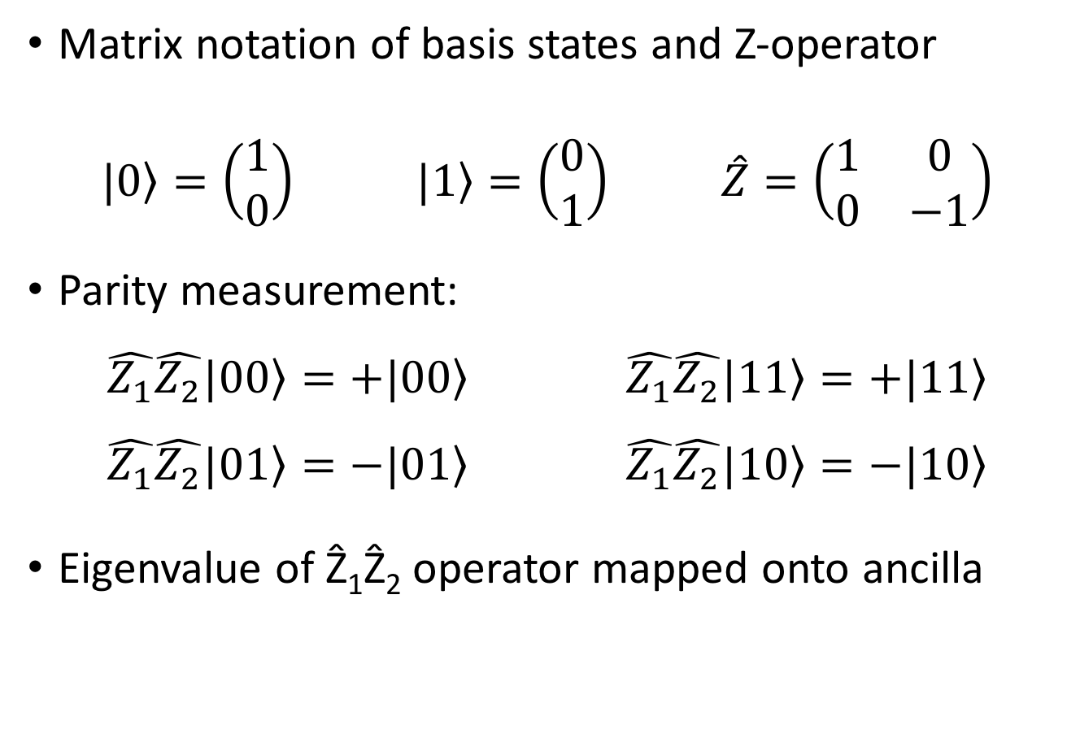
Basics of Quantum error correction
Matrix notation of basis states and Z-operator
$$|\left.0\right\rangle =\left(\begin{aligned}1 \\ 0\end{aligned}\right) |\left.1\right\rangle =\left(\begin{aligned}0 \\ 1\end{aligned}\right) \hat{Z}=\left(\begin{matrix}1 & 0 \\ 0 & −1\end{matrix}\right)$$
Parity measurement:
$$\hat{Z_{1}}\hat{Z_{2}}|\left.00\right\rangle =+|\left.00\right\rangle \hat{Z_{1}}\hat{Z_{2}}|\left.11\right\rangle =+|\left.11\right\rangle$$
$$\hat{Z_{1}}\hat{Z_{2}}|\left.01\right\rangle =−|\left.01\right\rangle \hat{Z_{1}}\hat{Z_{2}}|\left.10\right\rangle =−|\left.10\right\rangle$$
Eigenvalue of Ẑ₁Ẑ₂ operator mapped onto ancilla

Slide 16
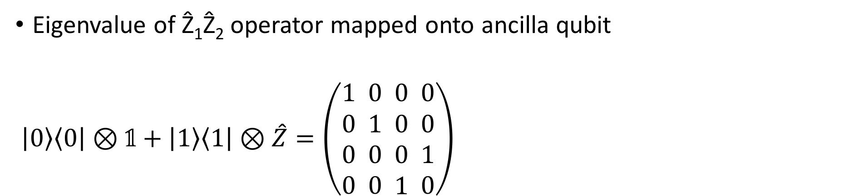
Controlled-NOT (CNOT) gate
Eigenvalue of Ẑ₁Ẑ₂ operator mapped onto ancilla qubit
$\left|\left.0\right\rangle \left\langle 0\right.\right|⊗𝟙+\left|\left.1\right\rangle \left\langle 1\right.\right|⊗\hat{Z}=\left(\begin{aligned}1 \\ 0 \\ 0 \\ 0\end{aligned} \begin{aligned}0 \\ 1 \\ 0 \\ 0\end{aligned} \begin{aligned}0 \\ 0 \\ 0 \\ 1\end{aligned} \begin{aligned}0 \\ 0 \\ 1 \\ 0\end{aligned}\right)$

Slide 17

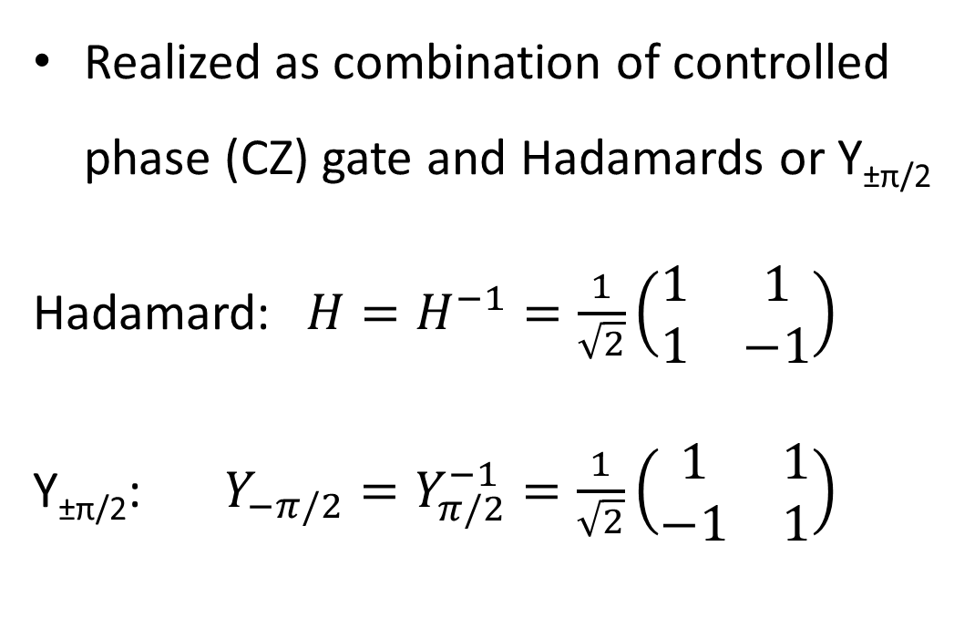
Controlled-NOT (CNOT) gate
Realized as combination of controlled phase (CZ) gate and Hadamards or Y_{±π/2}
Hadamard:$H=H^{−1}=\frac{1}{\sqrt{2}}\left(\begin{matrix}1 & 1 \\ 1 & −1\end{matrix}\right)$
Y_{±π/2}:$Y_{−π/2}=Y_{π/2}^{−1}=\frac{1}{\sqrt{2}}\left(\begin{matrix}1 & 1 \\ −1 & 1\end{matrix}\right)$

Slide 18
CNOT with data qubits on ancilla qubits results in 8 possible states:
Basics of Quantum Error Correction
Example of QEC:
(Steane, 2000)
Failure probability
with correction
without correction
Ancilla measurement in basis
Single qubit is encoded into three qubits
Qubits sent along a noisy channel
Introduction of further qubits (ancilla)
CNOT gates and ancilla measurement
State correction
Single qubit is regained by decoding
Notes:
Why ancilla are introduced: Check if error occurred without measuring the state itself (collapse of the state, loss of information).
4 Ancilla allow for correction of bit flip and phase flip. In the paper, only bit flips were corrected. A 2D chequerboard would allow for correction of both errors.

Slide 19
Error propagation and identification
Circuit for a repetition code with three cycles
Horizontal error propagation with time
Vertical error propagation with gates
Error on measurement qubit is detected in two rounds
Data error before CNOT gates
Data error between CNOT gates
Data error after last round
Reminder
Corresponding Connectivity graph
possible patterns of detection events
Resulting detection errors will recover the input data qubit state
Kelly et. al., 2015
Notes:
-Error on measurement qubit (detection in two rounds)
-Data error before measuring with both adjacent qubits: two detection events in the same cycle
-Data error between two parity measurements: two detection events in subsequent cycles
-Data error after last round: detection by constructing the final set of ZZ eigenvalues from the data qubit measurements:
Bem:
- CNOT gates werden später eingeführt!
- Error connectivity patterns v.s. connections (edges)

Slide 20
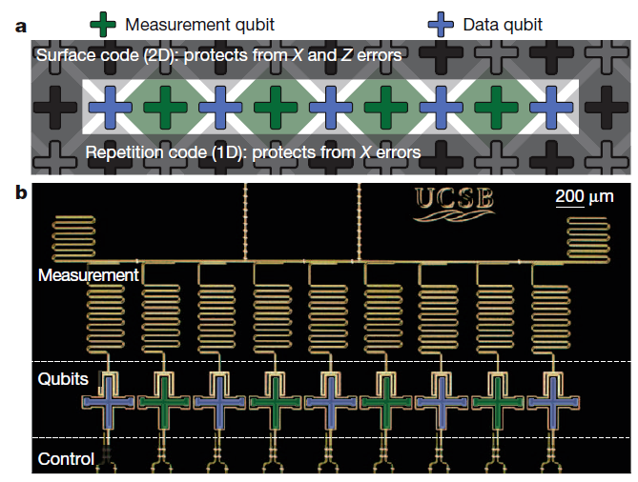
Experimental setup
So far realized: 1D array
  Corrects only X errors
  Alternating data qubits (blue) and measurement (ancilla) qubits (green)
  n^{th} order fault tolerant for
  4n+1 qubits
Future idea: 2D checkerboard pattern
  Corrects X and Z errors
  n^{th} order fault tolerant for
  (4n+1)² qubits

Slide 21
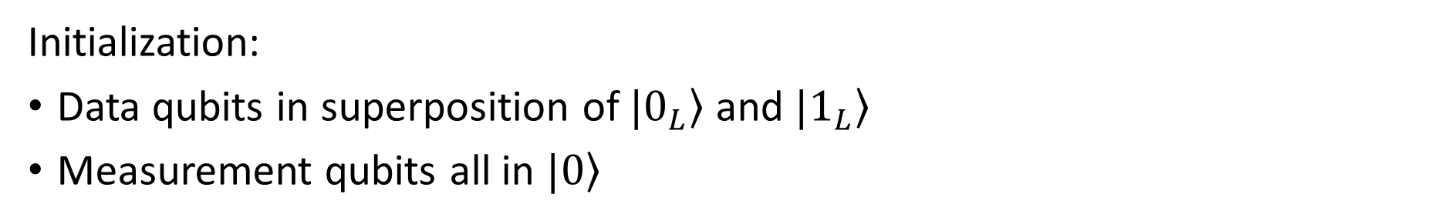
Quantum repetition Code
Initialization:
Data qubits in superposition of $|\left.0_{L}\right\rangle$ and $|\left.1_{L}\right\rangle$
Measurement qubits all in $|\left.0\right\rangle$

Slide 22
Quantum repetition Code
Parity measurement of neighboring data qubits
Measurement qubits are read out
Cycle repeated several times

Slide 23
Quantum repetition Code
Data qubits are read out
Error correction by minimum-weight perfect matching

Slide 24
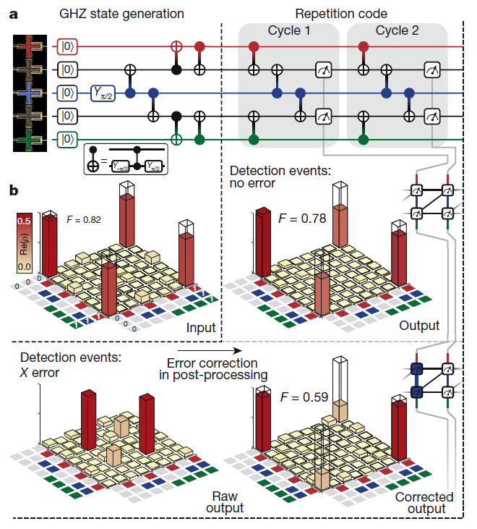
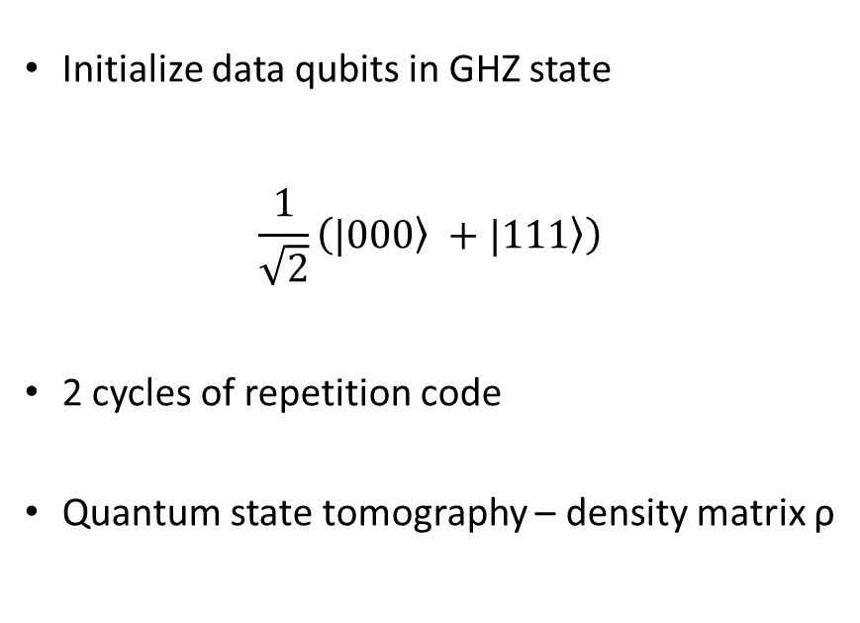
Preservation of quantum states
Initialize data qubits in GHZ state
$\frac{1}{\sqrt{2}}\left(|\left.000\right\rangle +|\left.111\right\rangle \right)$
2 cycles of repetition code
Quantum state tomography – density matrix ρ

Slide 25

Preservation of quantum states
Fidelity:
$$F=Tr(ρ_{ideal}ρ)$$
In general $0≤F≤1$
Here $F>50\%$: genuine entanglement

Slide 26
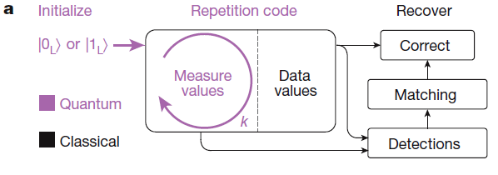
Logical state preservation
90‘000 repetitions for each k ϵ {1,…8} and each inital logical value
Test for each, if logical state is preserved

Slide 27
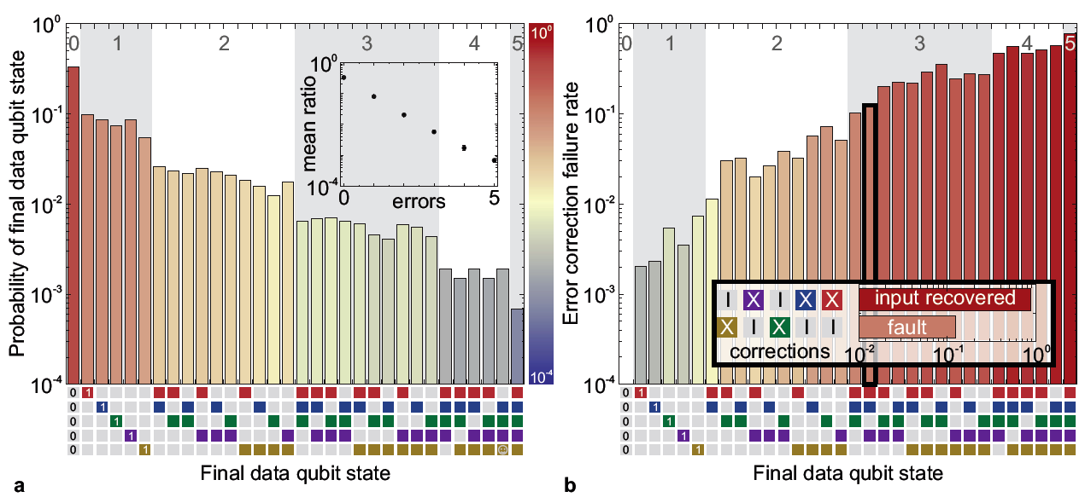
Failure rates
Kelly et. al., 2015
Overall failure rate between 3.350% and 2.300% (after optimizations)

Slide 28
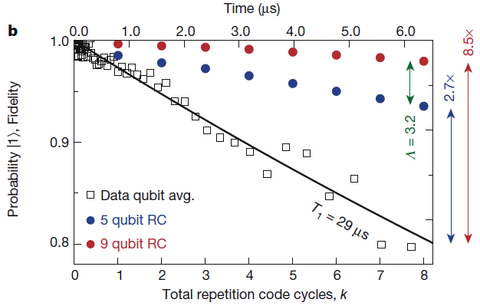
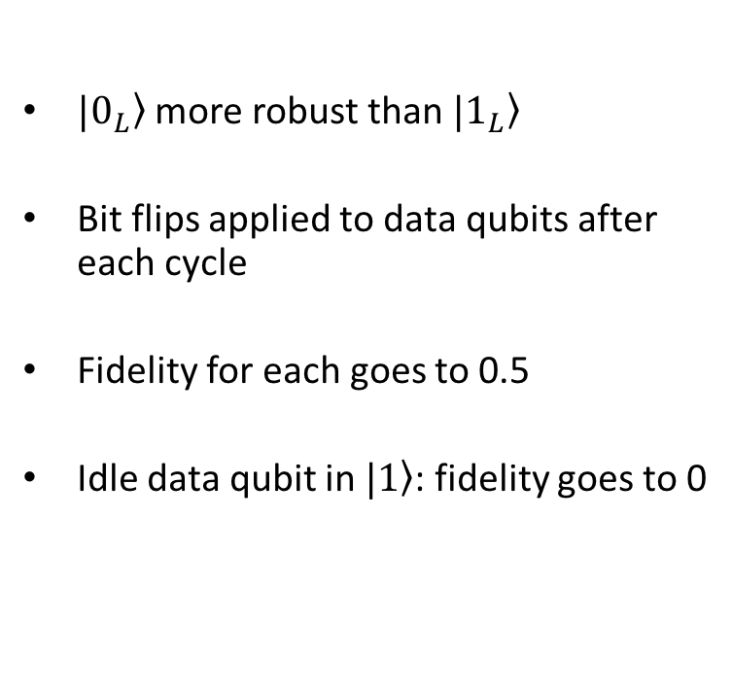
Fidelity of repetition code
$|\left.0_{L}\right\rangle$ more robust than $|\left.1_{L}\right\rangle$
Bit flips applied to data qubits after each cycle
Fidelity for each goes to 0.5
Idle data qubit in $|\left.1\right\rangle$: fidelity goes to 0

Slide 29
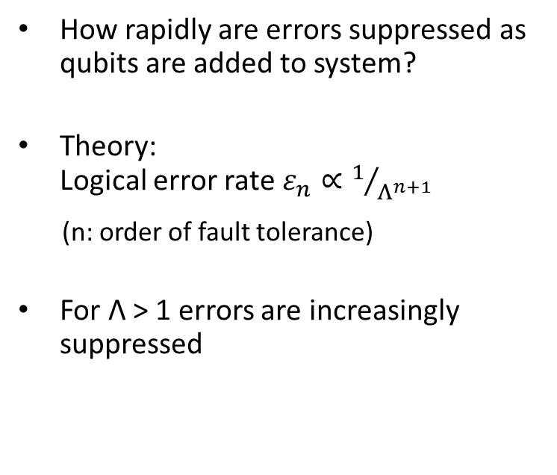
Error suppression factor Λ
How rapidly are errors suppressed as qubits are added to system?
Theory:
Logical error rate$ε_{n}∝1/{Λ^{n+1}}$
(n: order of fault tolerance)
For Λ > 1 errors are increasingly suppressed

Slide 30
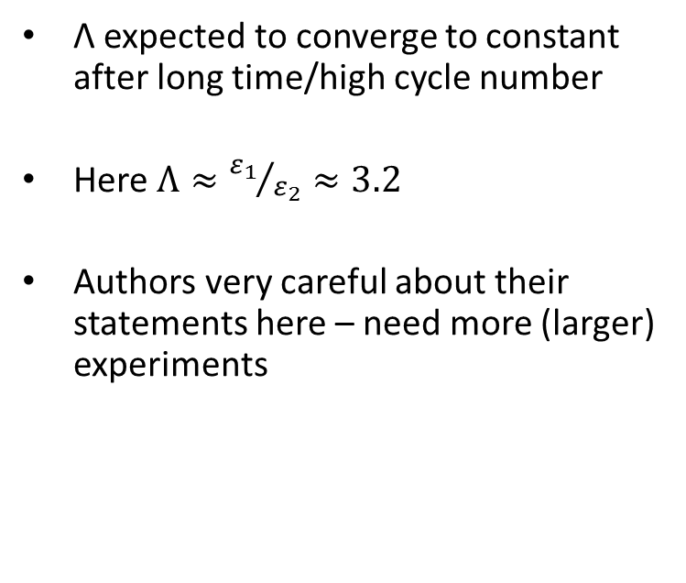
Error suppression factor Λ
Λ expected to converge to constant after long time/high cycle number
Here$Λ≈{ε_{1}}/{ε_{2}}≈3.2$
Authors very careful about their statements here – need more (larger) experiments

Slide 31
Summary
Quantum errors detected by parity measurements
Quantum states preserved
Reliability increases with size

Slide 32
Acknowledgements and References
Acknowledgements
Many thanks to Sebstian Krinner for supervising this presentation
References
J. Kelly et al., State preservation by repetitive error detection in a superconducting quantum circuit, Nature 519, 66-69 (2015)

Slide 33
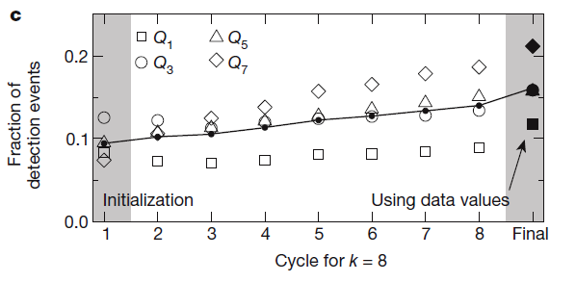
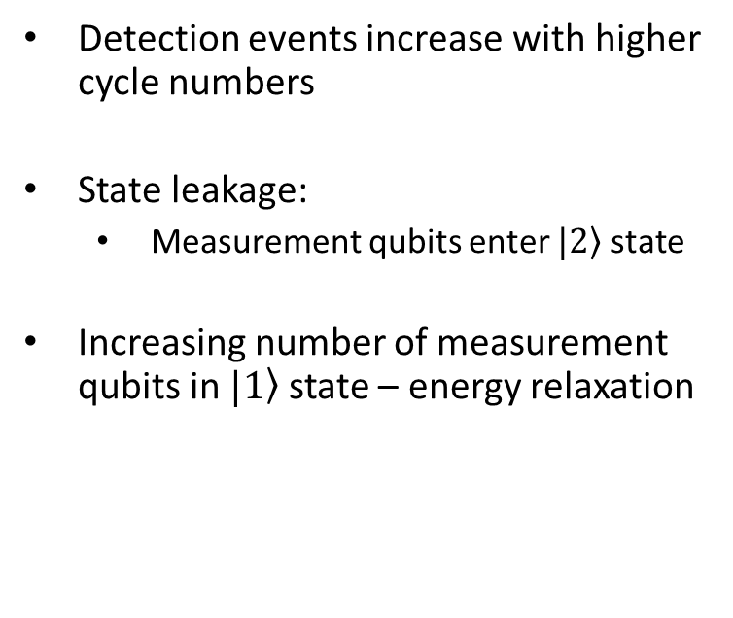
Memory fidelity
Detection events increase with higher cycle numbers
State leakage:
  Measurement qubits enter $|\left.2\right\rangle$ state
Increasing number of measurement qubits in $|\left.1\right\rangle$ state – energy relaxation

Slide 34
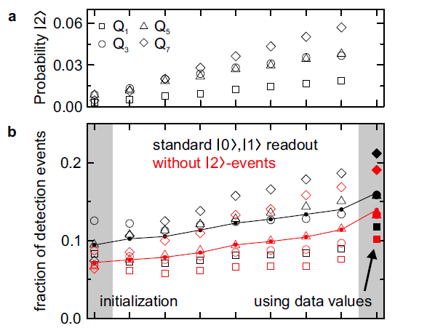
Memory fidelity
Detection events increase with higher cycle numbers
State leakage:
  Measurement qubits enter $|\left.2\right\rangle$ state
Increasing number of measurement qubits in $|\left.1\right\rangle$ state – energy relaxation

Slide 35
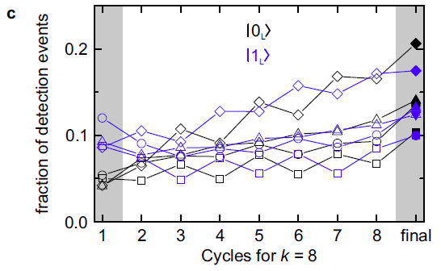
Memory fidelity
Detection events increase with higher cycle numbers
State leakage:
  Measurement qubits enter $|\left.2\right\rangle$ state
Increasing number of measurement qubits in $|\left.1\right\rangle$ state – energy relaxation

