Slide 1
Laterally confined Semiconductor Quantum dots
Martin Ebner and Christoph Faigle

Slide 2
Semiconductor Quantum Dots
Material Composition & Fabrication
Biasing
Energy diagram
Coulomb blockade
Spin blockade
QPC
Readout
Rabi oscillations
Summary

Slide 3
Materials and Fabrication
AlGaAs layer doped with Si introduces free electrons which accumulate at the AlGaAs/GaAs interface
creation of 2D electron gas (height ca. 10 nm) at interface.
Through molecular beam epitaxy, electrodes are created (~10 nm). Through choice of structure, depleted areas can be isolated from the rest of the electrons -> QDs
By applying voltages to metal electrodes on top of AlGaAs layer, local depletion areas in the 2DEG are created
To be able to measure the quantum effects, the device is cooled to 20mK.

Slide 4
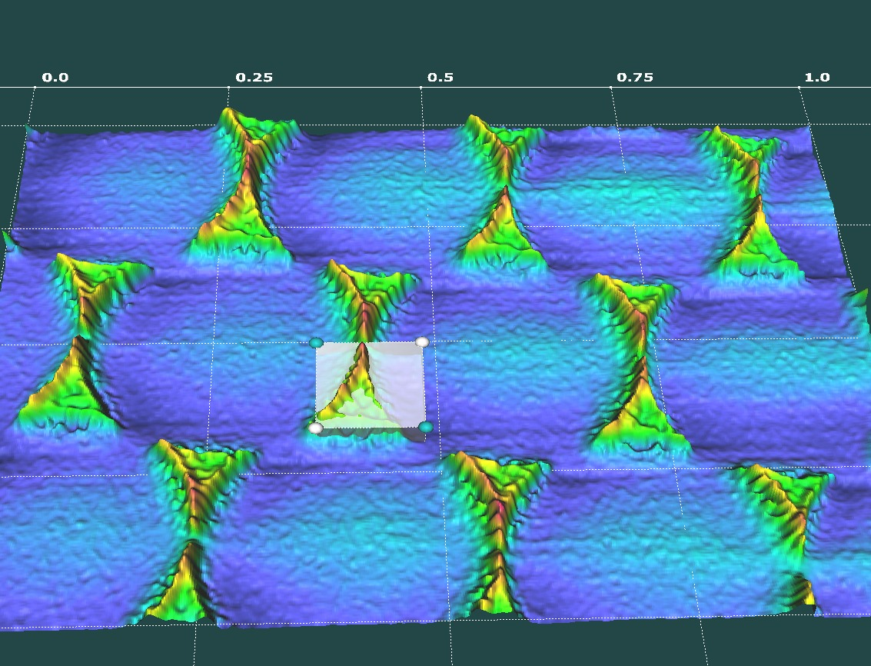

Slide 5
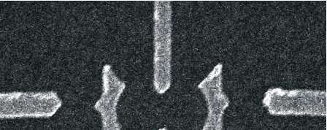
Biasing the Quantum Dot
Drain
Source
V_{SD}
I_{DOT}
V_{QPC-L}
V_{QPC-R}
I_{QPC}
I_{QPC}
QPC-L
QPC-R

Slide 6
adjusting tunnel rates
Drain
T
Source
Γ_{D}
Γ_{S}
Γ_{LR}
QPC-L
L
M
R
QPC-R

Slide 7
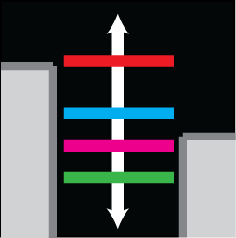
Gate voltages
Drain
Source
QPC-L
P_{L}
P_{R}
QPC-R

Slide 8
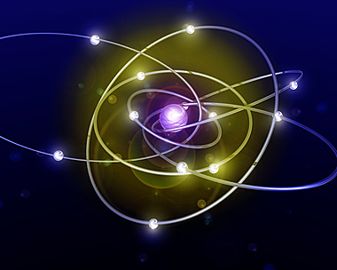

Slide 9
Energy diagrams

Slide 10
Zeeman splitting
by application of a magnetic field -> Zeeman splitting

Slide 11
Zeeman splitting

Slide 12
State transition energies

Slide 13
Transition energies and potentials
State Preparation: align source potential and transition energy
by tuning V_{G}

Slide 14
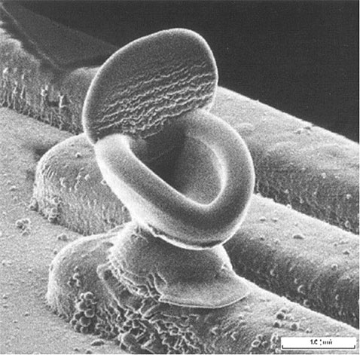

Slide 15
Coulomb blockade

Slide 16
Hanson, Vandersypen et al. 2004: Coulomb diamonds

Slide 17
Transition potentials and tunneling
Source-drain potential differences lead to single-electron tunneling, depending on the potential of the gate
Tunneling works only when ground to ground-state transition levels are tuned into the bias window. Once initial current flows excited state transitions can contribute to the tunneling → two-path tunneling
If the next ground state also falls into the potential window, there can be two-electron tunneling
Allowed regions are mapped by the coulomb diagram, in Coulomb blockade regions, there is no tunneling and thus no current flow

Slide 18
Spin blockade
According to the Pauli principle, no two electrons with the same spin are allowed on one orbital

Slide 19
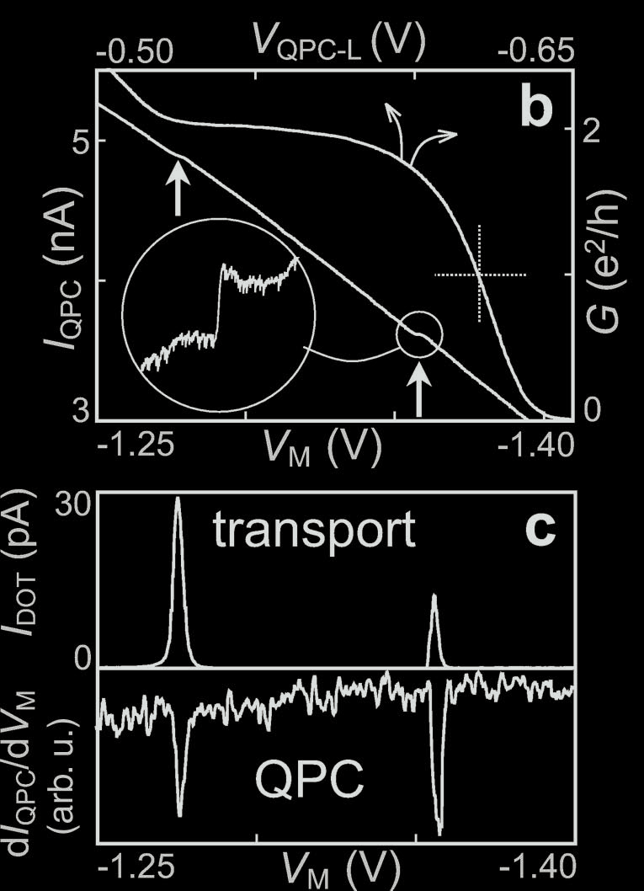
QPC
V_{QPC} has to be tuned to regime of maximum sensitivity → steepest slope

Slide 20
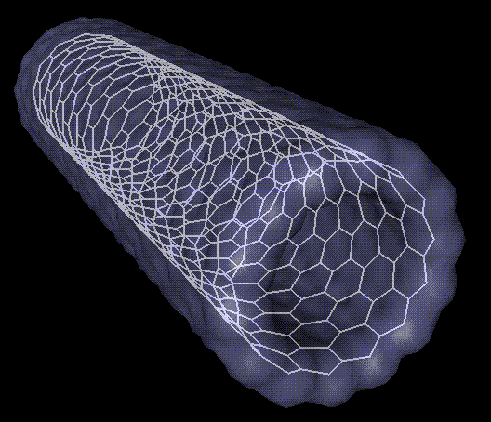

Slide 21
Charge sensing
determine number of electrons on dot
non-invasive (no current flow)
only one reservoir needed
conductance of QPC electrometer depends on electrostatic environment
failure for long tunnel times and high tunnel barriers
measurement time about 10us

Slide 22
Single shot spin readout
Spin-to-charge conversion
Energy selective readout
only excited state can tunnel off quantum dot due to potential
Tunnel-rate-selective readout
difference in tunnel rate leads to high probability of one state
then charge is measured on dot, original state is determined

Slide 23
Energy selective readout

Slide 24
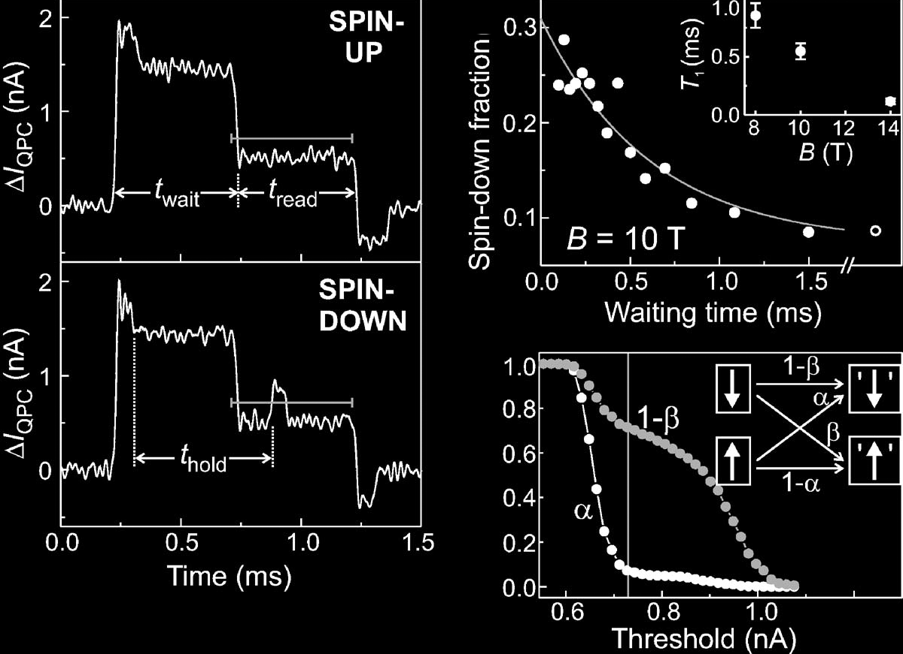
Elzerman et al. 2004:
fidelity: 82%, T1: 0.5ms @10 T

Slide 25
EOR Problems
requires large Energy splitting: k_{b}T << ΔE_{Z}
sensitive to fluctuations of el.stat. potential
photon assisted tunneling from |⬇> to reservoir due to high frequency noise ???

Slide 26
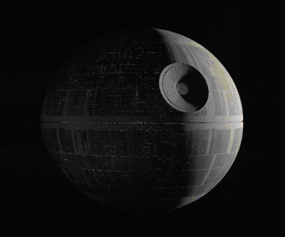

Slide 27
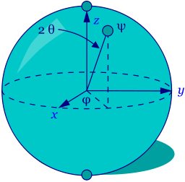
RABI Oscillations
ESR: electron spin resonance
alternating B_{ac} perpendicular to B_{ext} and resonant to state splitting

Slide 28
continuous Rabi oscillation detection scheme

Slide 29
Koppens et al.: Tuning B_{ext} with/without B_{ac}

Slide 30
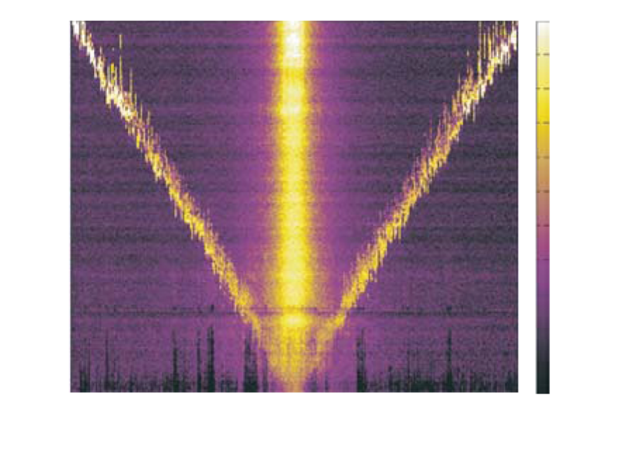
Koppens et al.: Tuning B_{ext} and B_{ac}

Slide 31
pulsed Rabi oscillation detection scheme

Slide 32
Koppens et al.: Rabi oscillations

Slide 33
Rabi performance
fidelity: 73% (131° instead of 180°)
use stronger B_{ac}
application of composite pulses
measure and compensate nuclear field fluctuations (nuclear state narrowing)
qbit discrimination:
B_{ac} or B_{ext} gradient
local g-factor engineering
use electric field (spin-orbit-interaction)

Slide 34
Summary
A scalable physical system with well-characterized qubits._✔
The ability to initialize the state of the qubits to a simple fiducial state._✔
Long (relative) decoherence times, much longer than the gate-operation time.? (T1 ≈ 1ms, T₂* ≈ 10ns, T2 > 1μs [spin echo])
A universal set of quantum gates.✖ NO ENTANGLEMENT YET (2005)
A qubit-specific measurement capability. ✔ (T_{readout} ≈ 10μs)

Slide 35
Thanks for your attention!

