Slide 1

Quantum Chemistry
using SC Qubits
09.04.2018
Giulia Mazzola, Simon Mathis, Thilo Schmid

Slide 2
Quantum Chemistry
Quantum mechanics → chemical properties
i.e. solve

Slide 3
Born-Oppenheimer Approximation
small
constant depending on R

Slide 4
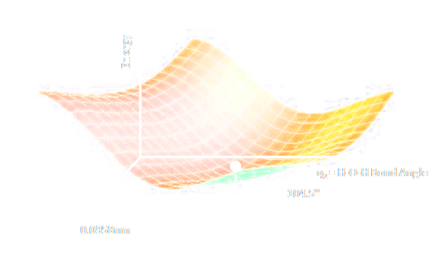
Energy Surface
Example - Water molecule
q1
q2
https://en.wikipedia.org/wiki/Potential_energy_surface

Slide 5

Energy Surface
E.G. Lewars, Computational Chemistry (Springer, 2011)
→ compute reaction rates (Eyring equation)
need chemical accuracy!

Slide 6
Problems of Classical Computers
Computational complexity scales exponentially with the problem
Example – n two-level systems

Slide 7
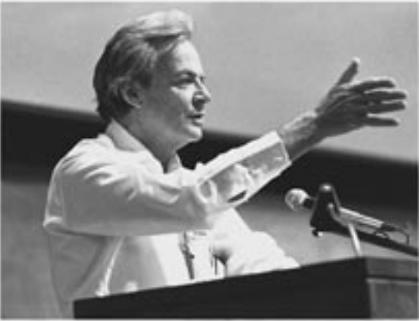
(…) and I'm not happy with all the analyses that go with just the classical theory, because nature isn't classical, dammit, and if you want to make a simulation of nature, you'd better make it quantum mechanical, and by golly it's a wonderful problem, because it doesn't look so easy.
- Richard Feynman, Simulating Physics with Computers, 1981
published in Int. J. Theor. Phys. 21 (1982)

Slide 8
Digital Quantum Simulation
Idea:
Map problem to qubit system
Solve qubit problem on the quantum computer
Patch together solution on classical computer
Limited by technology Error correction possible

Slide 9


Second Quantization
Classical computer
Quantum computer
Overlap integrals using basis sets

Slide 10
Jordan Wigner
Map the fermions to
Imitate the anti-commutation relations
but

Slide 11
Jordan Wigner
yields

Slide 12
Jordan Wigner
yields
non-local
→ use Bravyi-Kitaev instead

Slide 13
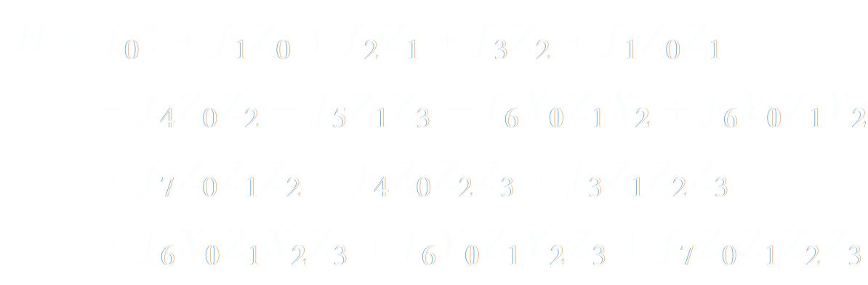
Reduces, because we can compute Z₁ and Z₃ directly from Hartree-Fock state

Slide 14
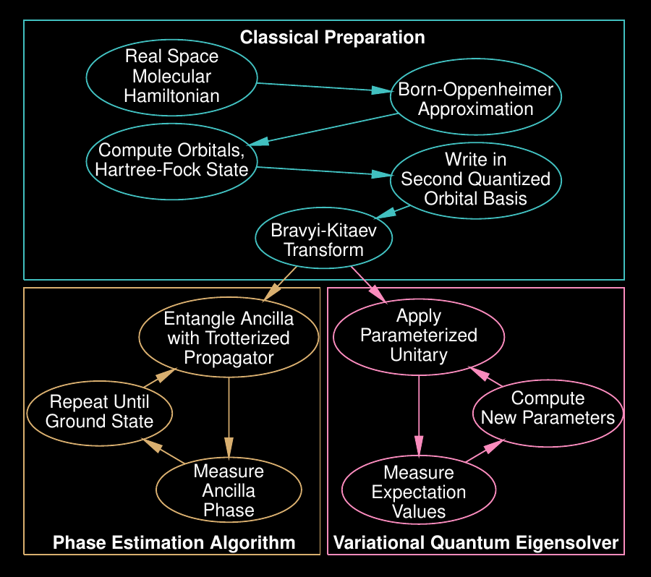
Overview:
Does the same job as Jordan Wigner but for O(log n) instead of O(n) qubits
from P.J.J. O’Malley et al., Phys. Rev. X 6 (2016)

Slide 15
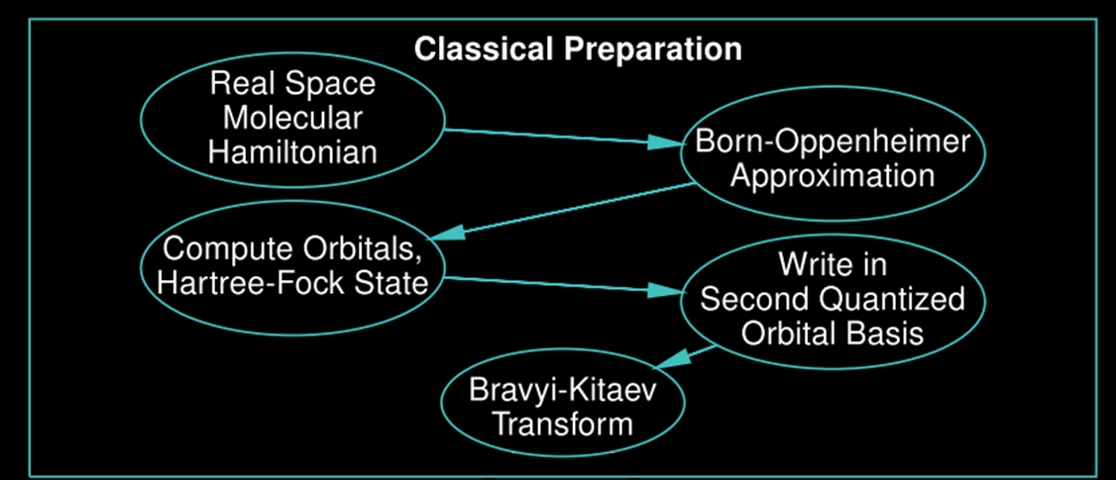
Workflow
Quantum Algorithm?
P. J. J. O’Malley et al., Phys. Rev. X 6, 031007 (2016)
Notes:
seen:
- how transform molecular H to qubit H
by starting with molecular H -> freezing nuclei positions
-> limiting Hilbert space to finite dimension (by choosing orbitals)
-> transforming truncated H to qubit H
Now have qubit H -> Question:
How do we get GS energy estimate from this qubit H?
2 Algos
before:
… again invite … questions … anytime … (Purpose is to help understand)

Slide 16



Phase estimation algorithm (PEA)
Main steps:
Prepare ground state
Apply controlled time evolution
Measure phase of ancilla
Trotterization:
Notes:
- First, pursue idea Thilo mentioned at outset of this talk
3 Steps:
1) Prepare groundstate psi0
2) apply controlled time evol. (controlled by ancilla)
3) read out phase of ancilla
What then happens: Phase of ancilla depends on GS energy (seen by calculating sys. state at THIS point) → prob. of measuring 0 is cos2 …
2 things to note:
1) need not true G.S. (only significant overlap)
2) time evol (exp (H) ) hard to implement -> TROTTER
Anyone guess a problem with current hardware?
Suscept. to dephasing noise
Long time evol. needed
many gates (Trotter)
→ to be useful with current hardware – more resilience vs errors, lower gate count

Slide 17






Variational quantum eigensolver (VQE)
ground state minimizes the energy
→ Key point: Find ground state by minimizing w.r.t.
Notes:
very useful algo in this respect: Var. Quant. Eigens.
use var. principle
IDEA: As GS minimizes energy → Find it by minimizing expectation value of H
Mathematically:
Start with parametrized Ansatz for GS
Use variational principle (best theta)
KEY POINT: Find groundstate by minimizing expectation value of H wrt to theta
algo is hybrid: Minimization classically, function evaluation quantum mechanically
→ Clearest in FLOWchart
Let’s look at the VQE algo here in the flowchart
(discuss flow chart)

Slide 18
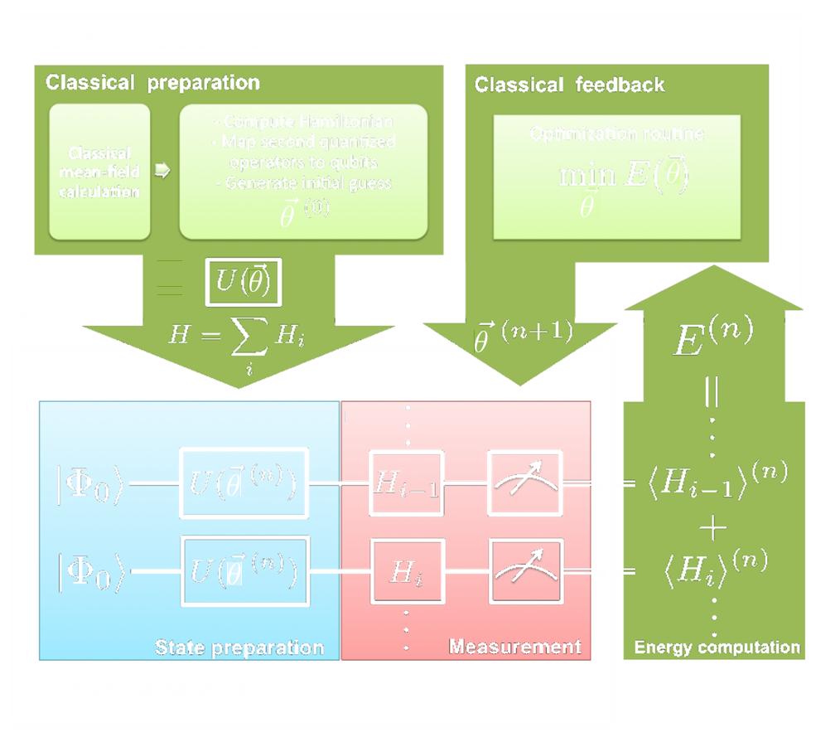
Variational quantum eigensolver
Notes:
upper box: Classical device
lower box: quantum device

Slide 19
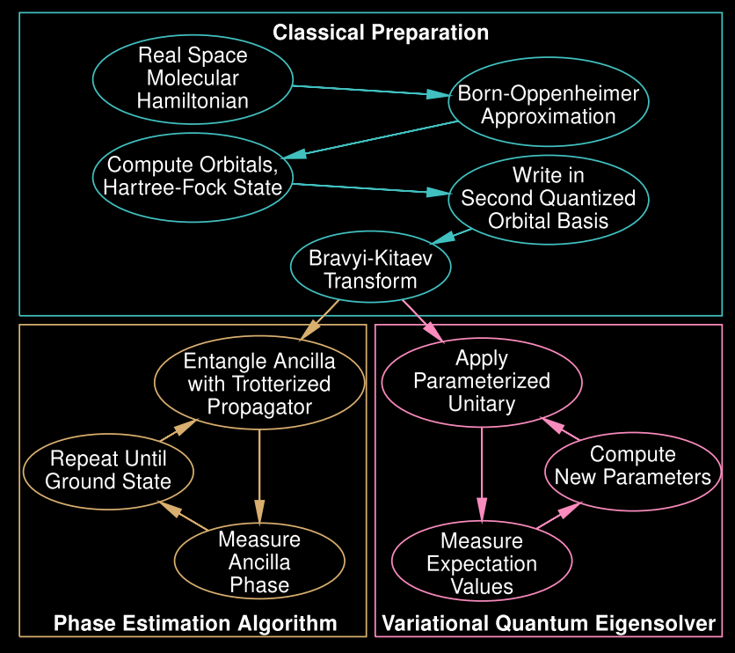
Overview
P. J. J. O’Malley et al., Phys. Rev. X 6, 031007 (2016)

Slide 20







Variational Principle ,
Parametrization of the ground state wavefunction
Hamiltonian
1st Idea: Hartree-Fock Approximation
Then is small, but crucial for chemistry!
2nd Idea (VQE): ,
Notes:
-> the ground-state wave function is likely to be in superposition over an exponential number of states in the basis of molecular orbitals
-> However, quantum circuits can prepare entangled states, which are not known to be efficiently representable classically. In VQE, the state is parametrized by the action of a quantum circuit on an initial state

Slide 21


Parametrization of the ground state wavefunction
,
quantum circuit
quantum gates
What is the explicit form of ?
Unitary Coupled Cluster Theory:
Notes:
-> NOTE that in Quantum Chemistry they use CC theory with classical computers

Slide 22
How does the experimental implementation look like?

Slide 23
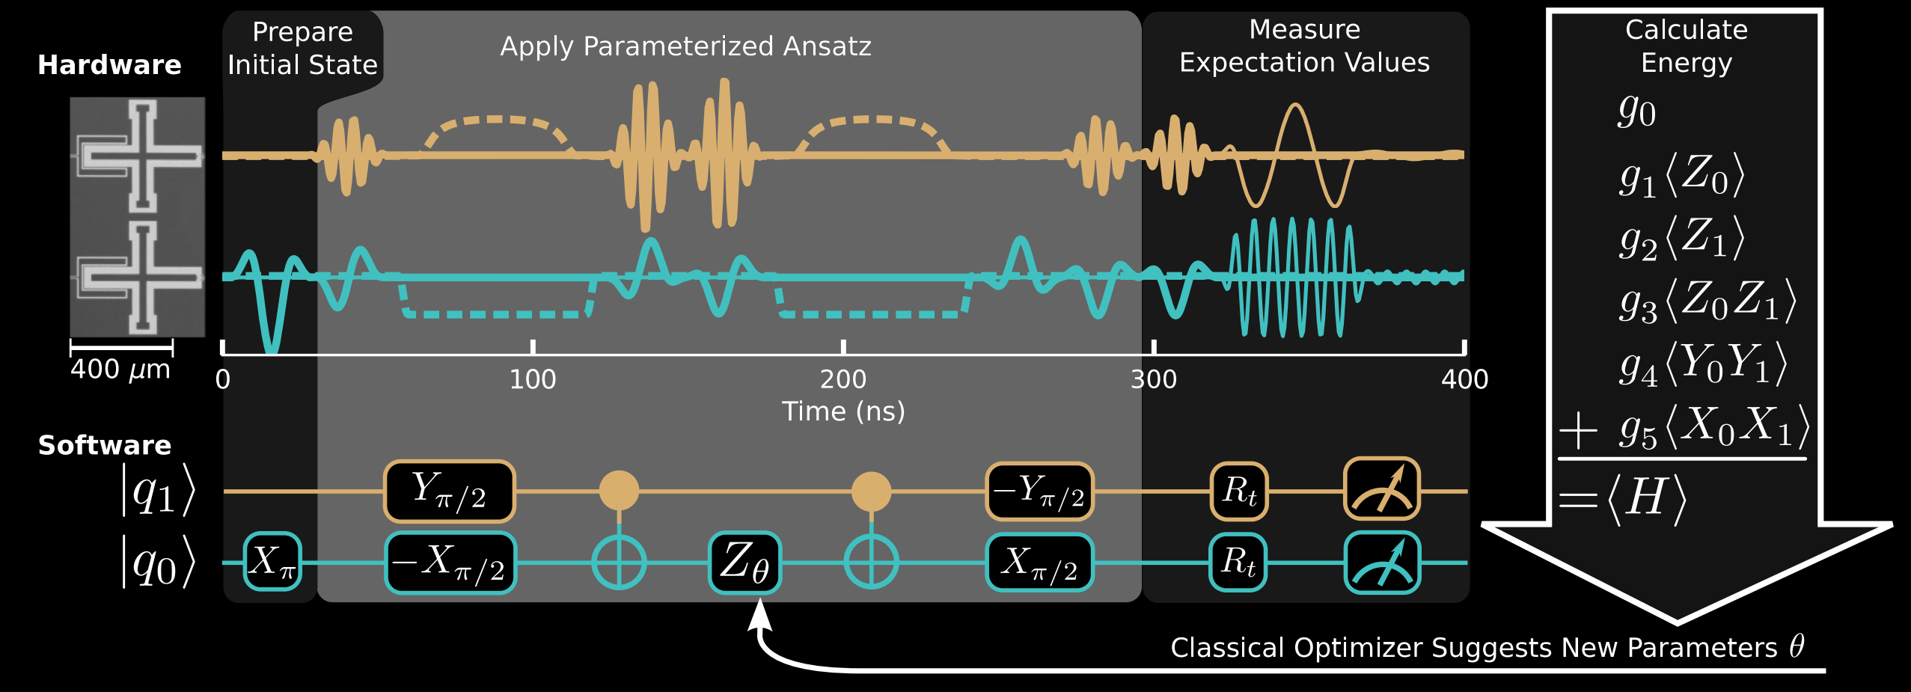

Implementation
Xmon Transmon Qubits
P. J. J. O’Malley et al., Phys. Rev. X 6, 031007 (2016)
Notes:
Measure Expectation Values:
-> microwave spectroscopy tones for qubit measurements (thin lines)
-> efficient partial tomography (R_t) to measure the expectation values
Technical Numbers:
-> we use the qubits q0 and q1,at 4.49 and 5.53 GHz, respectively, while all the other qubits are detuned to 3 GHz and below
-> X, Y gates are 25 ns long, CNOT gate is 105 ns long (during which the frequency of q0 is fixed and q1 is moved)
-> The rotation Zθ is implemented as a phase shift on all subsequent gates.
-> The readout duration is set to 1000 ns for higher fidelity

Slide 24
Implementation
Xmon Transmon Qubits
microwave pulse sequences (single-qubit rotations)
dc pulses (two-qubit entangling gates)
P. J. J. O’Malley et al., Phys. Rev. X 6, 031007 (2016)
Notes:
Measure Expectation Values:
-> microwave spectroscopy tones for qubit measurements (thin lines)
-> efficient partial tomography (R_t) to measure the expectation values
Technical Numbers:
-> we use the qubits q0 and q1,at 4.49 and 5.53 GHz, respectively, while all the other qubits are detuned to 3 GHz and below
-> X, Y gates are 25 ns long, CNOT gate is 105 ns long (during which the frequency of q0 is fixed and q1 is moved)
-> The rotation Zθ is implemented as a phase shift on all subsequent gates.
-> The readout duration is set to 1000 ns for higher fidelity

Slide 25
Implementation
Xmon Transmon Qubits
microwave pulse sequences (single-qubit rotations)
dc pulses (two-qubit entangling gates)
P. J. J. O’Malley et al., Phys. Rev. X 6, 031007 (2016)
Notes:
Measure Expectation Values:
-> microwave spectroscopy tones for qubit measurements (thin lines)
-> efficient partial tomography (R_t) to measure the expectation values
Technical Numbers:
-> we use the qubits q0 and q1,at 4.49 and 5.53 GHz, respectively, while all the other qubits are detuned to 3 GHz and below
-> X, Y gates are 25 ns long, CNOT gate is 105 ns long (during which the frequency of q0 is fixed and q1 is moved)
-> The rotation Zθ is implemented as a phase shift on all subsequent gates.
-> The readout duration is set to 1000 ns for higher fidelity

Slide 26

Results
H₂ energy curve
minimum energy bond length (R = 0.72 Å)
dissociation energy
P. J. J. O’Malley et al., Phys. Rev. X 6, 031007 (2016)
Notes:
-> the dissociation energy: the exponential of this quantity determines the chemical dissociation rate.
-> 1 hartree = 0.043 eV
…-> Error bars are computed from a Gaussian process regression applied to the potential energy curve obtained from Fig. 2(b) using error estimates propagated from the shot-noise-limited measurements shown in Fig. 2(a)

Slide 27
Results
H₂ energy curve
the dissociation energy determines the chemical dissociation rate
The efficient implementation predicts the correct dissociation energy to within chemical accuracy (small errors)
The VQE is robust to systematic device errors
first scalable quantum simulation of molecular energies performed on quantum hardware
minimum energy bond length (R = 0.72 Å)
dissociation energy
P. J. J. O’Malley et al., Phys. Rev. X 6, 031007 (2016)
Notes:
Scalable -> in the sense that our algorithm is efficient and does not benefit from exponentially costly precompilation
VQE error -> error of (8+-5) × 10^(-4) hartree
Chemical accuracy -> 1.6 × 10^(-3) hartree = 68.8 μeV

Slide 28
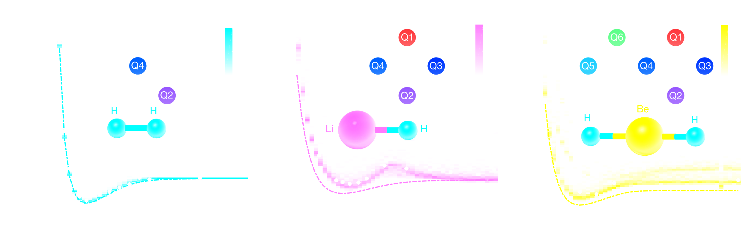
More experiments (IBM)
A. Kandala et al., Nature 549, 242–246 (2017)

Slide 29
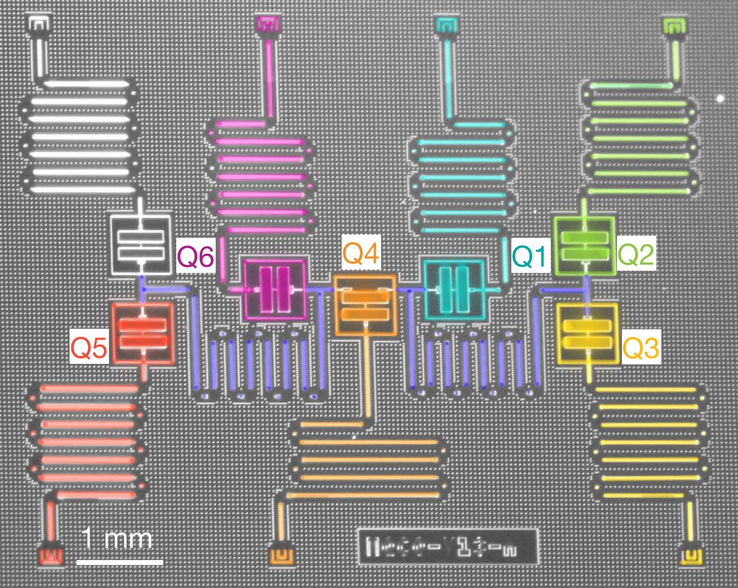

Slide 30
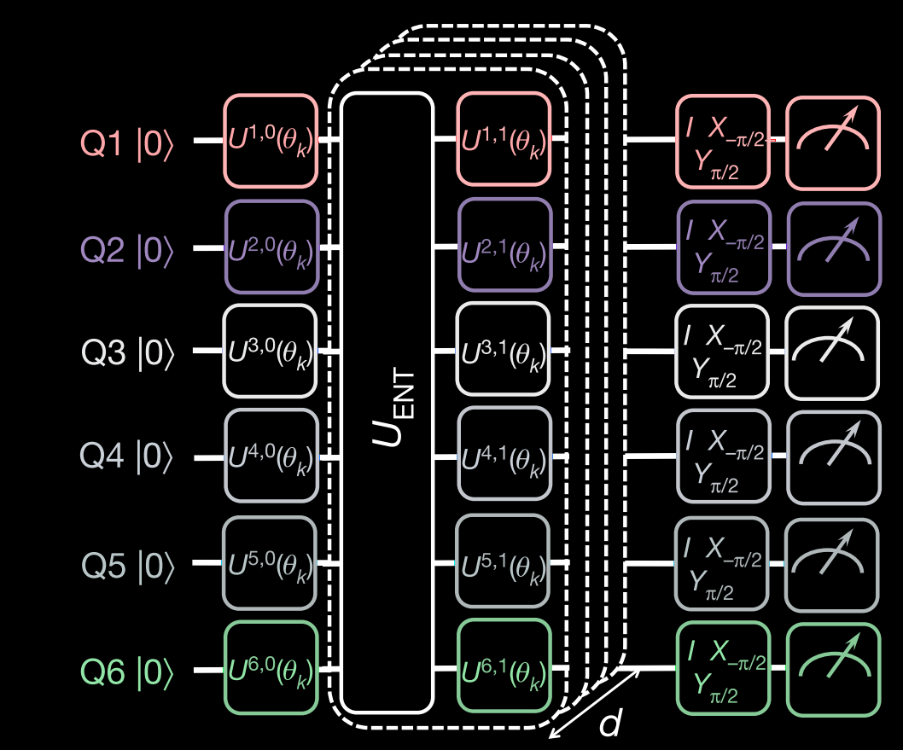
More experiments (IBM)
A. Kandala et al., Nature 549, 242–246 (2017)

Slide 31


Thank you!

Slide 32
Backup Slides

Slide 33




Bravyi – Kitaev Transform
from 2nd quantized Hamiltoian
need to satisfy
iterative definition (BK-Transform)
Coeff. computed from orbital overlap (after choice of basis)
Notes:
Jordan Wigner – mapping btw spins & fermions (first 1928, 2002 for QC),
Order (n) n … orbitals
Occupation & Parity are locally/nonlocally stored
Bravyi Kitaev
first 2002
order (log n)
parity & flip & update set
fewer CNOT gates as less non-local than JW

Slide 34

Bravyi – Kitaev Example

Slide 35
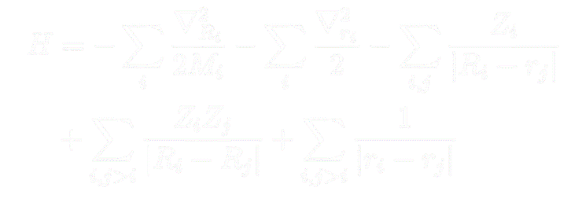
Electronic structure problem
Molecular Hamiltonian (in Hartee)
Hartee:

Slide 36


Electronic structure problem – 2nd quantization

Slide 37

Unitary coupled cluster ansatz (UCC)
Example:
  BK transformed H₂ Hamiltonian
Unitary coupled cluster theory ansatz:

Slide 38

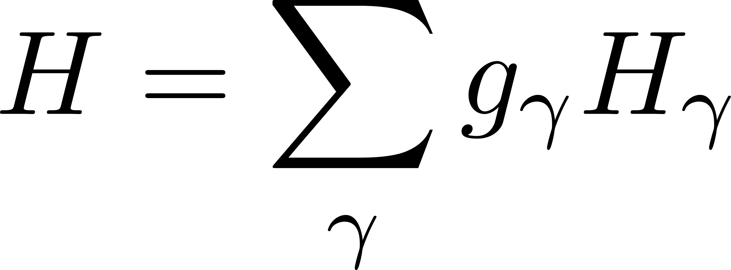

Variational quantum eigensolver (VQE)
ground state minimizes the energy
Example: H₂ Hamiltonian (qubit-form)
Notes:
very useful algo in this respect: Var. Quant. Eigens.
Hybrid which uses var. principle
IDEA: As GS minimizes energy → Find it by minimizing expectation value of H
Mathematically:
Start with parametrized Ansatz for GS
Use variational principle (best theta
Evaluate the Hamiltonian with quantum hardware by measuring its expectation in this G.S. – To find best approximation to G.S. energy we perform minimization, for example with standard gradient descent algorithm. All evaluations of the Hamiltonian (needed to construct gradient) are computed on quantum hardware by measuring.
Let’s look at the VQE algo here in the flowchart
(discuss flow chart)

