Slide 1
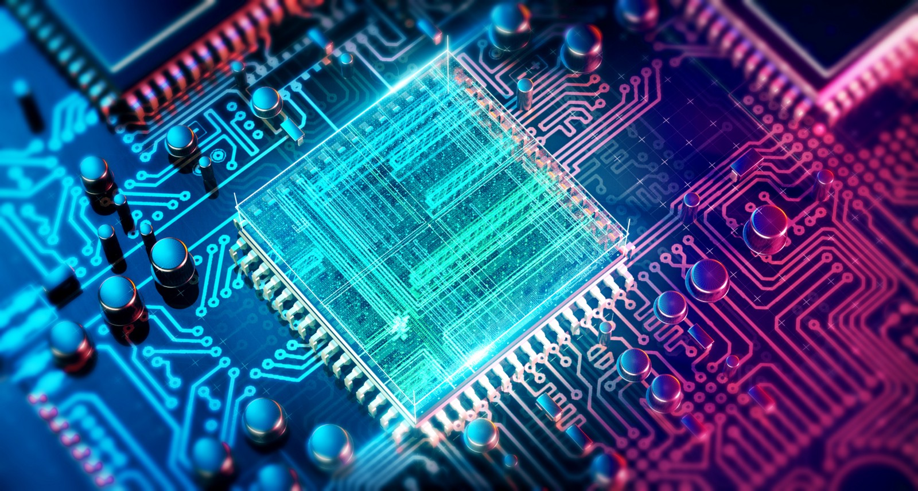
Demonstration of two-qubit algorithms with a superconducting quantum processor
Notes:
Han das Bild vo de Farbe her passend gfunde. Isch uf google cho woni nach quantum computing gsuecht han. Was das gnau isch weissi aber au nid^^

Slide 2
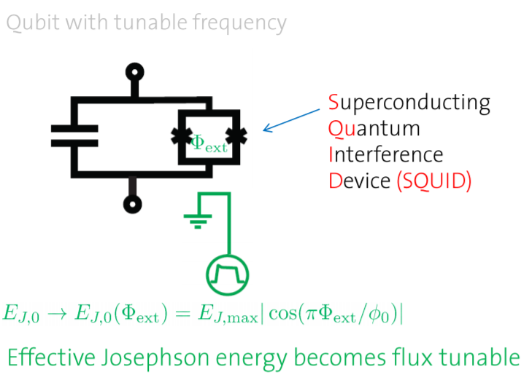
Processor
J.Koch et al., Phys. Rev. A 76, 042319 (2007)

Slide 3
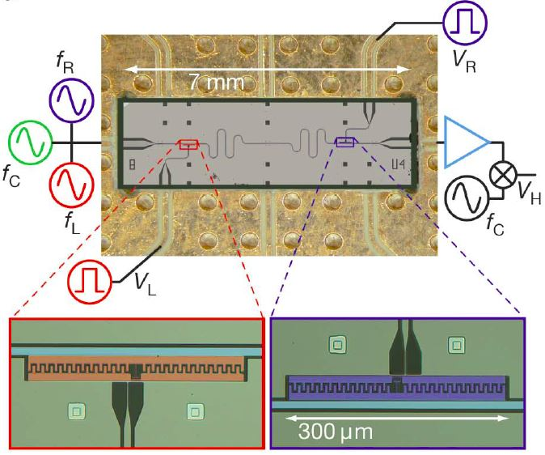
Processor
DiCarlo, L. et al. Demonstration of two-qubit algorithms with a superconducting quantum processor. Nature 460, 240–244 (2009)

Slide 4
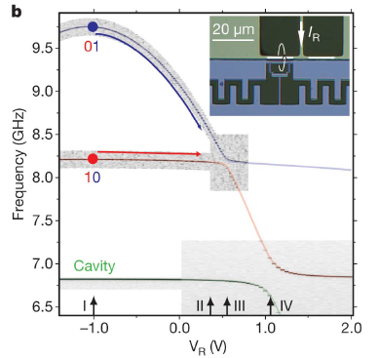
2 Qubits in a cavity (Dispersive limit)
DiCarlo, L. et al. Demonstration of two-qubit algorithms with a superconducting quantum processor. Nature 460, 240–244 (2009)
Notes:
Question: How to use the processor for algorithms

Slide 5
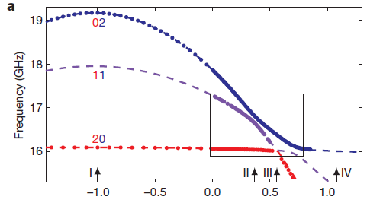
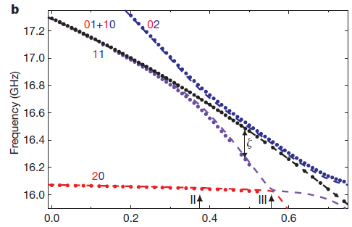
2 Qubits in a cavity
DiCarlo, L. et al. Demonstration of two-qubit algorithms with a superconducting quantum processor. Nature 460, 240–244 (2009)
Notes:
Question: How to use the processor for algorithms

Slide 6
2 Qubits in a cavity
The Tavis-Cummings generalized to multi-level transmon qubits:
Notes:
Question: How to use the processor for algorithms

Slide 7
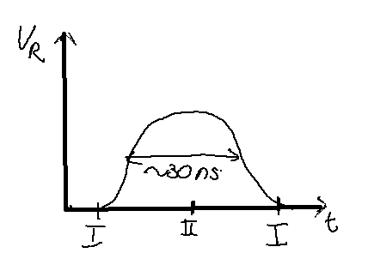
2 Qubits in a cavity (C-Phase gate)
DiCarlo, L. et al. Demonstration of two-qubit algorithms with a superconducting quantum processor. Nature 460, 240–244 (2009)
Notes:
Question: How to use the processor for algorithms

Slide 8
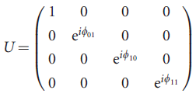
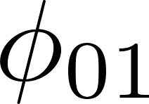
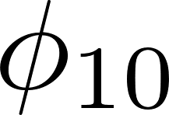
2 Qubits in a cavity (C-Phase gate)
All the computational basis states aquire a relative phase because of the pulse
To realize a C-Phase gate we would like to get
Choose the pulse such that
Play with the pulse form and to make and integer multiples of .
Notes:
Question: How to use the processor for algorithms

Slide 9
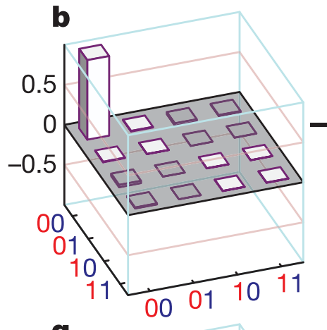
2 Qubit readout
Goal: We want to be able to perform a full state tomography of our processor to test it’s functionality.
We need independent measurement operators
DiCarlo, L. et al. Demonstration of two-qubit algorithms with a superconducting quantum processor. Nature 460, 240–244 (2009)
Notes:
Question: How to use the processor for algorithms

Slide 10
2 Qubit readout
Cavity resonance frequency gets shifted by state of the Qubit.
A measurement of the homodyne Voltage corresponds to a measurement of the operator
Precompose with rotations to get more measurement operators
Filipp et al., Phys. Rev. Lett. 102, 200402 (2009)
Notes:
Question: How to use the processor for algorithms

Slide 11
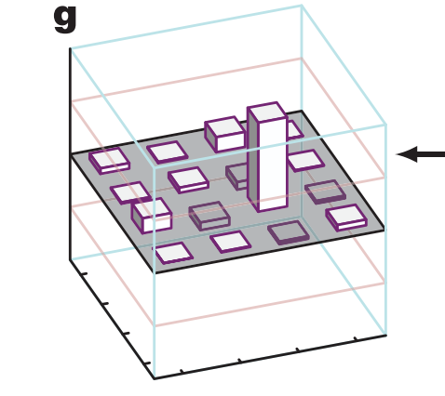
Implementations – Grover & Bell States
input
output
DiCarlo, L. et al. Demonstration of two-qubit algorithms with a superconducting quantum processor. Nature 460, 240–244 (2009)
Notes:
Question: How to use the processor for algorithms

Slide 12
Universal?
We have implemented:
single qubit rotations
C-phase gate (two qubit gate)
Universality!
Notes:
Frage: wie funktioniert das mit dem phase shift genau?
Und ich muess no sege wieso das universality impliziert^^

Slide 13
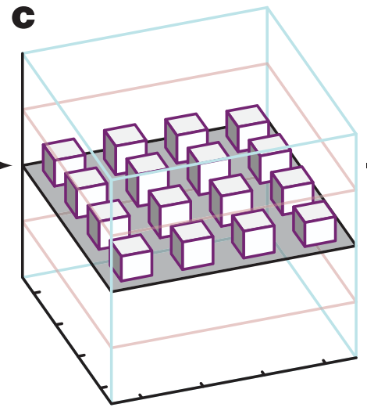
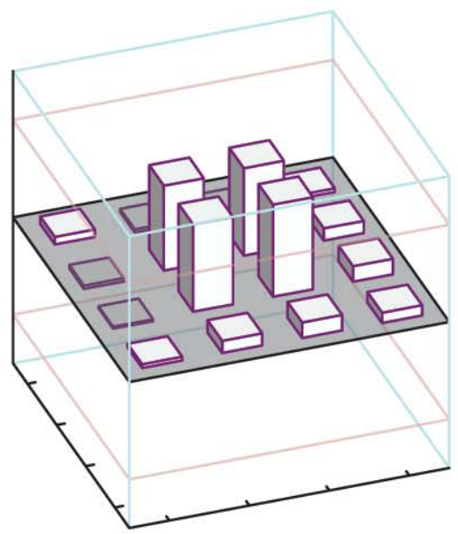
Testing the processor – Bell States
Density matrix:
DiCarlo, L. et al. Demonstration of two-qubit algorithms with a superconducting quantum processor. Nature 460, 240–244 (2009)
Notes:
Use Blackboard as support
introduce density matrix
explain phase shift
say how one achieves the Bell states and what is special about them (how to use them)

Slide 14
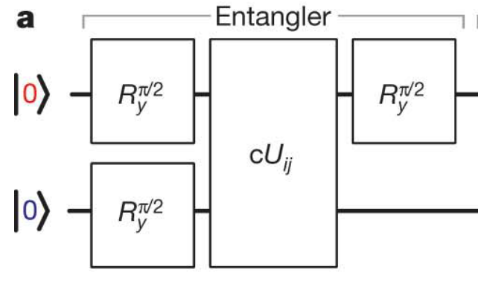
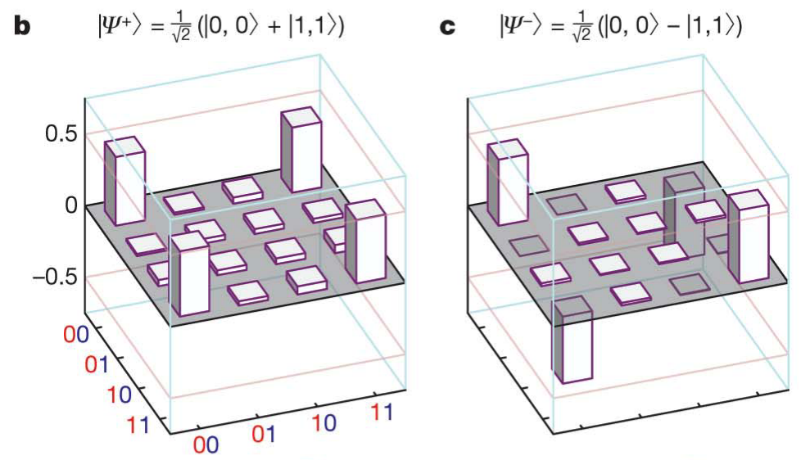
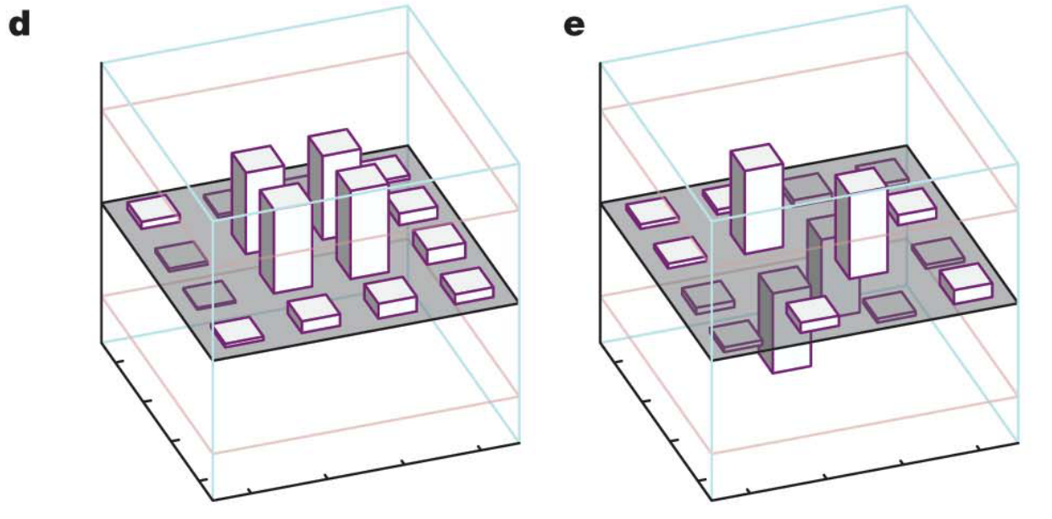
Bell States
DiCarlo, L. et al. Demonstration of two-qubit algorithms with a superconducting quantum processor. Nature 460, 240–244 (2009)
Notes:
Depending on cU_ij we can get to any of the 4 Bell states. We can (naively) see that the processor works well.
But not all of the Bell states are achieved with the same accuracy.

Slide 15
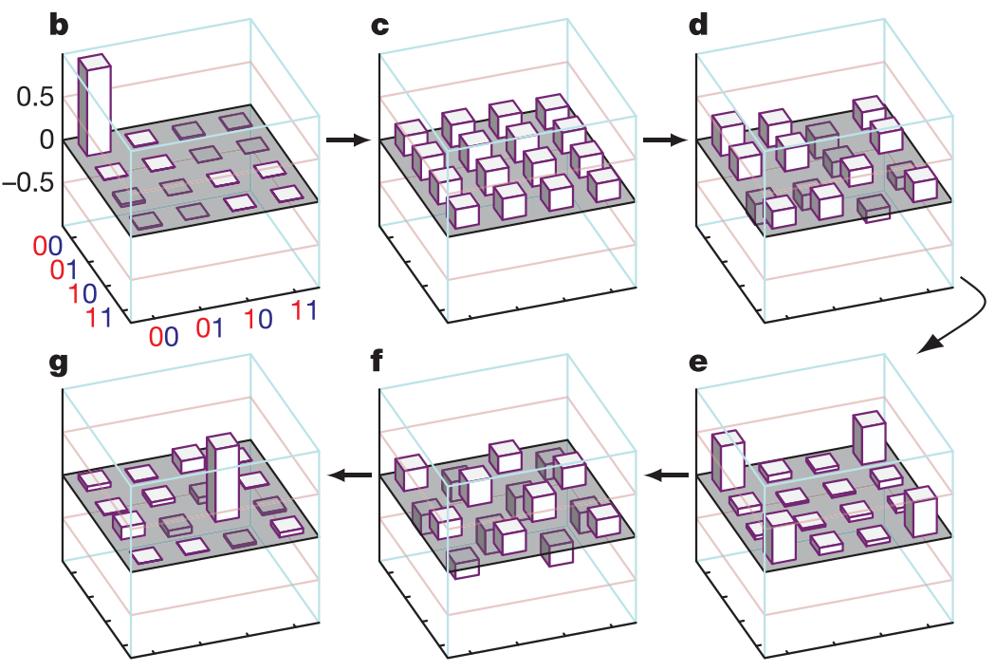
Grover Algorithm
DiCarlo, L. et al. Demonstration of two-qubit algorithms with a superconducting quantum processor. Nature 460, 240–244 (2009)
Notes:
Show the implementation step by step.
but only quickly (I am not sure how educational this is)...

Slide 16
Algorithmic Performance
DiCarlo, L. et al. Demonstration of two-qubit algorithms with a superconducting quantum processor. Nature 460, 240–244 (2009)
Coherence time: 1 $μs$
~30 operations
1 operation takes ~ 30ns
Nowadays: ~ 50 $μs$

