Slide 1

Bell tests with Photons
Henry Clausen

Slide 2
Photon Bell Tests

Slide 3
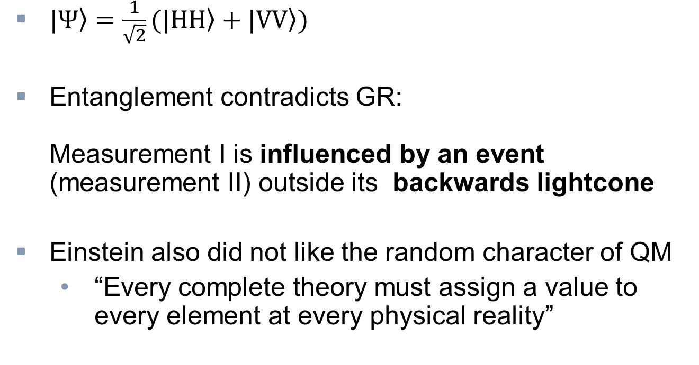
EPR-Paradoxon
Bell‘s theorem
Photon Bell Test by Aspect
Loopholes
Photon Bell Test by Weihs
Outlook
Bob
Alice
Collapse
$\left.|Ψ\right\rangle =\frac{1}{\sqrt{2}}(\left.|HH\right\rangle +\left.|VV\right\rangle )$
Entanglement contradicts GR:
Measurement I is influenced by an event (measurement II) outside its backwards lightcone
Einstein also did not like the random character of QM
  “Every complete theory must assign a value to every element at every physical reality”
+
+
Emmission
Image source: http://rqgravity.net/images/paradox/Paradox-7N.gif (18.05.2013)

Slide 4
Local hidden variable theory
Bell‘s theorem
Photon Bell Test by Aspect
Loopholes
Photon Bell Test by Weihs
Outlook
Considerations:
  Quantum mechanics might be incomplete
  Unknown variables determine outcome of measurements prior to measurement
    No randomness
    Locality
For entangled photons:
  Whether + or - is measured is determined before the measurement

Slide 5
Bell‘s theorem
Bell‘s theorem
Photon Bell Test by Aspect
Loopholes
Photon Bell Test by Weihs
Outlook
“Quantum mechanics cannot arise from a theory of local pre-existing hidden variables”
Necessary conditions on theory for Bell’s theorem:
Locality
Counterfactual definiteness

Slide 6
Locality
Bell‘s theorem
Photon Bell Test by Aspect
Loopholes
Photon Bell Test by Weihs
Outlook
No influence of events outside the backwards light cone
Counterfactual definiteness
A property is assigned to a system at all times independently of whether the measurement is carried out

Slide 7
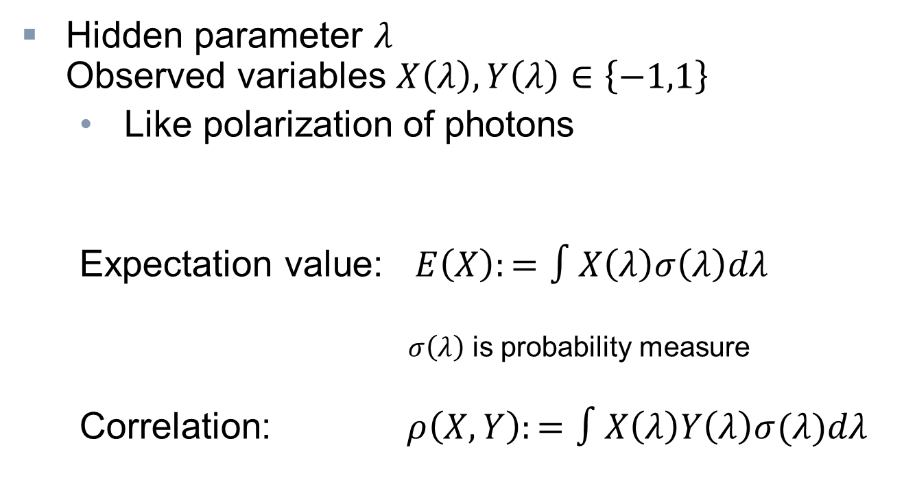
Correlation
Bell‘s theorem
Photon Bell Test by Aspect
Loopholes
Photon Bell Test by Weihs
Outlook
Hidden parameter $λ$
Observed variables $X\left(λ\right), Y\left(λ\right)∈\left\{−1,1\right\}$
  Like polarization of photons
  Expectation value: $E\left(X\right):=∫X\left(λ\right)σ\left(λ\right)dλ$
  $σ\left(λ\right)$ is probability measure
  Correlation: $ρ\left(X,Y\right):=∫X\left(λ\right)Y\left(λ\right)σ(λ)dλ$
Notes:
Erklärungen von Symbolen auf Folien

Slide 8
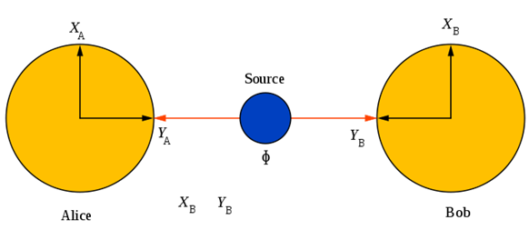
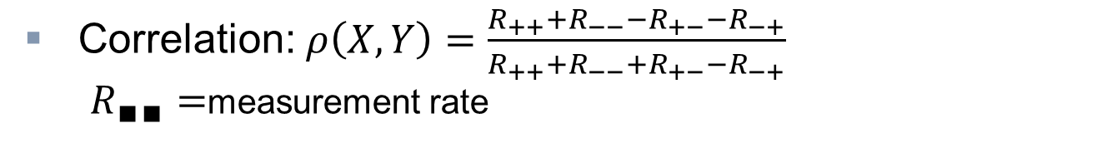
Correlation
Bell‘s theorem
Photon Bell Test by Aspect
Loopholes
Photon Bell Test by Weihs
Outlook
Correlation: $ρ\left(X,Y\right)=\frac{R_{++}+R_{−−}−R_{+−}−R_{−+}}{R_{++}+R_{−−}+R_{+−}−R_{−+}}$
$R_{∎∎}=$measurement rate
Parallel | Pair 1 | Pair 2 | Pair 3 | Pair 4 | …
Alice | + | - | + | +
Bob | + | - | + | +
Correlation | +1 | +1 | +1 | +1 | +1
Antiparallel | Pair 1 | Pair 2 | Pair 3 | Pair 4 | …
Alice | + | - | + | +
Bob | - | + | - | -
Correlation | -1 | -1 | -1 | -1 | -1
Image source: http://en.wikipedia.org/wiki/File:Bell%27s_theorem.svg (18.05.2013)
Notes:
Erklärungen von Symbolen auf Folien

Slide 9
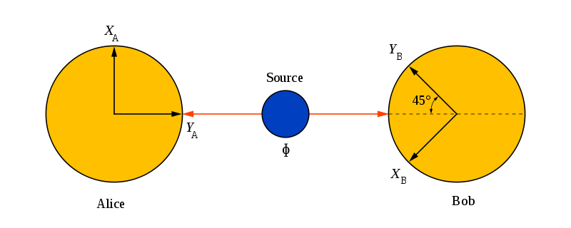
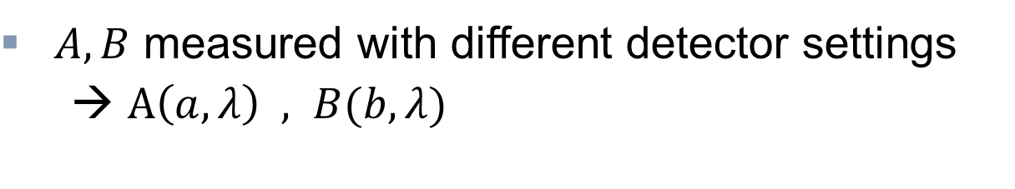
Correlation
Bell‘s theorem
Photon Bell Test by Aspect
Loopholes
Photon Bell Test by Weihs
Outlook
$A,B$ measured with different detector settings
  → $A\left(a,λ\right) , B(b,λ)$
Orthogonal | Pair 1 | Pair 2 | Pair 3 | Pair 4 | Pair 5 | …
Alice | + | - | - | + | +
Bob | + | + | - | + | -
Correlation | +1 | -1 | +1 | +1 | -1 | 0
Image source: http://en.wikipedia.org/wiki/File:Bell%27s_theorem.svg (18.05.2013)
Notes:
Erklärungen von Symbolen auf Folien

Slide 10
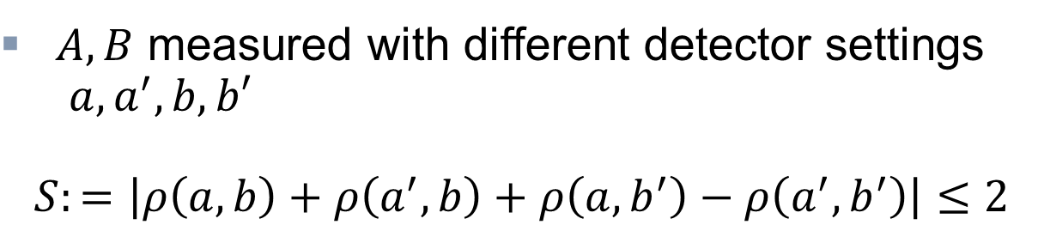
CHSH inequality
Bell‘s theorem
Photon Bell Test by Aspect
Loopholes
Photon Bell Test by Weihs
Outlook
$A,B$ measured with different detector settings
$a,a^{′},b,b′$
$$S:=\left|ρ\left(a,b\right)+ρ\left(a^{′},b\right)+ρ\left(a,b^{′}\right)−ρ\left(a^{′},b^{′}\right)\right|≤2$$
Image source: http://en.wikipedia.org/wiki/File:Bell%27s_theorem.svg (18.05.2013)
Notes:
This is because A and B are just correlated because of their emission
AB+AB’=A(B+B’)
Clauser, Horne, Shimony and Holt

Slide 11
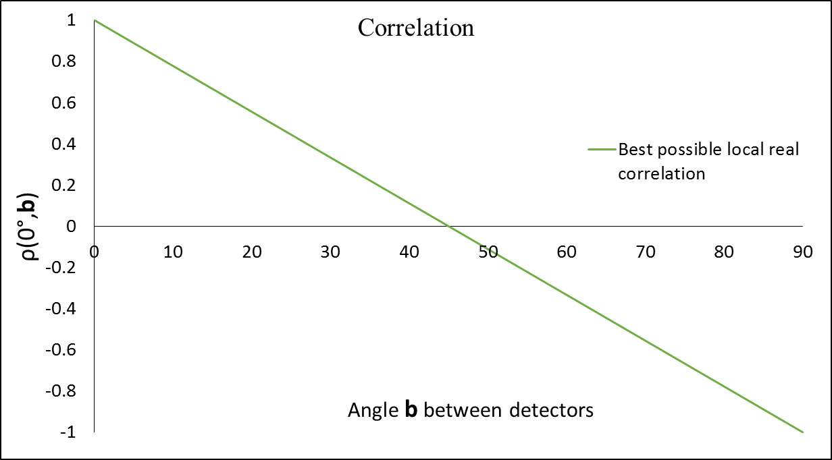
CHSH inequality
Bell‘s theorem
Photon Bell Test by Aspect
Loopholes
Photon Bell Test by Weihs
Outlook
$A,B$ measured with different detector settings
$a,a^{′},b,b′$
$$S:=\left|ρ\left(a,b\right)+ρ\left(a^{′},b\right)+ρ\left(a,b^{′}\right)−ρ\left(a^{′},b^{′}\right)\right|≤2$$
Notes:
This is because A and B are just correlated because of their emission
AB+AB’=A(B+B’)

Slide 12
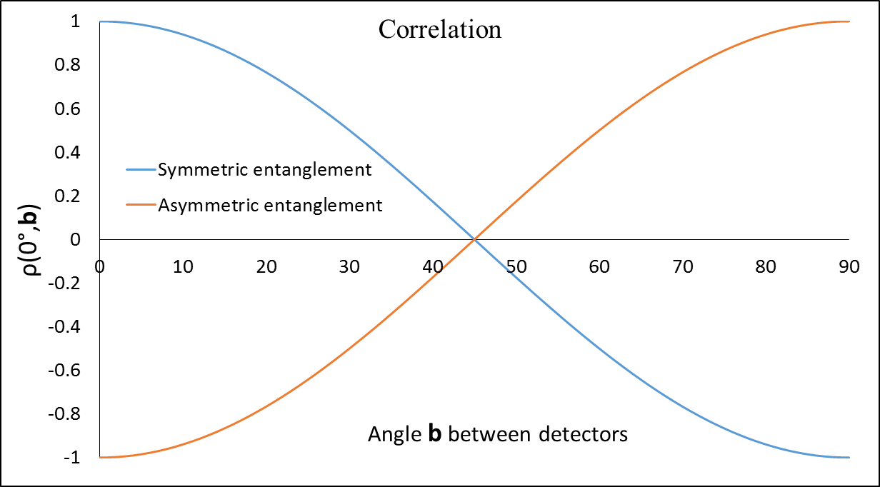

But…
Bell‘s theorem
Photon Bell Test by Aspect
Loopholes
Photon Bell Test by Weihs
Outlook
For entangled photons: $ρ\left(a,b\right)=±cos⁡[2 \left(a−b\right)]$
$$\left|ρ\left(0°,22,5°\right)+ρ\left(45°,67,5°\right)+ρ\left(45°,22,5°\right)−ρ\left(0,67,5°\right)\right|=\frac{4}{\sqrt{2}}>2$$
$α, α^{′}:\left\{0°,45°\right\}$
$β, β^{′}:\left\{22,5°,67,5°\right\}$
Notes:
Achsenbeschriftung klarer

Slide 13
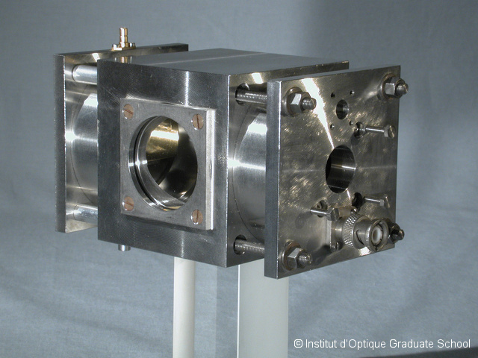
Bell Test by Alain Aspect, 1981
Bell‘s theorem
Photon Bell Test by Aspect
Loopholes
Photon Bell Test by Weihs
Outlook
Paper: Experimental Realization of Einstein-Podolsky-Rosen-Bohm Gedankenexperiment: A New Violation of Bell's Inequalities
A. Aspect, P. Grangier,
G. Roger
Phys. Rev. Lett. 49, 2
(1982)
Image source: http://phototheque.institutoptique.fr/picture.php?/7212 (18.05.2013)
Notes:
Alain Aspect
Phillipe Grangier
Gérard Roger
Volume 49, Article number 2

Slide 14
Bell Test by Alain Aspect, 1981
Bell‘s theorem
Photon Bell Test by Aspect
Loopholes
Photon Bell Test by Weihs
Outlook
Done in Paris
First experiment to measure the Bell inequality directly
Prior only single-channel-
analyzer experiments
Image source: http://phototheque.institutoptique.fr/picture.php?/7212 (18.05.2013)

Slide 15
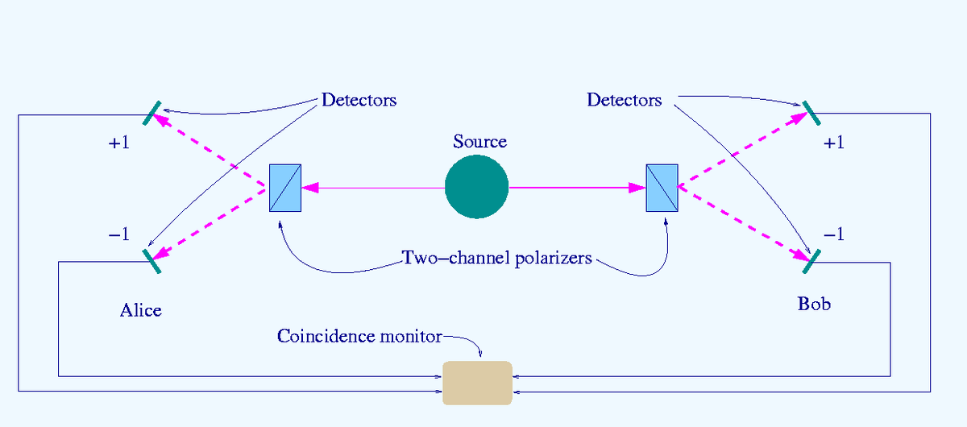
Setup
Bell‘s theorem
Photon Bell Test by Aspect
Loopholes
Photon Bell Test by Weihs
Outlook
WL-filter
WL-filter
Single rate
monitor
Single rate
monitor
Image source: http://en.wikipedia.org/wiki/File:Bell-test-photon-analyer.png (18.05.2013)

Slide 16
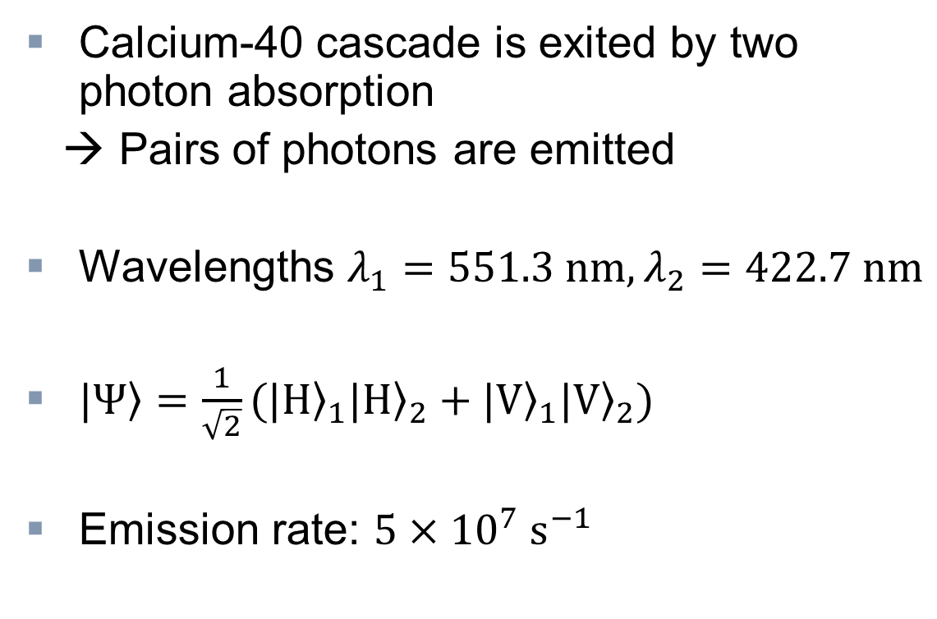
Photon Source
Bell‘s theorem
Photon Bell Test by Aspect
Loopholes
Photon Bell Test by Weihs
Outlook
Calcium-40 cascade is exited by two photon absorption
→ Pairs of photons are emitted
Wavelengths $λ_{1}=551.3 nm, λ_{2}=422.7 nm$
$\left.|Ψ\right\rangle =\frac{1}{\sqrt{2}}({\left.|H\right\rangle }_{1}{\left.|H\right\rangle }_{2}+{\left.|V\right\rangle }_{1}{\left.|V\right\rangle }_{2})$
Emission rate: $5×{10}^{7} s^{−1}$

Slide 17
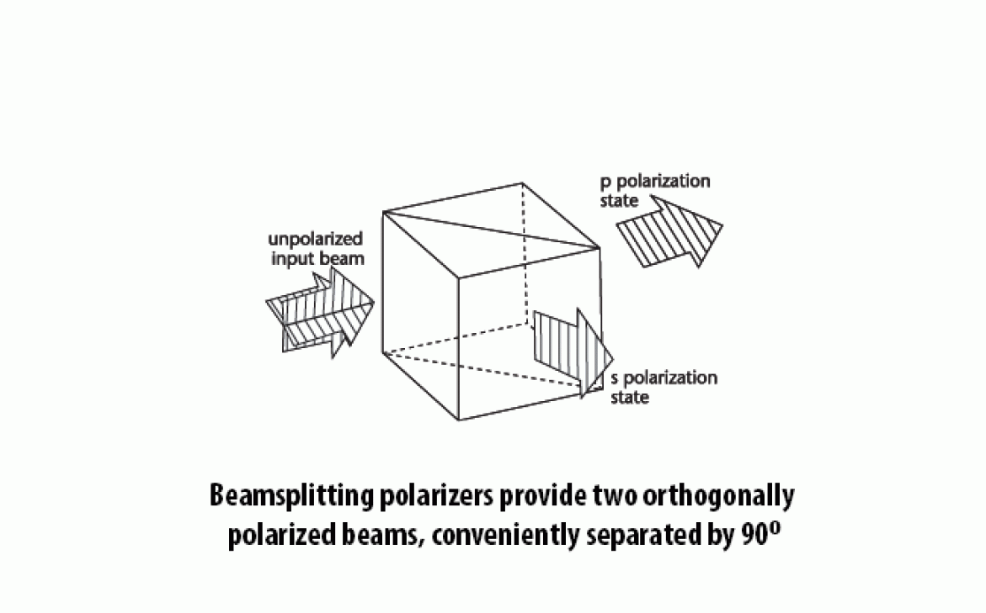
Polarizers
Bell‘s theorem
Photon Bell Test by Aspect
Loopholes
Photon Bell Test by Weihs
Outlook
Two prisms separated by thin
film
  Parallel polarized light
  transmitted
  Orthogonal polarized
  light reflected
Rotatable
Image source: http://www.meadowlark.com/images/products_large/laserline_beamsplitting_polarizer_fig1_17_2_13895.gif (18.05.2013)
Notes:
Polarizing beam splitter
Brewster Angle + total reflection angle

Slide 18



Polarizers
Bell‘s theorem
Photon Bell Test by Aspect
Loopholes
Photon Bell Test by Weihs
Outlook
$T_{1}^{∥}=R_{1}^{⊥}=0.950$
$T_{1}^{⊥}=R_{1}^{∥}=0.007$
$T_{2}^{∥}=R_{2}^{⊥}=0.930$
$T_{2}^{⊥}=R_{2}^{∥}=0.007$
for $λ_{1}$
for $λ_{2}$
Image source: http://www.meadowlark.com/images/products_large/laserline_beamsplitting_polarizer_fig1_17_2_13895.gif (18.05.2013)

Slide 19
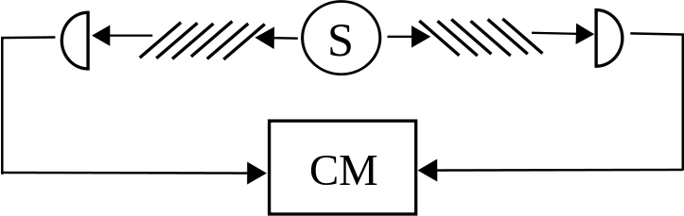
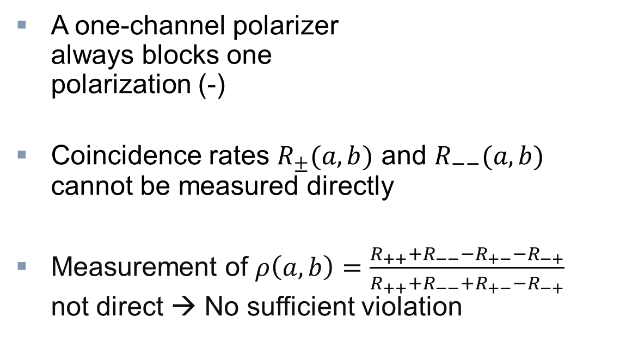
Advantage of two-channel polarizers
Bell‘s theorem
Photon Bell Test by Aspect
Loopholes
Photon Bell Test by Weihs
Outlook
A one-channel polarizer
always blocks one
polarization (-)
Coincidence rates $R_{±}(a,b)$ and $R_{−−}(a,b)$ cannot be measured directly
Measurement of $ρ\left(a,b\right)=\frac{R_{++}+R_{−−}−R_{+−}−R_{−+}}{R_{++}+R_{−−}+R_{+−}−R_{−+}}$
not direct → No sufficient violation
Image source: http://en.wikipedia.org/wiki/File:Single-channel_Bell_test.svg (18.05.2013)

Slide 20
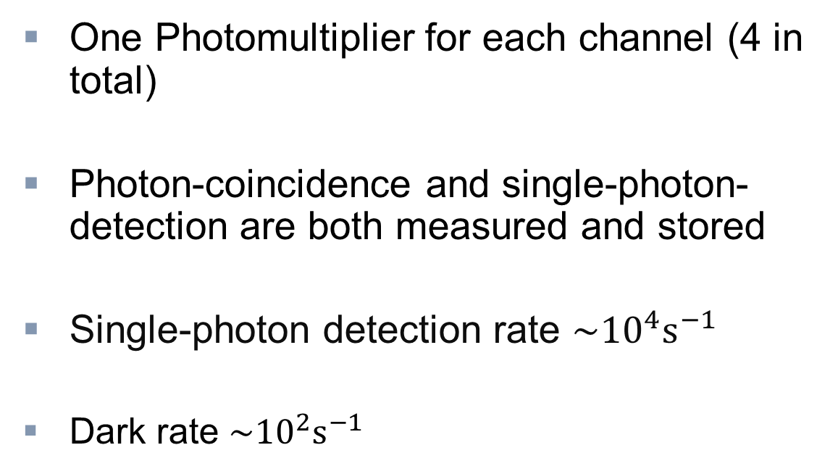
Detection
Bell‘s theorem
Photon Bell Test by Aspect
Loopholes
Photon Bell Test by Weihs
Outlook
One Photomultiplier for each channel (4 in total)
Photon-coincidence and single-photon-detection are both measured and stored
Single-photon detection rate $\sim {10}^{4}s^{−1}$
Dark rate $\sim {10}^{2}s^{−1}$

Slide 21
Setup
Bell‘s theorem
Photon Bell Test by Aspect
Loopholes
Photon Bell Test by Weihs
Outlook
WL-filter
WL-filter
Single
monitor
Single
monitor
Image source: http://en.wikipedia.org/wiki/File:Bell-test-photon-analyer.png (18.05.2013)

Slide 22
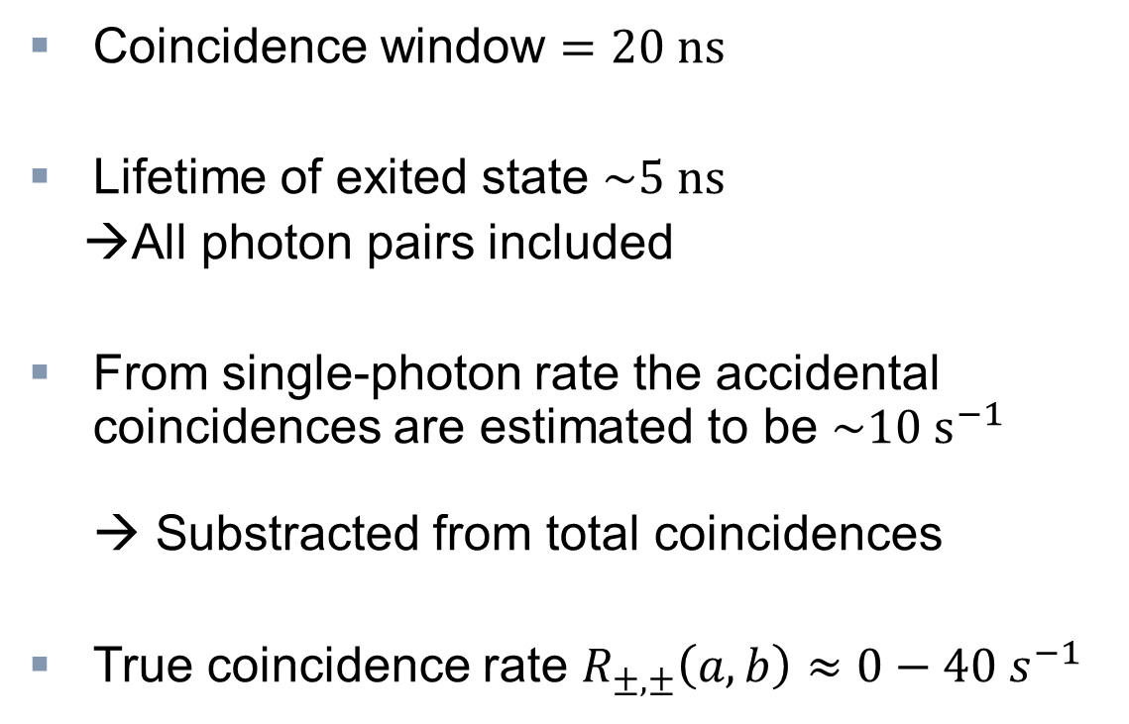
Detection
Bell‘s theorem
Photon Bell Test by Aspect
Loopholes
Photon Bell Test by Weihs
Outlook
Coincidence window $=20 ns$
Lifetime of exited state $\sim 5 ns$
→All photon pairs included
From single-photon rate the accidental coincidences are estimated to be $\sim 10{ s}^{−1}$
→ Substracted from total coincidences
True coincidence rate $R_{±,±}\left(a,b\right)≈0−40{ s}^{−1}$
Notes:
Loophole because of estimation
Use of quantum mechanical prediction to prove quantum mechanics

Slide 23
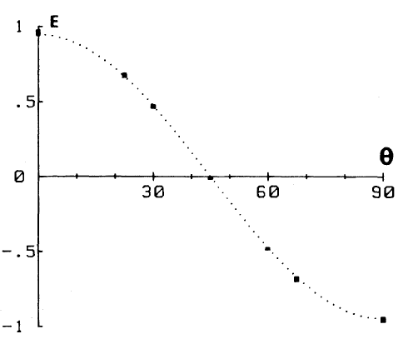
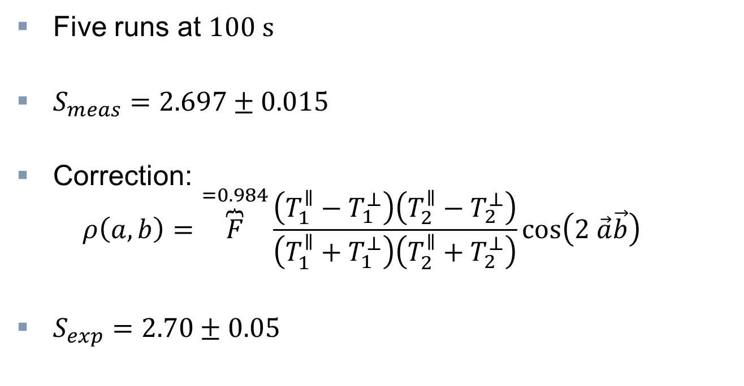
Result
Bell‘s theorem
Photon Bell Test by Aspect
Loopholes
Photon Bell Test by Weihs
Outlook
Five runs at $100 s$
$S_{meas}=2.697±0.015$
Correction:
$ρ\left(a,b\right)=\overset{=0.984}{\overbrace{F}}\frac{\left(T_{1}^{∥}−T_{1}^{⊥}\right)\left(T_{2}^{∥}−T_{2}^{⊥}\right)}{\left(T_{1}^{∥}+T_{1}^{⊥}\right)\left(T_{2}^{∥}+T_{2}^{⊥}\right)}cos\left(2 \vec{a}\vec{b}\right)$
$S_{exp}=2.70±0.05$
Image source: [2]
Notes:
First error: Poisson distribution standard deviation
Second error: Lack of symmetry of the detectors
Maybe: Different detection efficiencies for different angles → 1% → Deviation smaller than: 2%
Already 83% of maximal violation

Slide 24
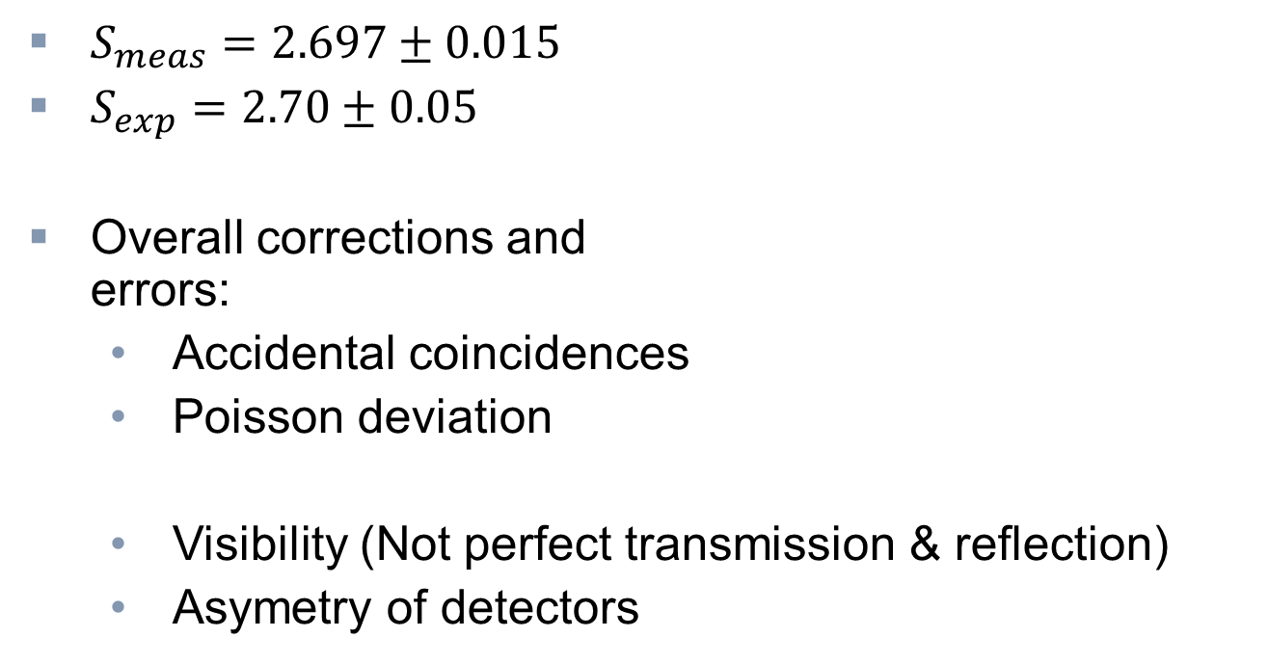
Result
Bell‘s theorem
Photon Bell Test by Aspect
Loopholes
Photon Bell Test by Weihs
Outlook
$S_{meas}=2.697±0.015$
$S_{exp}=2.70±0.05$
Overall corrections and
errors:
  Accidental coincidences
  Poisson deviation
  Visibility (Not perfect transmission & reflection)
  Asymetry of detectors
Image source: [2]
Notes:
First error: Poisson distribution standard deviation
Second error: Lack of symmetry of the detectors
Maybe: Different detection efficiencies for different angles → 1% → Deviation smaller than: 2%

Slide 25
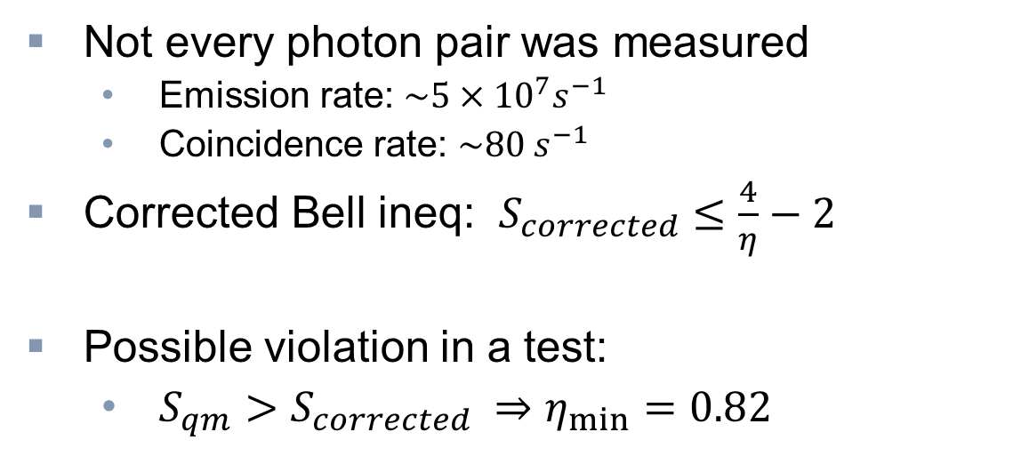
Detection Loophole
Bell‘s theorem
Photon Bell Test by Aspect
Loopholes
Photon Bell Test by Weihs
Outlook
Not every photon pair was measured
  Emission rate: $\sim {5×10}^{7}s^{−1}$
  Coincidence rate: $\sim 80 s^{−1}$
Corrected Bell ineq: $S_{corrected}≤\frac{4}{η}−2$
Possible violation in a test:
  $S_{qm}>S_{corrected} ⇒η_{min}=0.82$

Slide 26
Locality Loophole
Bell‘s theorem
Photon Bell Test by Aspect
Loopholes
Photon Bell Test by Weihs
Outlook
No communication between measurements assumed
Even if separation spacelike:
→ Communication after changing the angle possible
Measurement basis (angle) has to be changed after photon emission
Notes:
Messbasis wird gewählt

Slide 27
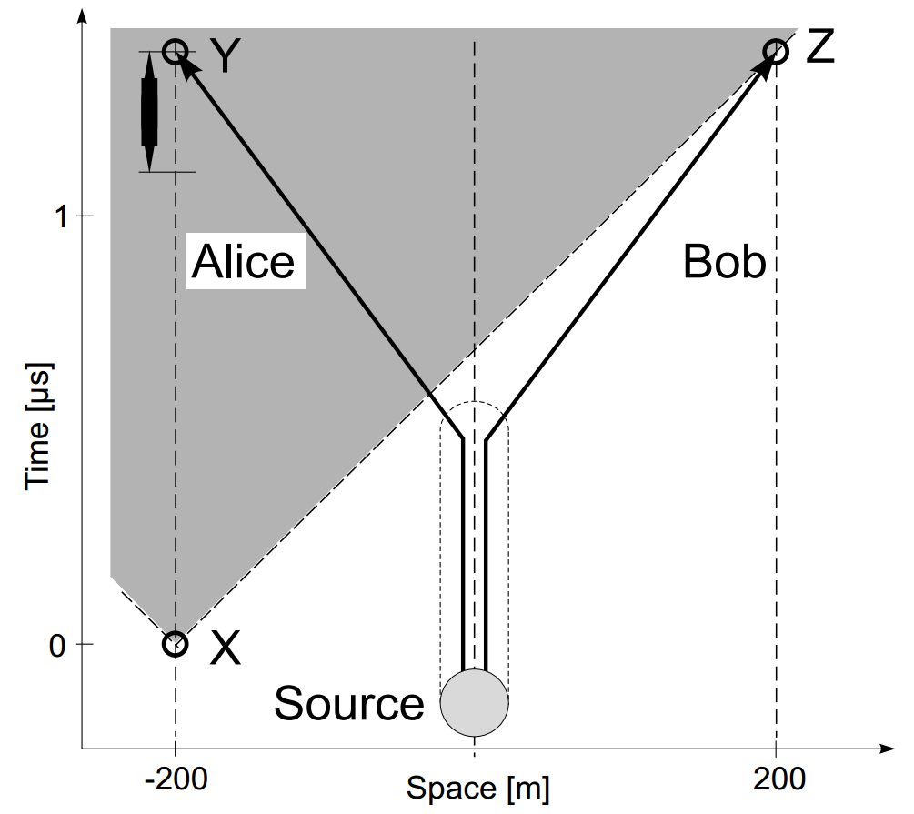
Bell Test by Gregor Weihs, 1998
Bell‘s theorem
Photon Bell Test by Aspect
Loopholes
Photon Bell Test by Weihs
Outlook
Paper: Violation of Bell’s
Inequality under Strict Einstein
Locality Conditions
G. Weihs, T. Jennewein, C. Simon,
H. Weinfurter, and A. Zeilinger
Phys. Rev. Lett. 81, 23
(1998)
Image source: [3]
Notes:
Gregor Weihs, Thomas Jennewein, Christoph Simon, Harald Weinfurter, and Anton Zeilinger

Slide 28
Bell Test by Gregor Weihs, 1998
Bell‘s theorem
Photon Bell Test by Aspect
Loopholes
Photon Bell Test by Weihs
Outlook
Spacelike separation of
measurements
Random number generator to
determine measurement basis
Done during photon flight
First time Locality Loophole was closed
Image source: [3]

Slide 29
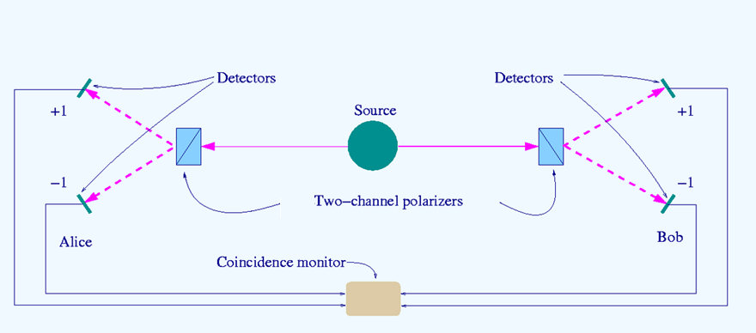
Setup Aspect
Bell‘s theorem
Photon Bell Test by Aspect
Loopholes
Photon Bell Test by Weihs
Outlook
WL-filter
WL-filter
Image source: http://en.wikipedia.org/wiki/File:Bell-test-photon-analyer.png (18.05.2013)

Slide 30


Setup Weihs
Bell‘s theorem
Photon Bell Test by Aspect
Loopholes
Photon Bell Test by Weihs
Outlook
Laser
Modulator
Modulator
400 m
Random-number-generators
Image source: http://en.wikipedia.org/wiki/File:Bell-test-photon-analyer.png (18.05.2013)

Slide 31
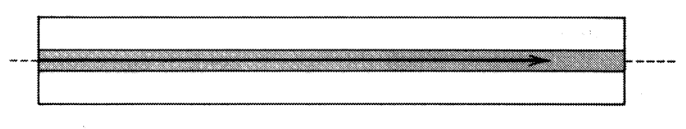
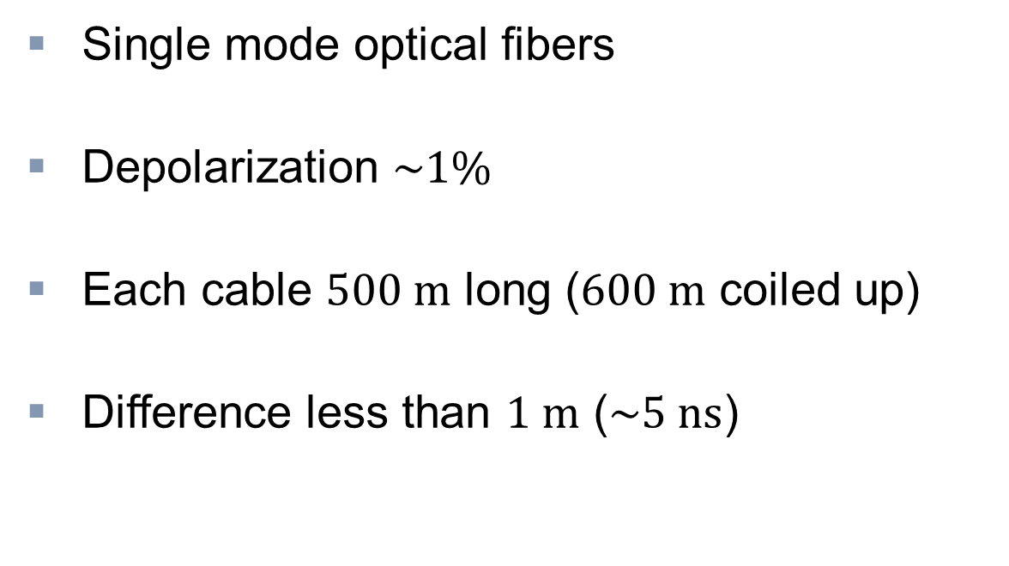
Fibers
Bell‘s theorem
Photon Bell Test by Aspect
Loopholes
Photon Bell Test by Weihs
Outlook
Single mode optical fibers
Depolarization $\sim 1\%$
Each cable $500 m$ long ($600 m$ coiled up)
Difference less than $1 m$ ($\sim 5 ns$)
Image source: S. Johnson, Quantum Electronics FS2013 Summary of lecture notes, (30.07.2013)

Slide 32
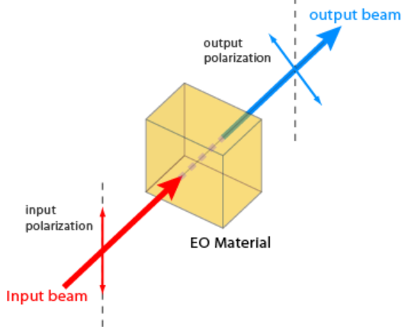
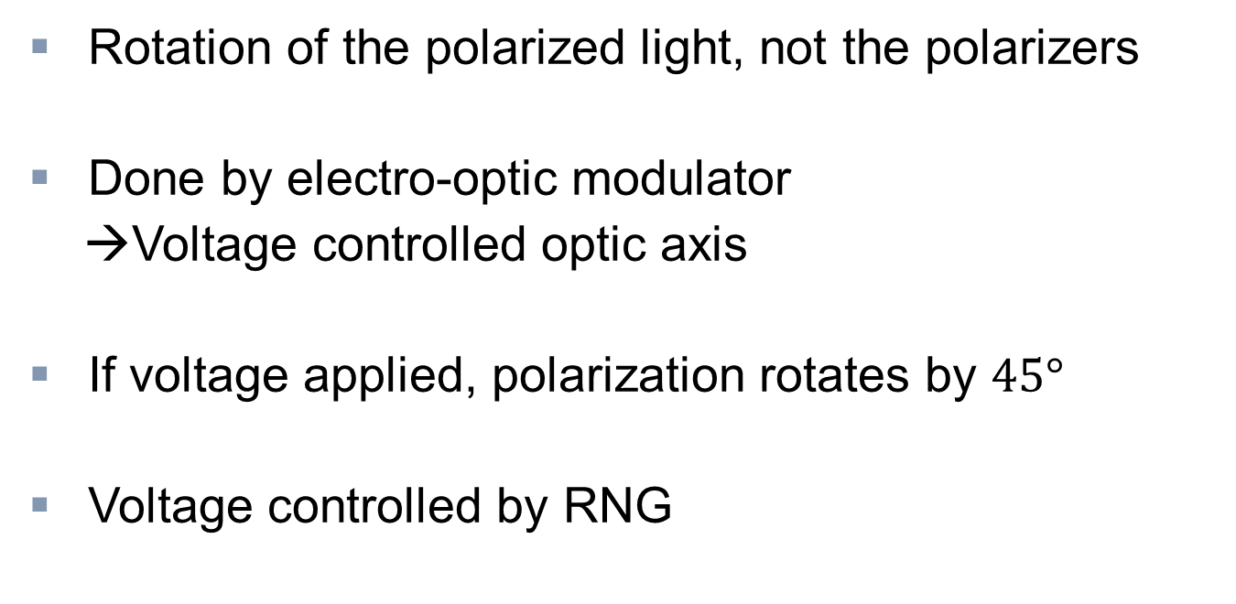
Rotation
Bell‘s theorem
Photon Bell Test by Aspect
Loopholes
Photon Bell Test by Weihs
Outlook
Rotation of the polarized light, not the polarizers
Done by electro-optic modulator
→Voltage controlled optic axis
If voltage applied, polarization rotates by $45°$
Voltage controlled by RNG
Image source: S. Johnson, Quantum Electronics FS2013 Summary of lecture notes, (30.07.2013)

Slide 33
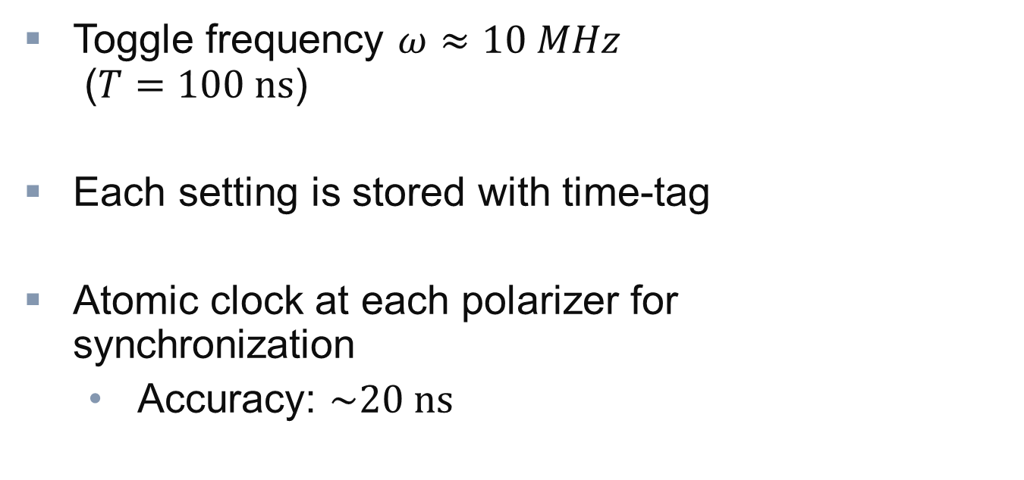
Rotation
Bell‘s theorem
Photon Bell Test by Aspect
Loopholes
Photon Bell Test by Weihs
Outlook
Toggle frequency $ω≈10 MHz$
$\text{(}T=100 ns\text{)}$
Each setting is stored with time-tag
Atomic clock at each polarizer for
synchronization
  Accuracy: $\sim 20 ns$
Image source: S. Johnson, Quantum Electronics FS2013 Summary of lecture notes, (30.07.2013)

Slide 34
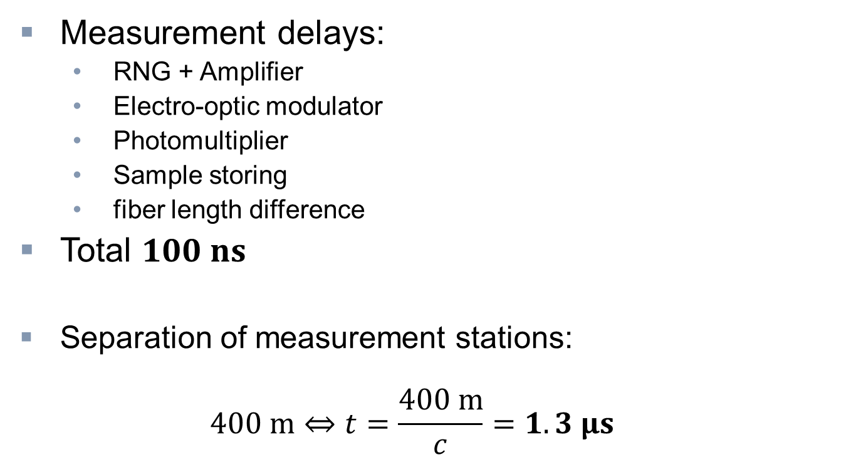
Locality of measurement
Bell‘s theorem
Photon Bell Test by Aspect
Loopholes
Photon Bell Test by Weihs
Outlook
Measurement delays:
  RNG + Amplifier
  Electro-optic modulator
  Photomultiplier
  Sample storing
  fiber length difference
Total $100 ns$
Separation of measurement stations:
$400 m⇔t=\frac{400 m}{c}=1.3 μs$
Notes:
Zeitpunkt der Erzeugung vor der Basiswahl

Slide 35
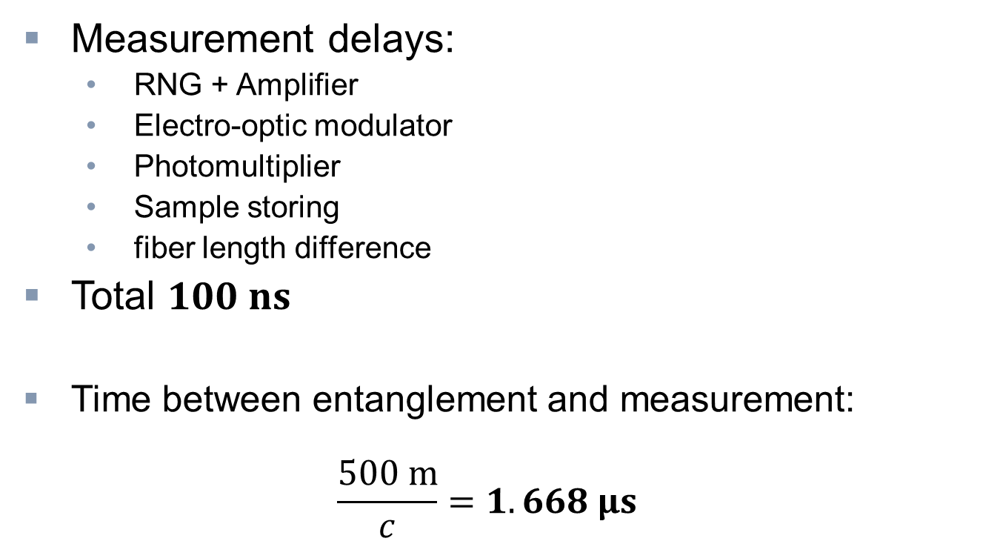
Locality of measurement
Bell‘s theorem
Photon Bell Test by Aspect
Loopholes
Photon Bell Test by Weihs
Outlook
Measurement delays:
  RNG + Amplifier
  Electro-optic modulator
  Photomultiplier
  Sample storing
  fiber length difference
Total $100 ns$
Time between entanglement and measurement:
$\frac{500 m}{c}=1.668 μs$
Notes:
Zeitpunkt der Erzeugung vor der Basiswahl

Slide 36
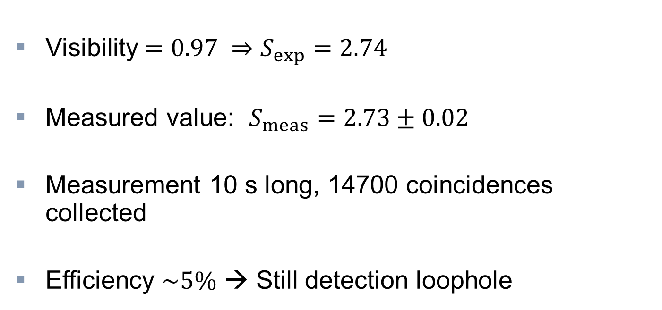
Result
Bell‘s theorem
Photon Bell Test by Aspect
Loopholes
Photon Bell Test by Weihs
Outlook
Visibility $=0.97 ⇒S_{exp}=2.74$
Measured value: $S_{meas}=2.73±0.02$
Measurement 10 s long, 14700 coincidences collected
Efficiency $\sim 5\%$ → Still detection loophole

Slide 37
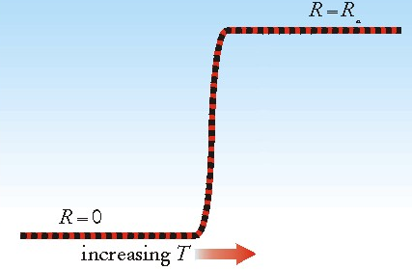
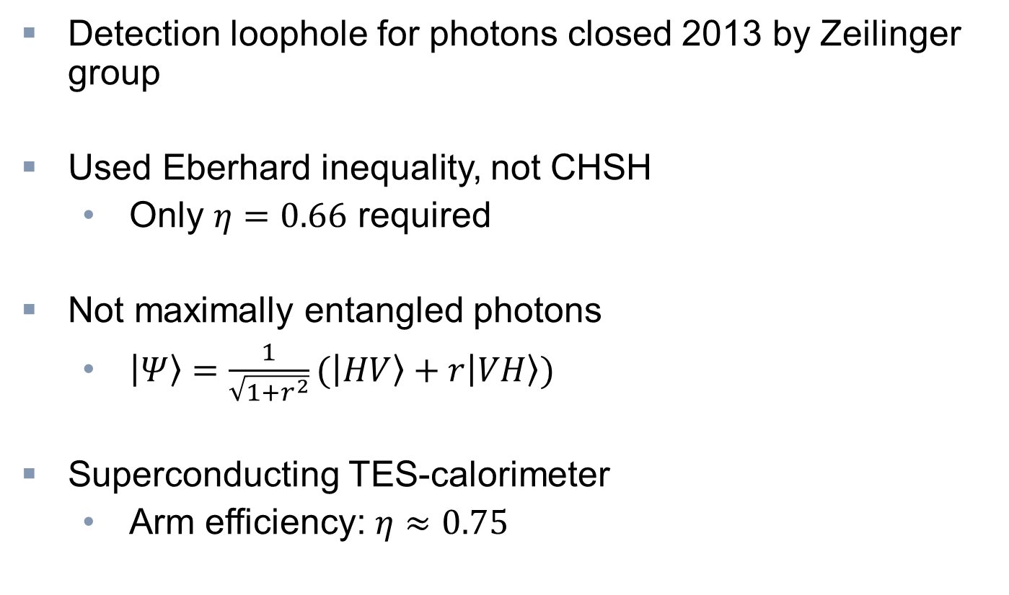
Outlook
Bell‘s theorem
Photon Bell Test by Aspect
Loopholes
Photon Bell Test by Weihs
Outlook
Detection loophole for photons closed 2013 by Zeilinger group
Used Eberhard inequality, not CHSH
  Only $η=0.66$ required
Not maximally entangled photons
  $\left|Ψ\right\rangle =\frac{1}{\sqrt{1+r^{2}}}(\left|HV\right\rangle +r\left|VH\right\rangle )$
Superconducting TES-calorimeter
  Arm efficiency: $η≈0.75$
Image source: http://phonon.gsfc.nasa.gov/qcal/qcal_f4.html (18.05.2013)
Notes:
Parametric down conversion
Optimal for Eberhard ineq. When n<82.8%
Transition Edge sensor
Wavelength-optimized
Very low heat capacity, very cool → Resistance increases exponentially to temperature change

Slide 38
Outlook
Bell‘s theorem
Photon Bell Test by Aspect
Loopholes
Photon Bell Test by Weihs
Outlook
Notes:
Wineland n>90% Massachusetts
Matsukevich & Moehring: n~100% Maryland

Slide 39
Sources

Slide 40
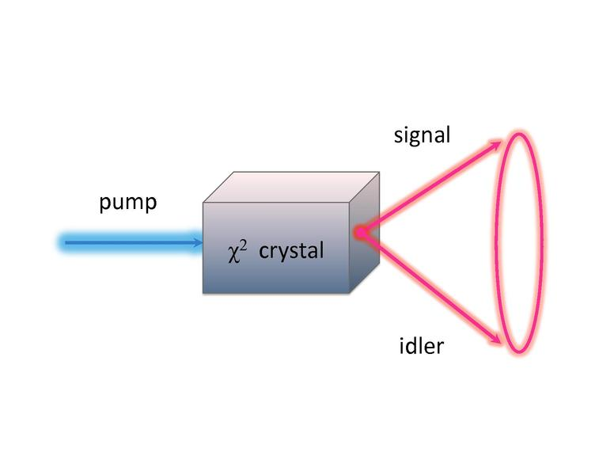
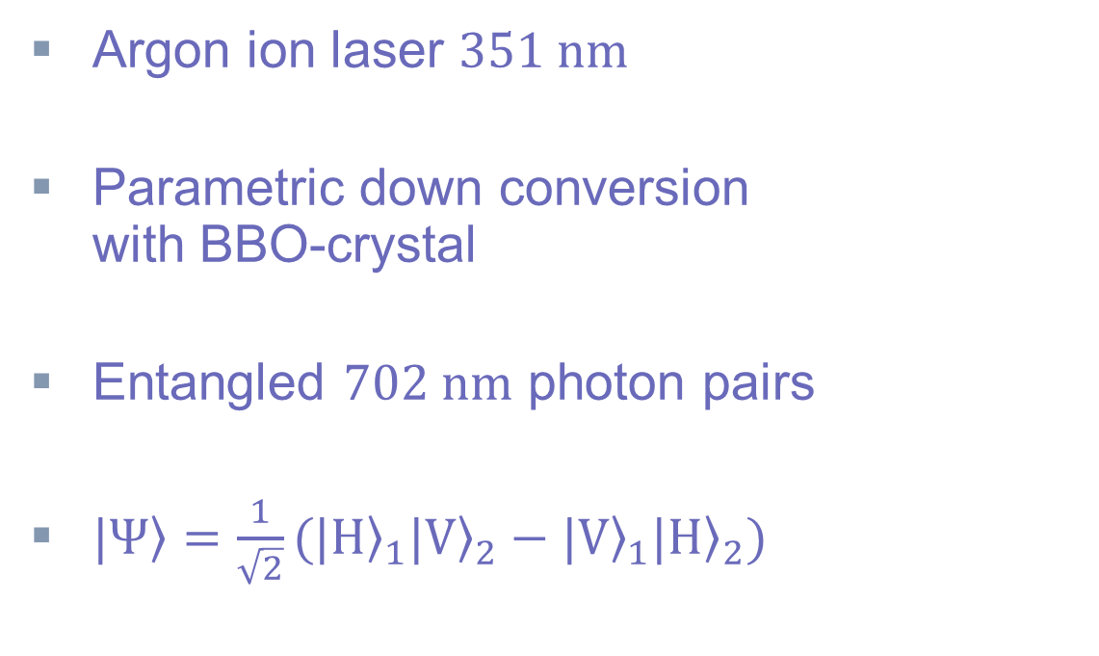
Source
Bell‘s theorem
Photon Bell Test by Aspect
Loopholes
Photon Bell Test by Weihs
Outlook
Argon ion laser $351 nm$
Parametric down conversion
with BBO-crystal
Entangled $702 nm$ photon pairs
$\left.|Ψ\right\rangle =\frac{1}{\sqrt{2}}({\left.|H\right\rangle }_{1}{\left.|V\right\rangle }_{2}−{\left.|V\right\rangle }_{1}{\left.|H\right\rangle }_{2})$
Image source: http://en.wikipedia.org/wiki/File:Scheme_of_spontaneous_parametric_down-conversion.pdf (18.05.2013)
Notes:
351 nm argon ion laser

Slide 41
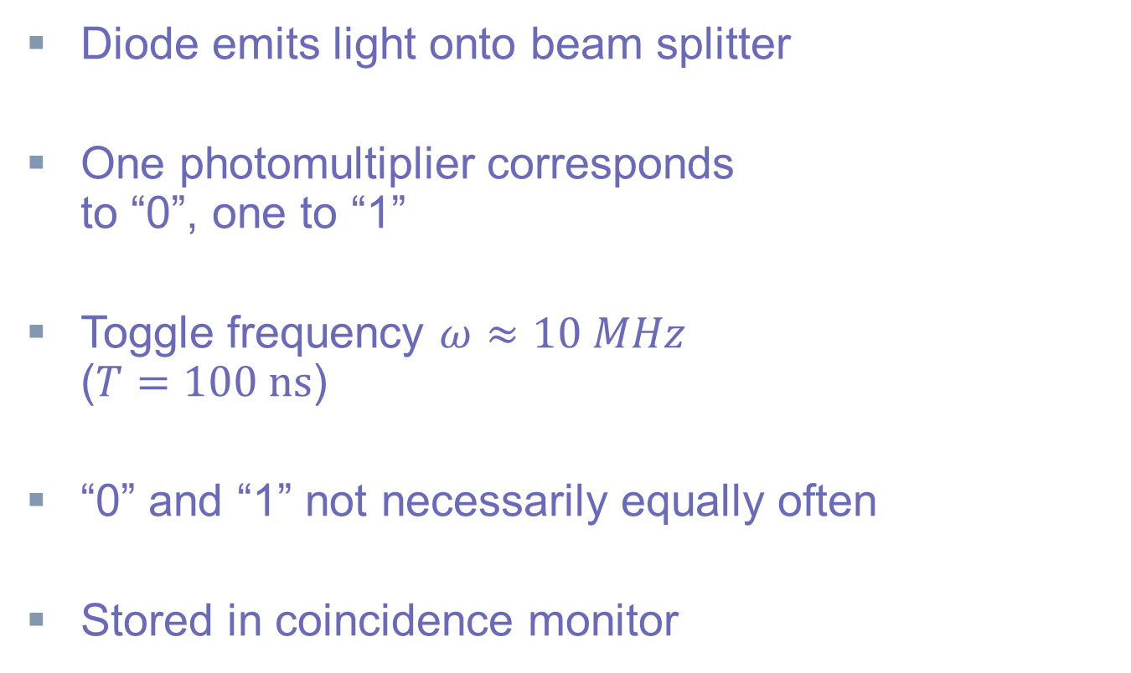
RNG
Bell‘s theorem
Photon Bell Test by Aspect
Loopholes
Photon Bell Test by Weihs
Outlook
Diode
Diode emits light onto beam splitter
One photomultiplier corresponds
to “0”, one to “1”
Toggle frequency $ω≈10 MHz$
($T=100 ns$)
“0” and “1” not necessarily equally often
Stored in coincidence monitor
1
BS
PM
PM
0
Notes:
0 & 1 almost equally often, 2% deviation

Slide 42
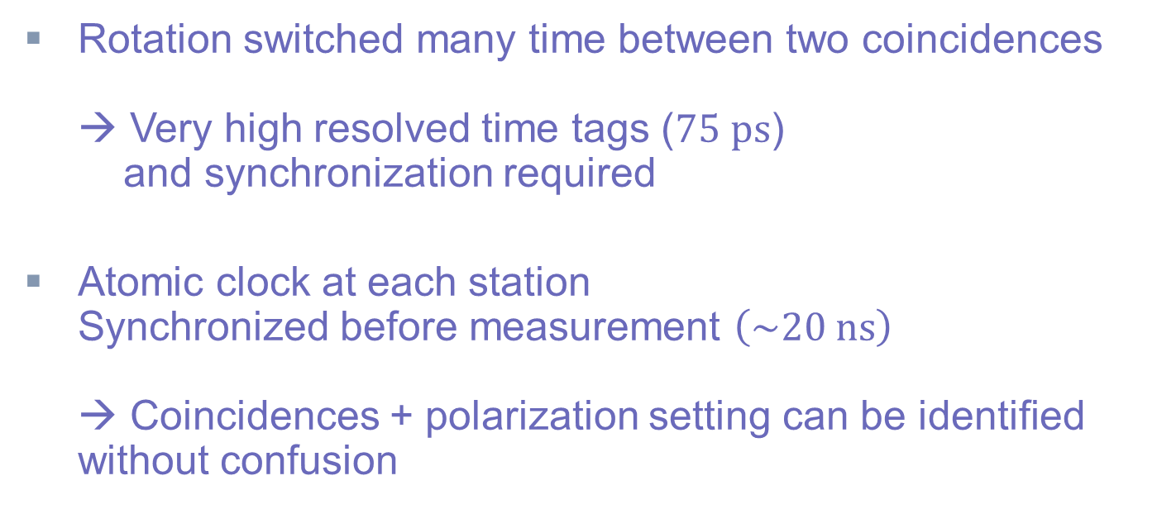
Detection
Bell‘s theorem
Photon Bell Test by Aspect
Loopholes
Photon Bell Test by Weihs
Outlook
Rotation switched many time between two coincidences
→ Very high resolved time tags ($75 ps$)
and synchronization required
Atomic clock at each station
Synchronized before measurement $\left(\sim 20 ns\right)$
→ Coincidences + polarization setting can be identified without confusion

