Slide 1
Polynomial-Time Algorithms for Prime Factorization on a Quantum Computer
Junxin Chen, Chi Zhang

Slide 2
Outline
Introduction
Order-finding Algorithm
Superposition State Preparation
Modular Exponentiation
Quantum Fourier Transform
Measurement and Estimating r
Example: Factorizing 21
Summary

Slide 3
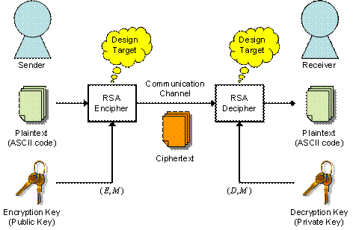
Why Shor’s Algorithm interesting?
RSA Encryption
Breaking RSA encryption requires prime factorizing a large integer (M)
Best classical algorithm:
Shor’s algorithm:
Image source:http://www.lsi-contest.com/2008/spec2_e.html

Slide 4
What is special for quantum algorithm?
Parallelism – Use of superposition states
Reversibility – Due to unitary operators
Special requirements:
Need additional output to keep track of the input
In intermediate steps, the additional output may need to be erased “reversibly”

Slide 5
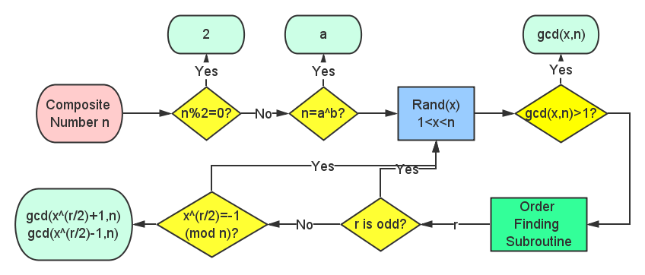
Procedure of prime factorization
gcd(x^{r/2} ± 1,N)

Slide 6
Quantum Order-finding Algorithm
Input: (x,n); Output: order r
Prepare Superposition
q : total number of states, integer power of 2
Modular Exponentiation
QFT
Measurement and estimate order r
Notes:
Question: The Fourier transform is only applied to Register 1, and in principle the measurement can be done only on 1. Then what is the use of the second regesiter?
Answer: It determines how the wavefunction collapses. The a’s who satisfy a=br+k are summed together, therefore the order r comes into the probability amplitude.

Slide 7
Prepare Superposition State
Goal:

Slide 8
Prepare Superposition State
H
First Register L qubits
H
…
H
Second register not changed

Slide 9
Modular Exponentiation
Goal:
Notes:
Here mention the parallelism.
As well mention the special requirement for reversibility.
The bottleneck in quantum factorizing -> the piece of factorizing algorithm which consumes the most time and space

Slide 10
Modular Exponentiation
Register a
Register power
…
…
result
b
c
Notes:
These “quantum” codes looks exactly same as classical codes. It do not require any special logic gate. If these methods fulfill the requirement for reversibility, and if these codes can be classically realized, then they can be realized quantum mechanically.

Slide 11
Modular Exponentiations
Register b
Register result
…
…
We do not want b in the final result!
→ One more step to go…

Slide 12
Modular Exponentiation
Register b
Register result
…
…
Bonus: quantum watchdog

Slide 13
Modular Exponentiation
Notes:
Here mention the parallelism.
As well mention the special requirement for reversibility.
The bottleneck in quantum factorizing -> the piece of factorizing algorithm which consumes the most time and space

Slide 14
Quantum Fourier Transform
Goal:

Slide 15
Quantum Fourier Transform
Definition of Fourier Transform
Quantum version

Slide 16
Quantum Fourier Transform
With a little algebra, quantum Fourier transform can be written into such a product representation
binary representation of
For deduction, see Nielson & Chuang, P218

Slide 17
Quantum Fourier Transform
Ingredients
Hadamard Gate
Controlled Phase Gate
H
R_{k}
R₂

Slide 18
Quantum Fourier Transform
H
R₂
…
R_{l-1}
R_{l}
H
…
R_{l-2}
R_{l-1}
…
H
R₂
H

Slide 19
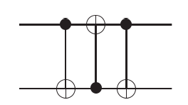
Quantum Fourier Transform
Compare the output of the above circuit
With the definition of Quantum Fourier Transform
→Use at most l/2 swap gates to change the order
→Read in reverse order

Slide 20
Measurement and Estimating r
Goal:
Measure the state of the two registers
Estimate r from the measured state

Slide 21
Measurement and Estimating r
Final state:
Has a probability to get

Slide 22
Measurement and Estimating r
Probability
Because the order of x is r, this sum is over all a satisfying
residue congruent to rc (mod q)

Slide 23
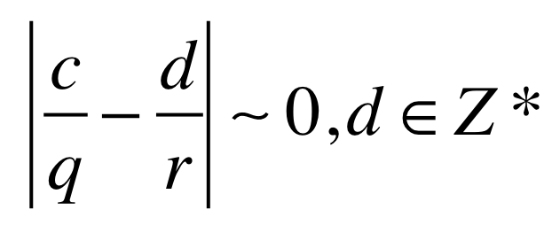
Measurement and Estimating r
Probability
Only when is close to 0, the probability would be significant
→ We can conclude our measurement of c is very likely to be an integer multiple of r/q
→ Therefore r can be estimated using classical computer

Slide 24
Example: Factorizing 21
First, choose a random integer in the range (1,20)
Extremely lucky: x=3
We are done! gcd(3,21) = 7, and 3×7 = 21
Quite lucky: x=9
gcd(9,21) = 3 and we get another prime factor by calculating 21 ÷ 3 = 7
Unlucky: x = 10
gcd(10,21) = 1
Therefore we need to run the quantum order-finding routine!

Slide 25
Example: Factorizing 21
Initial states:
Superposition states:
…

Slide 26
Example: Factorizing 21
Modular Exponentiation
Period of 6
Note: No tensor product here.
They are entangled states!

Slide 27
Example: Factorizing 21
Quantum Fourier Transform
Measurement
Suppose the output of the second register is 19
We need to collect all the possible a, such that
???

Slide 28
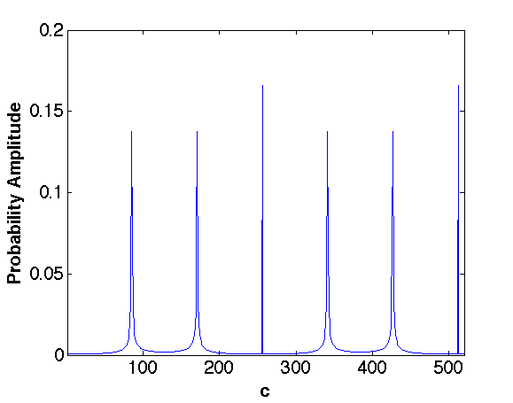
Example: Factorizing 21
Measurement
Probability amplitude to get a value c in the first register:
512
(0)
The measurement output of first register will most probably be one of the 6 numbers.
Let’s assume we get 341…
256
85
171
341
427

Slide 29
Example: Factorizing 21
Estimate r
Check if r=3 correct? No…
Run the order-finding program again with input x=10³(mod21), to get another factor of r, which is 2. Therefore r=2×3=6
Or make some trials based on r₁=3, with classical computer
Get correct answer r=6

Slide 30
Example: Factorizing 21
Now we know r=6
r is even
10³+1(mod21)= 14, does not equal to 20
Good choice!
gcd(10³+1,21)=7
gcd(10³-1,21)=3
We are done!

Slide 31
Summary
Only polynomial time needed for Shor’s algorithm. Exponential time need classically.
Procedure of Shor’s algorithm:
Prepare superposition states
Modular exponentiation
Quantum Fourier transform
Measure the register. Estimate the order r using classical computer.
Quantum parallelism makes Shor’s algorithm faster than classical ones, but requirement for reversibility makes it more complicated than classical.

Slide 32
Literature
Shor, Peter W. "Polynomial-time algorithms for prime factorization and discrete logarithms on a quantum computer." SIAM journal on computing 26.5 (1997): 1484-1509.
‪Michael A. Nielsen, ‪Isaac L. Chuang ”Quantum Computation and Quantum Information.” Cambridge University Press, (2000)

Slide 33
Thank you for your attention!

