Slide 1
Rydberg atoms part 2
Tobias Thiele

Slide 2
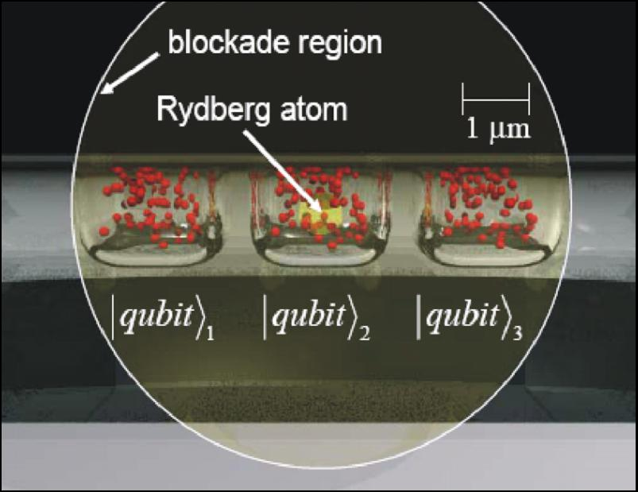
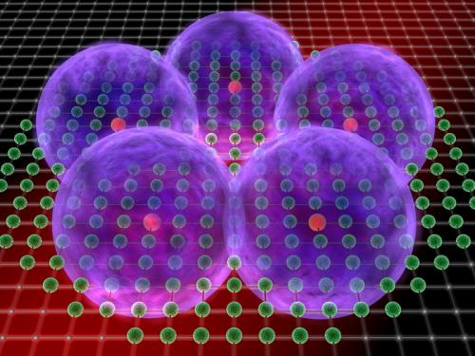
Part 2- Rydberg atoms
Typical Experiments:
Beam experiments
(ultra) cold atoms
Vapor cells

Slide 3
Goal
Couple atoms to cavities
Realize Jaynes-Cummings Hamiltonian
Single atom(dipole) - coupling to cavity:
$$g=\frac{d F_{0}}{ℏ}=\sqrt{\frac{ω_{0 }d^{2}}{2 ε_{0}ℏ V}}$$
Reduce mode volume
Increase resonance frequency
Increase dipole moment

Slide 4
Coupling Rydberg atoms
Couple atoms to cavities
Realize Jaynes-Cummings Hamiltonian
Single atom(dipole) - coupling to cavity:
Can we go arbitrarily high with Rydbergs?
$g=\frac{d F_{0}}{ℏ}=\sqrt{\frac{ω_{0 }d^{2}}{2 ε_{0}ℏ V}}≈110 n^{2}=2 π 43.768 kHz$
Increase dipole moment for fixed frequency (~50 GHz, n=50)
$${∝n}^{2}$$
$$g=\frac{d F_{0}}{ℏ}=\sqrt{\frac{ω_{0 }d^{2}}{2 ε_{0}ℏ V}}≈4∗{10}^{12} n^{−4}$$
$${∝n}^{−3}$$
$${∝n}^{9}$$

Slide 5
Coupling Rydberg atoms
Couple atoms to cavities
Realize Jaynes-Cummings Hamiltonian
Single atom(dipole) - coupling to cavity:
Can we go arbitrarily high with Rydbergs?
$g=\frac{d F_{0}}{ℏ}=\sqrt{\frac{ω_{0 }d^{2}}{2 ε_{0}ℏ V}}≈110 n^{2}=2 π 43.768 kHz$
Increase dipole moment for fixed frequency (~50 GHz, n=50)
$${∝n}^{2}$$
$$g=\frac{d F_{0}}{ℏ}=\sqrt{\frac{ω_{0 }d^{2}}{2 ε_{0}ℏ V}}≈2 π 6∗{10}^{11} n^{−4}$$
$${∝n}^{−3}$$
$${∝n}^{9}$$

Slide 6
Advantages microwave regime for strong coupling g>>  , 
Coupling to ground state of cavity
~0.01 m (microwave, possible) for n=50
● ~10⁻⁷ m (optical, n. possible),
Typical mode volume: 1mm *(50 m)² ->
Linewidth:
 ~ 10 Hz (microwave)
 ~ MHz (optical)
$$g∝\sqrt{n}$$

Slide 7
Summary coupling strength
n⁻⁴
Microwave:
Optical:
What about ?
Optical _{6p}~ 2.5 MHz
Rydberg _{50p}~300 kHz, _{50,50}~100 Hz
> $g\text{/}$_{np} $∝$ 1/n, $g\text{/}$_{n,n-1} $∝$n
$g\sim 2π 40 kHz, κ$ $\sim 2π 10 Hz$
frequency limited
$g\sim 2π 5 MHz, κ$ $\sim 2π 1 MHz$
Mode volume limited
Optimal n when g >>  ~ $κ$
n⁻³
n⁻⁵

Slide 8
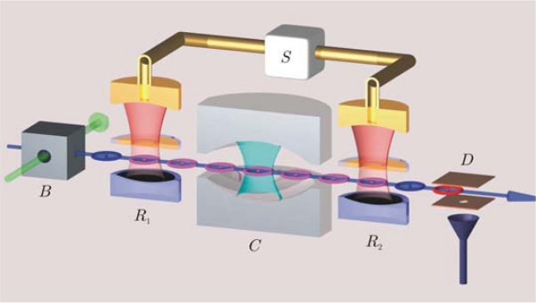
Experiment Haroche
Effusive beam Laser filtering
w. doppler effect: 400m/s
Black Box:
Excitation to circular
Rydberg states
Advanced information: Nobelprize 2012, S. Haroche

Slide 9
Circular States: 53 photons
m = 2 3 4 5 …
n=52
l=51
m=51
5F m=2
❐
n=52 in 2.5 V/cm
n=51
l=50
m=50
5D
250 MHz
⬧
B-field: 18 Gauss
5P
 
5S
Modified from lecture note: S. Haroche: quantumlah.org

Slide 10
Experiment Haroche
$$\left|\left.e\right\rangle \right.$$
detection
$$a\left|\left.g\right\rangle +b\left|\left.e\right\rangle \right.\right.$$
(off) resonant interaction with cavity
Ramsey interferometer: apply single atom pulses
Advanced information: Nobelprize 2012, S. Haroche

Slide 11
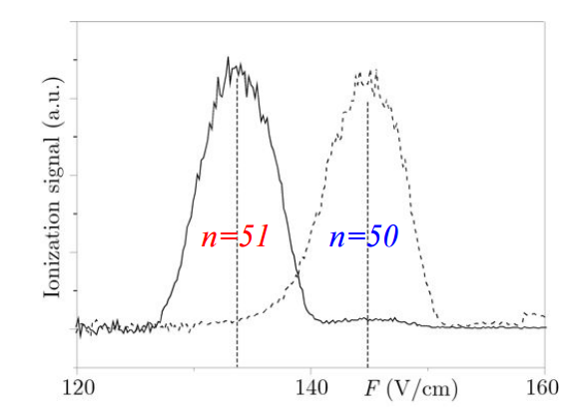
Detection
Ramped field ionization: n⁻⁴
Detecetion efficiency > 50%
From lecture note: S. Haroche: quantumlah.org

Slide 12
Rabi oscillations
$$\left|\left.e\right\rangle \right.$$
Detection: $b\left|\left.g\right\rangle \right.$
$$\left|\left.e\right\rangle \right.$$
$a\left|\left.0,e\right\rangle \right.$+$b\left|\left.1,g\right\rangle \right.$
resonant interaction with cavity
Advanced information: Nobelprize 2012, S. Haroche

Slide 13
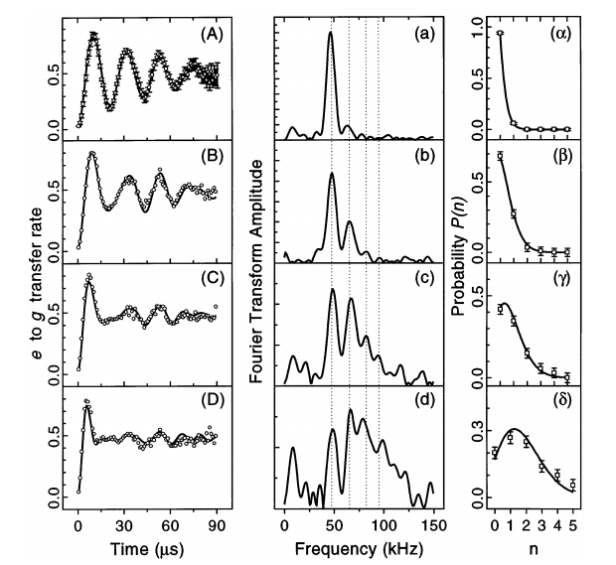
Rabi oscillations – change velocity
PRL 76, 1800 (1996)
Rydberg population
Fourier Transform
Cavity population
Vacuum field
Coherent states

Slide 14
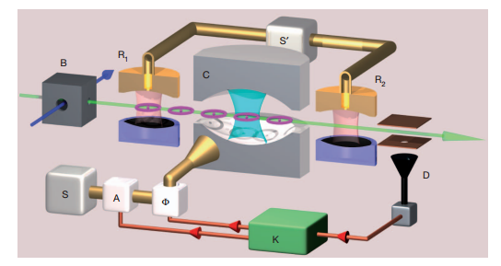
The next step: Quantum feedback
Injects single photons into cavity
Feedback calculation
Nature 477, 73-77 (2011)

Slide 15
The next step: Quantum feedback
offresonant interaction with cavity
$$\left|\left.g\right\rangle +\left|\left.e\right\rangle \right.\right.$$
Detect atomstate
->Infer phase shift
Injects single photons into cavity
Feedback calculation
Nature 477, 73-77 (2011)

Slide 16
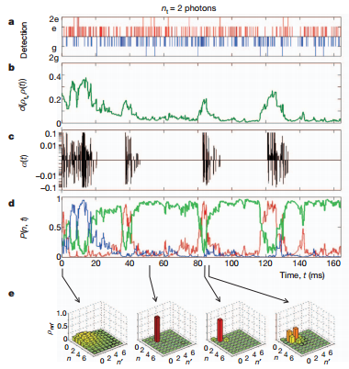
The next step: Quantum feedback
Atom state detection
Mathematic distance to target state
Applied power to
feedback antenna
Probability photon state:
g =target
r= too few
b=too many
Calculated density matrix
Nature 477, 73-77 (2011)

Slide 17
END

Slide 18
ETH physics Rydberg experiment
Creation of a cold supersonic beam of Helium.
Speed: 1700m/s, pulsed: 25Hz, temperature atoms=100mK

Slide 19
ETH physics Rydberg experiment
Excite electrons to the 2s-state, (to overcome very strong binding energy in the xuv range)
by means of a discharge – like a lightning.

Slide 20
ETH physics Rydberg experiment
Actual experiment consists of 5 electrodes. Between the first 2 the atoms
get excited to Rydberg states up to n=inf with a dye laser.

Slide 21
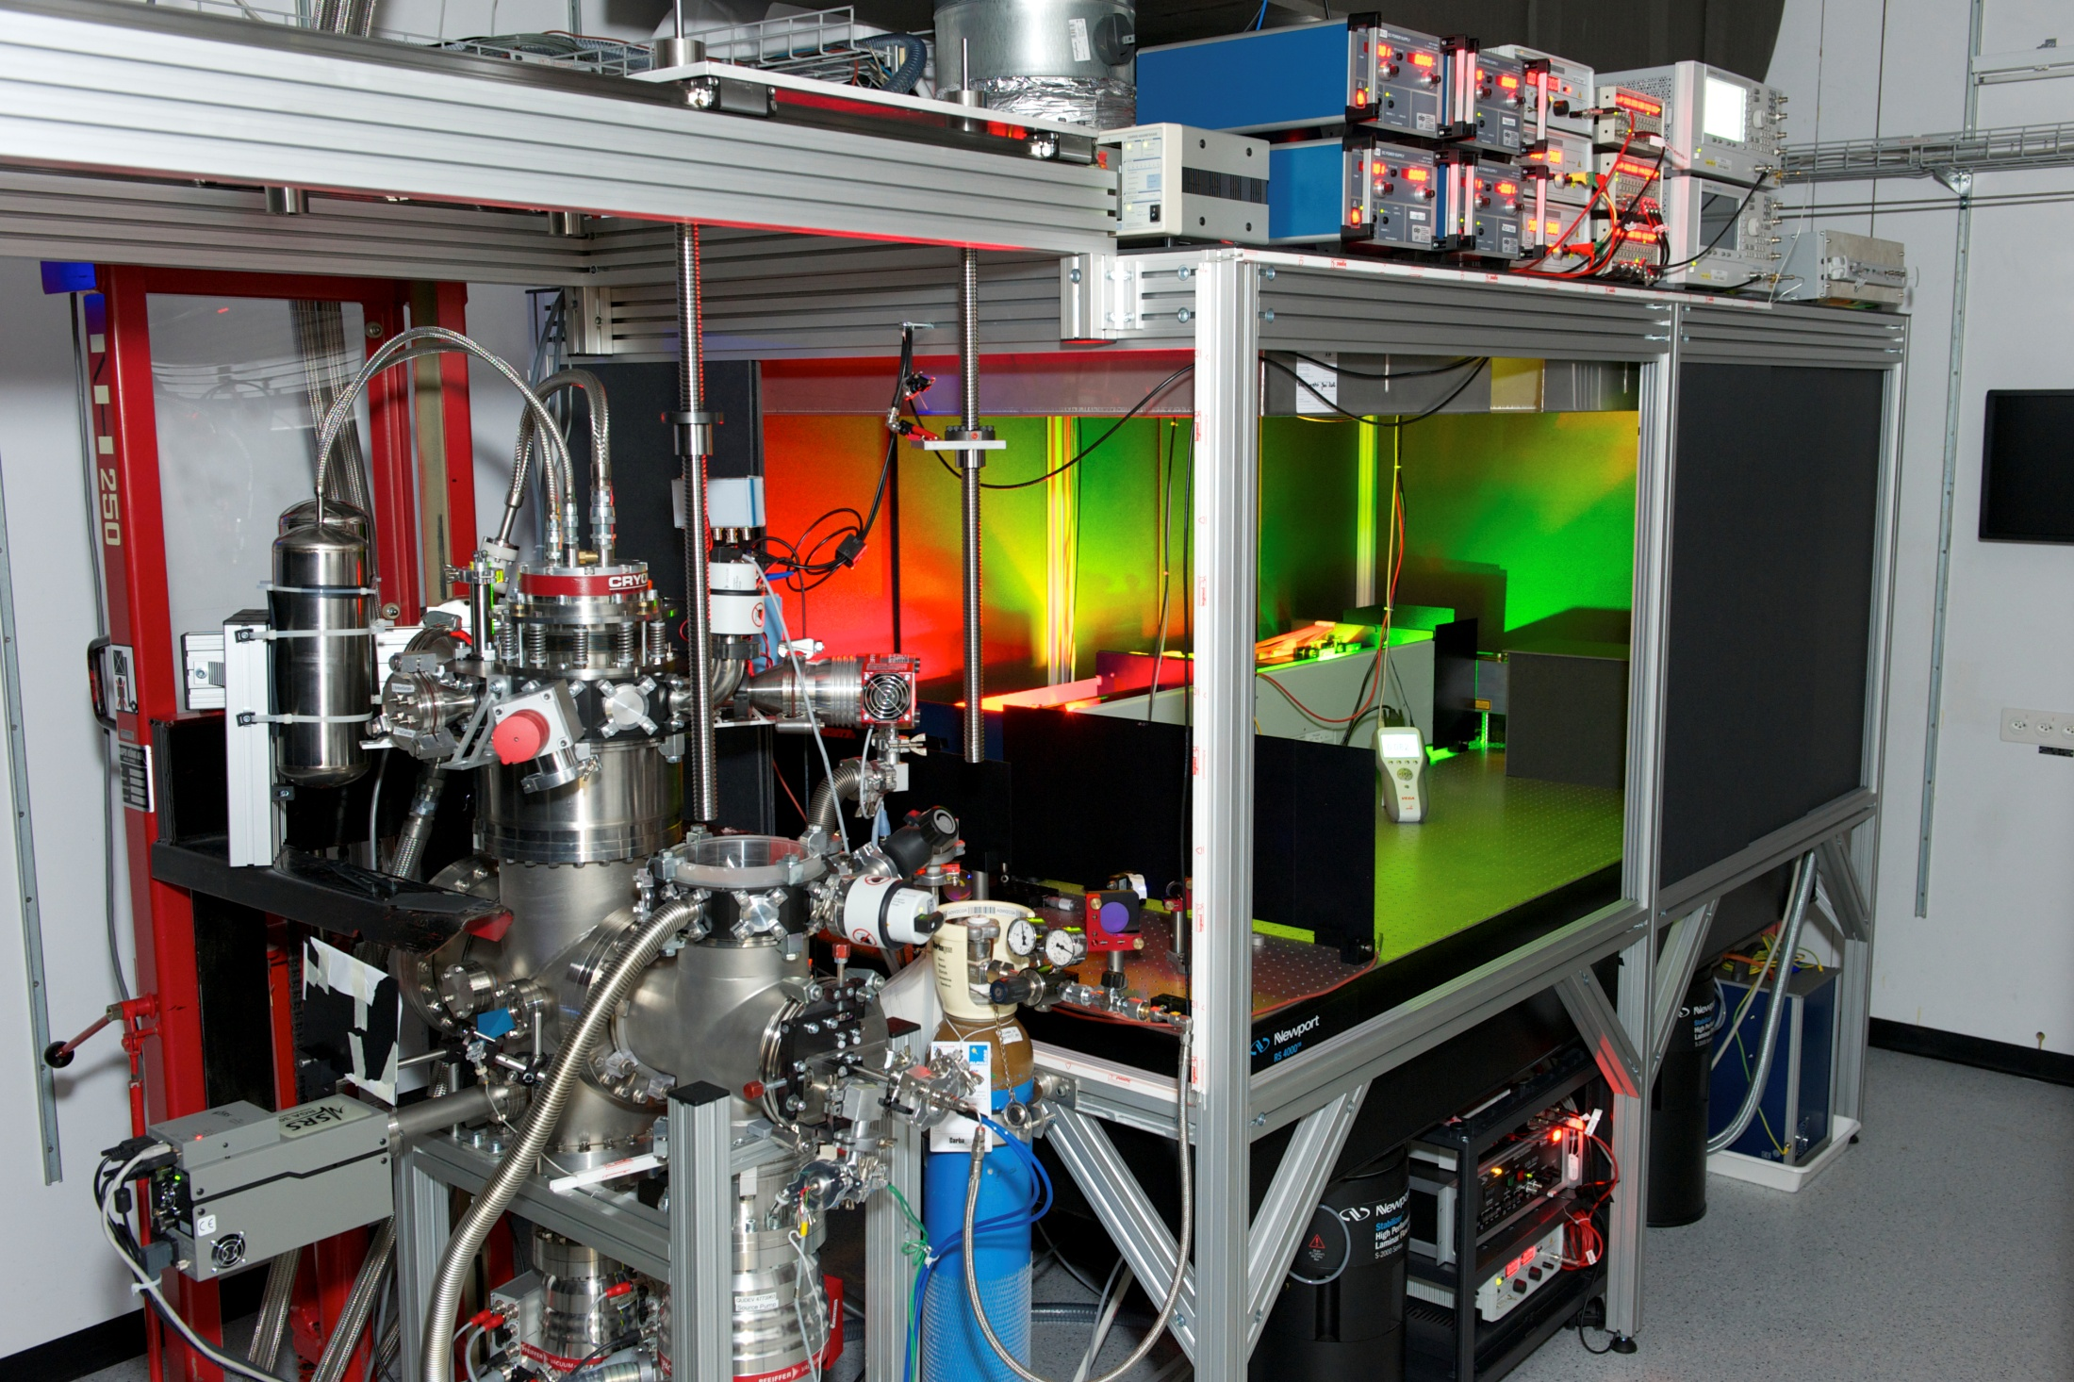
Dye/Yag laser system

Slide 22
Dye/Yag laser system
Experiment

Slide 23
Dye/Yag laser system
Experiment
Nd:Yag laser (600 mJ/pp, 10 ns pulse length, Power -> 10ns of MW!!)
Provides energy for dye laser

Slide 24
Dye/Yag laser system
Dye laser with DCM dye: Dye is excited by Yag and fluoresces. A cavity creates light with 624 nm wavelength. This is then frequency doubled to 312 nm.
Experiment
Nd:Yag laser (600 mJ/pp, 10 ns pulse length, Power -> 10ns of MW!!)
Provides energy for dye laser

Slide 25
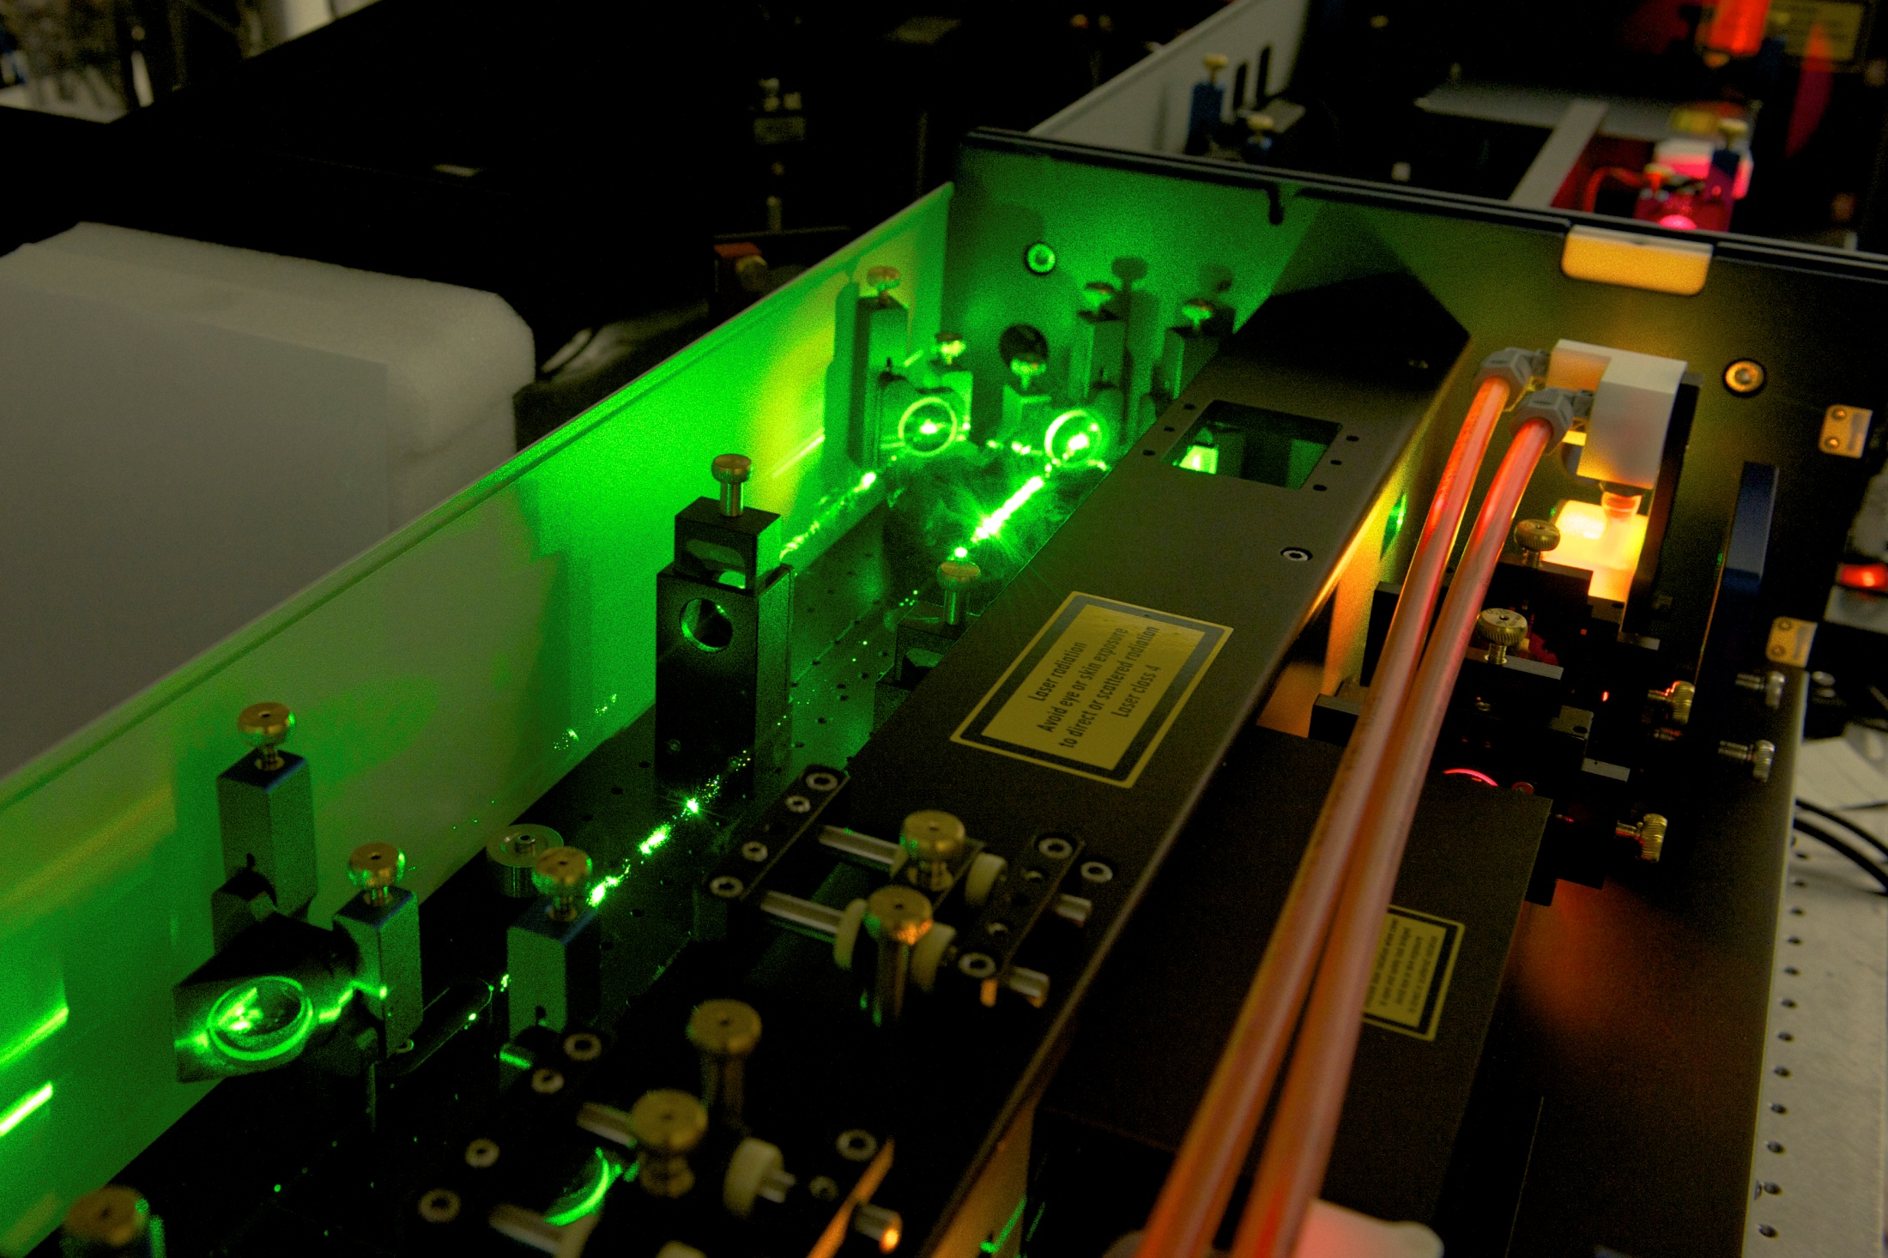
Dye laser
Nd:Yag pump laser
cuvette
Frequency doubling
DCM dye

Slide 26
ETH physics Rydberg experiment
Detection: 1.2 kV/cm electric field applied in 10 ns. Rydberg atoms ionize and electrons are
Detected at the MCP detector (single particle multiplier) .

Slide 27
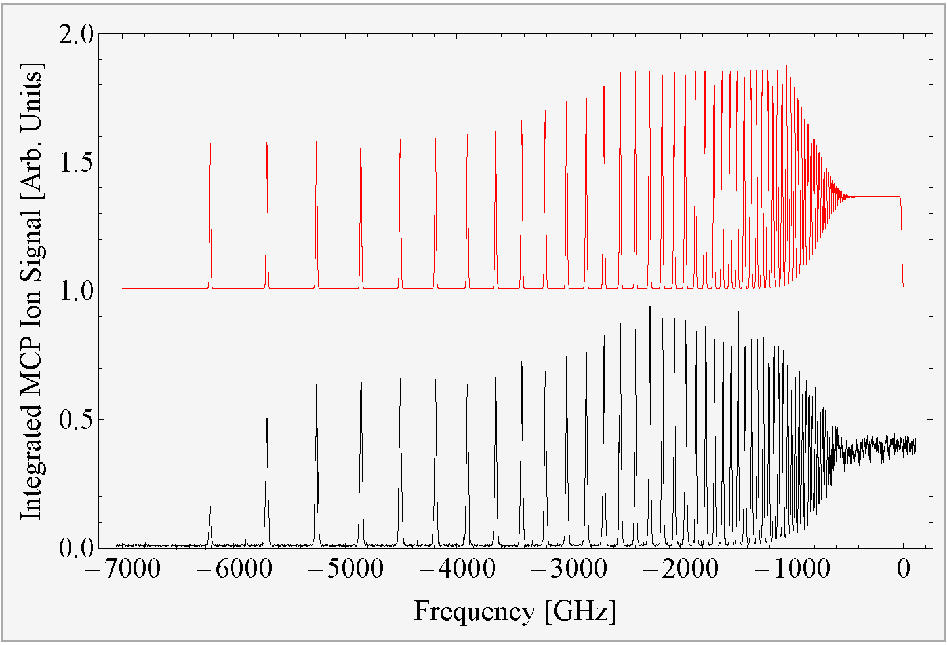
Results TOF 100ns

Slide 28
Results TOF 100ns
Inglis-Teller limit

Slide 29
Results TOF 100ns
Adiabatic Ionization-
rate ~ 70% (fitted)

Slide 30
Results TOF 100ns
Adiabatic Ionization-
rate ~ 70% (fitted)
Pure diabatic Ionization- rate:

Slide 31
Results TOF 100ns
Adiabatic Ionization-
rate ~ 70% (fitted)
Pure diabatic Ionization- rate:
saturation
From ground state

Slide 32
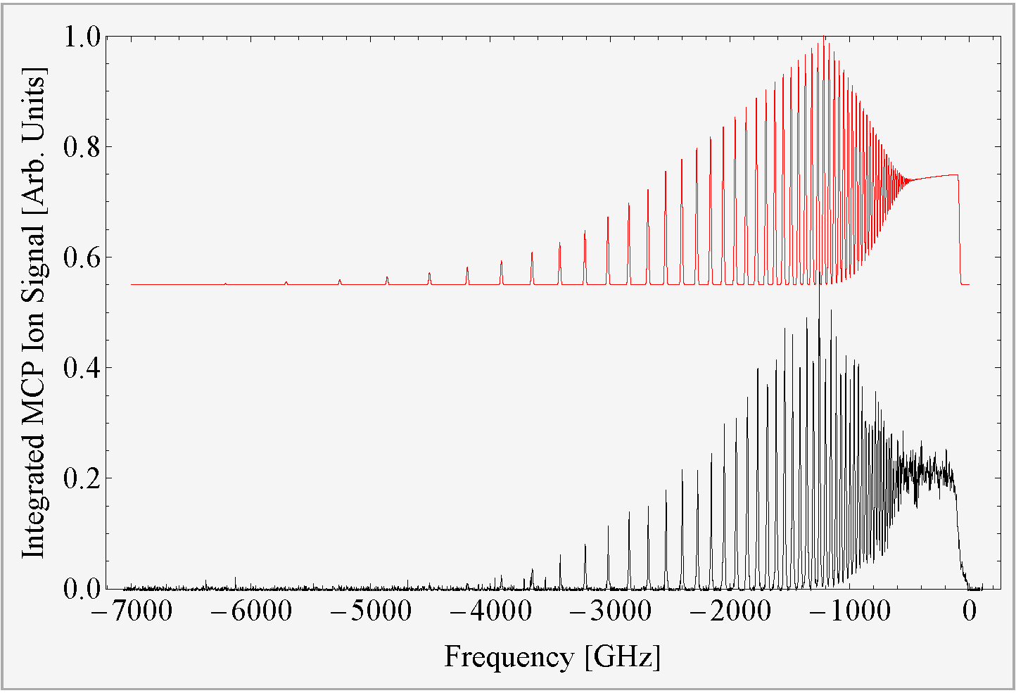
Results TOF 15 μs
From ground state
lifetime

