Slide 1
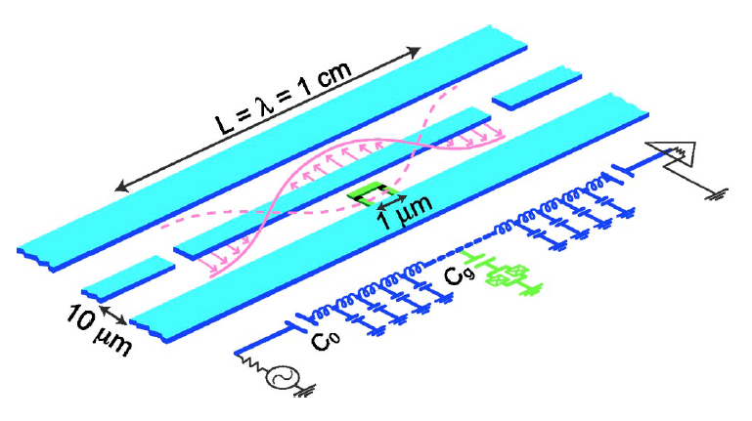
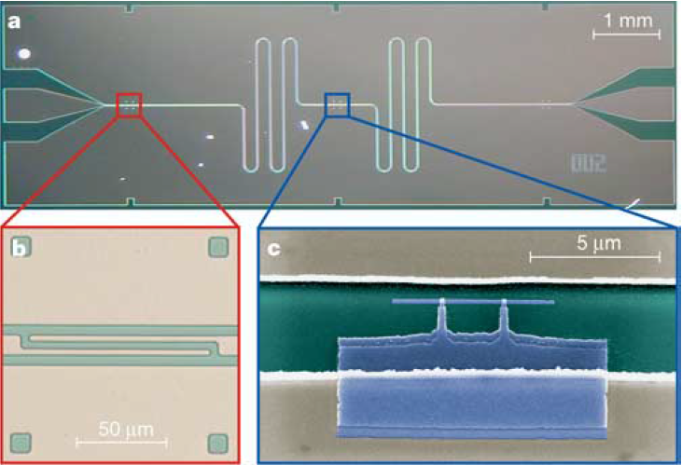
Circuit QED Experiment
Peng Zhou
Zi-Jin Lei

Slide 2
Nature, Vol431, September2004, 162-167

Slide 3
Outline
Motivation: (Peng)
Why Circuit QED?
What is strong coupling and how to testify?
Methods and Difficulties: (Zi-Jin)
Sample fabrication
Measurement techniques
Measurements and Results (Peng)
Summary(both)

Slide 4
Motivation
Highly polarizable artificial atom → large dipole moment
Comparison between dipole of SC and Ryderberg atom
Small size of 1D cavity → large field strength
Strong coupling limit

Slide 5
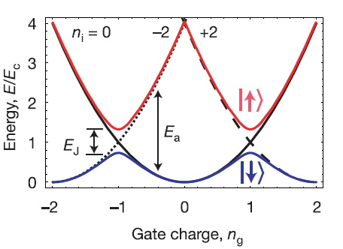
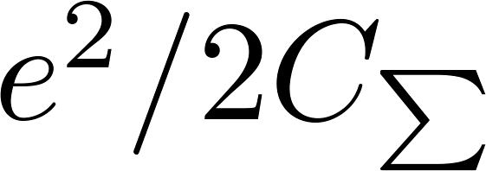
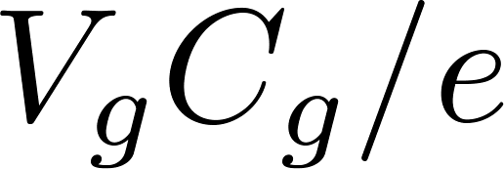
Cooper Pair Box: Qubit Engineering
Artificial atom
Qubit Hamiltonian in basis
Two level system in basis
Band Structure
Tunneling lifts the degeneracy
$$\left.|1\right\rangle$$
fabrication
$$\left.|0\right\rangle$$
$$\left.|−1\right\rangle$$
In situ
In situ
Electrostatic energy in absence of
Josephson tunneling
fabrication
Notes:
Overall scale engineered during fabrication
Further tuned in situ electrically

Slide 6
Strip line resonator
Operating Temperature: ~20mK
Superconducting, no dissipation
Microwave (~6GHz) photon energy larger than thermal photon
1D waveguide
Dissipation
(maybe more properties to be added )

Slide 7
Zi-Jin: Methods and Difficulties
Cavity and CPB fabrication
Measurement techniques
Dilution refrigerator
Sub-in-situ amplifier at 1K
Phase lock-in tech
The realization of single photon

Slide 8
How to fabricate a microwave cavity?
Optical lithography
Silicon Substrate, Niobium film cavity
Quasi one dimensional coplanar cavity
The shape is meandered
To meet the requirements
Si is transparent for microwave, low dissipation, Qint ~ 10 6
Size: d1 = μm, d2 = μm, Ersm = 0.2 V/m
Z = 50 Ω, impendence match to Microwave Components
Tc(Nb) = 9.26K, Tc (Al) = 1.20K, superconducting

Slide 9
How to fabricate a microwave cavity?
Cross section of transm. Line, TEM mode

Slide 10
How to fabricate CPB
Aluminum-oxidation-aluminum structure
Coupling to cavity, connecting to ground
Sub-micrometer size structure: Electron beam lithography
E_{J} is controlled by the depth of oxidation layer
Double angles deposition

Slide 11
How to fabricate CPB
Aluminum-oxidation-aluminum structure
Coupling to cavity, connecting to ground
Sub-micrometer size structure: Electron beam lithography
E_{J} is controlled by the depth of oxidation layer
Double angles deposition

Slide 12
Measurement Technique
Low temperature tech
Sub-in-situ amplification
Microwave technique
Small signal analysis

Slide 13
Dilution Refrigerator

Slide 14
Dilution Refrigerator

Slide 15
Dilution refrigerator

Slide 16
RF amplifier at 1K
No thermal excitation of electron-hole pairs
Mature High Electron Mobility Transistor (HEMT)
Low noise
Luckily, you can buy it!
Cross-sectional STEM image of the gate region in a 130-nm InP, from IEEE ELECTRON DEVICE LETTERS, VOL. 33, NO. 5, MAY 2012

Slide 17
Phase lock-in tech
the orthogonality of sine functions
Collect out the signal even 1000 less than noise

Slide 18
The realization of single photon
To be added

Slide 19
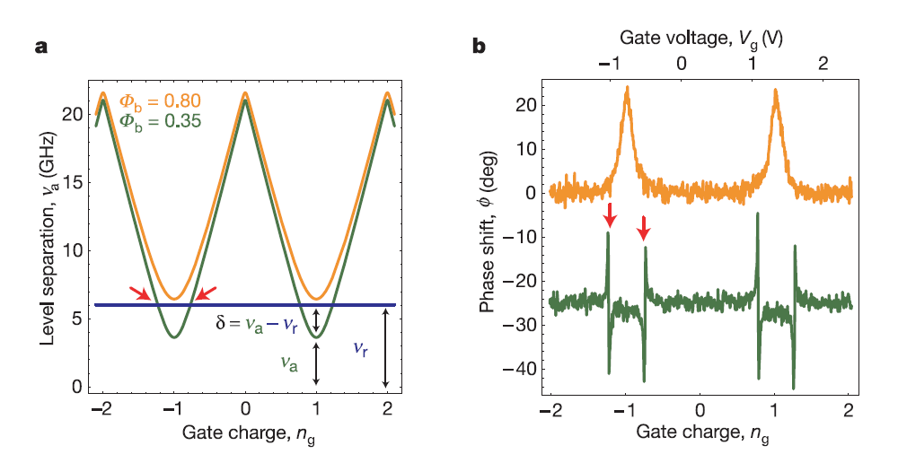
Dispersive Readout: Why Ng = 1?
First order decoupled from 1/f noise
Dispersive is the most sensitive (high SNR)

Slide 20
1/f noise sensitivity
To be added

Slide 21
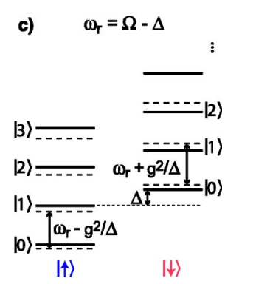
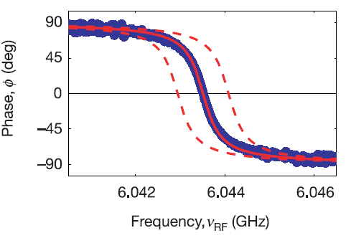
Transmission Power and Phase Spectrum
Probe the resonator system spectroscopically
Far-detuned qubit qubit and resonator are decoupled
Dispersive QND readout at e.g.
Notes:
Question: why shift the experimental data by +- Vr? Is this QND measurement? → yes
Why the peak is not at 6.044GHz. Does that mean the resonator resonance frequency is still shifted?

Slide 22
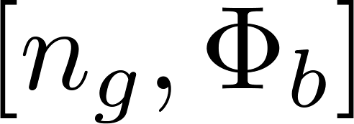
Measurements of phase shift vs.

Slide 23
Measurements of phase shift vs.

Slide 24
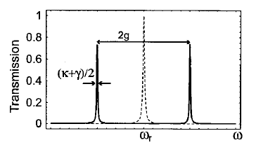
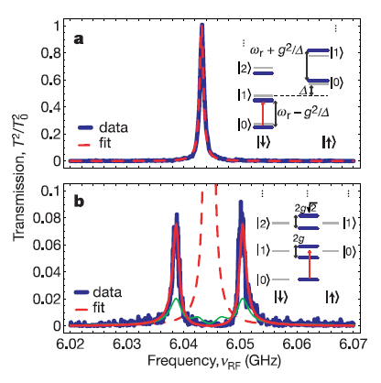
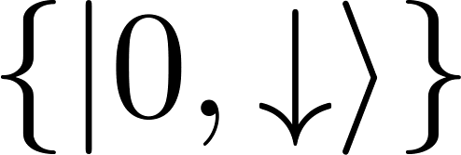
Vacuum Rabi Mode Splitting
Qubit at charge degeneracy
Combined ground state
Weak probe beam
Sensitive to photon number
Evidence for strong coupling
$$n=0.06$$
$$n=0.5$$

Slide 25
Weak Beak: Why and How?
If n too large: maybe excite to large energy values
If n too small: cannot distinguish from thermal noise.
To be added: How?

Slide 26
Vacuum Rabi Mode Splitting (cont'd)

Slide 27
Summary
In situ control of qubit parameter
Transmission measurement
QND readout is possible
Strong coupling regime is achieved

Slide 28
References
[1] Wallraff, Andreas, et al. "Strong coupling of a single photon to a superconducting qubit using circuit quantum electrodynamics." Nature 431.7005 (2004): 162-167.

Slide 29
Appendix: Dilution refrigerator

