Slide 1

Violation of Bell inequalities using photons

Slide 2
Overview
Theoretical Introduction – Bell inequalities
General Experimental Setup
Detailed Setup and technical Difficulties
  The Source – Generation of photons and entanglement
  Detection – Beamsplitters and Photomultipliers
Results
Outlook

Slide 3
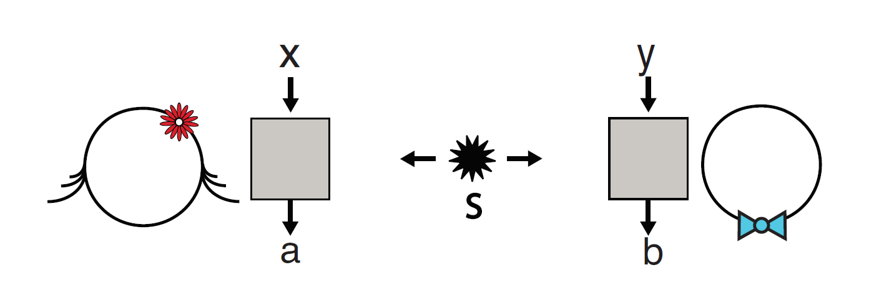
Theoretical Introduction – Bell Inequalities
Brunner et al., 2013, Bell nonlocality

Slide 4
Introduction – What is a Bell Experiment?
Alice
Bob
Brunner et al., 2013, Bell nonlocality
Test of local realistic theories
Notes:
- Measurements at two different locations
- Inputs x,y (correspond to direction of polarization measurement) and outputs a,b (correspond to outcome → aligned or orthogonal)
- Local realistic theory → bounds on certain quantities (Bell inequalities)
- Quantum statistics violate these Bell inequalities

Slide 5
Introduction – Local Realism
Properties of a local realistic theory
  Locality: outcomes of Alice do not depend on inputs of Bob and vice versa
  Reality: value of observables is determined independent of measurement
Properties of quantum mechanics
  Locality: ü
  Reality: û
    Value of observable only manifests itself in (certain) measurement
    Outcomes not completely predetermined
Notes:
Locality condition: outputs of one party don’t depend on inputs of other party
called the non-signaling condition for obvious reasons (Bob could send Alice messages by choosing specific inputs which Alice could distinguish if her outcomes depended on his inputs)
Reality: value of observable is completely predetermined
Moon is there when when one doesn’t look
Reality in QM: only random if measure in different basis!

Slide 6
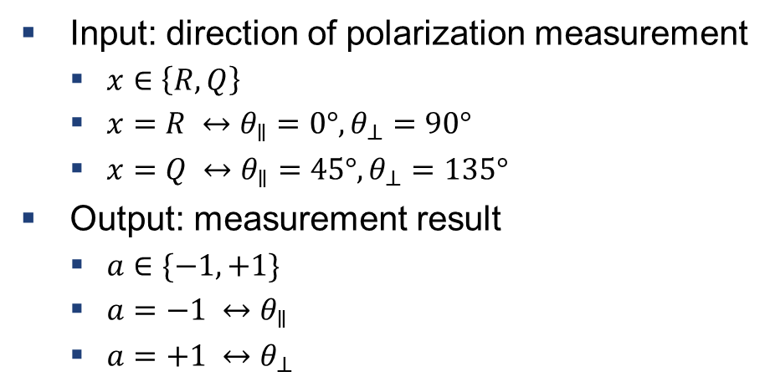
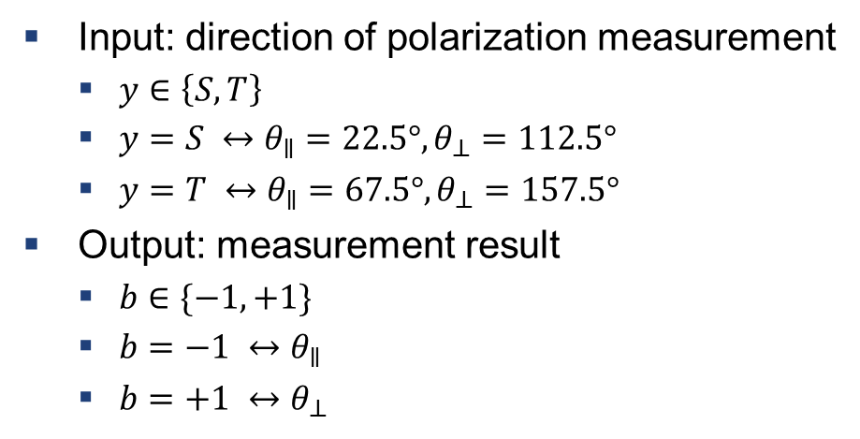
Introduction – the CHSH Inequality
Alice
Bob
Input: direction of polarization measurement
  $x∈\left\{R,Q\right\}$
  $x=R ↔θ_{∥}=0°, θ_{⊥}=90°$
  $x=Q ↔θ_{∥}=45°, θ_{⊥}=135°$
Output: measurement result
  $a∈\{−1,+1\}$
  $a=−1 ↔θ_{∥}$
  $a=+1 ↔θ_{⊥}$
Input: direction of polarization measurement
  $y∈\left\{S,T\right\}$
  $y=S ↔θ_{∥}=22.5°, θ_{⊥}=112.5°$
  $y=T ↔θ_{∥}=67.5°, θ_{⊥}=157.5°$
Output: measurement result
  $b∈\{−1,+1\}$
  $b=−1 ↔θ_{∥}$
  $b=+1 ↔θ_{⊥}$
$S=E\left(QS\right)+E\left(RS\right)+E\left(RT\right)−E\left(QT\right)=2\sqrt{2}>2$
Notes:
Configuration for maximal violation!!
X <-> input
Theta <-> polarization angle
Outcomes: set a/b theta_i when measured theta_i; a=q for x=Q and a=r for x=R
Bell inequality as mentioned in lecture (q<->

Slide 7
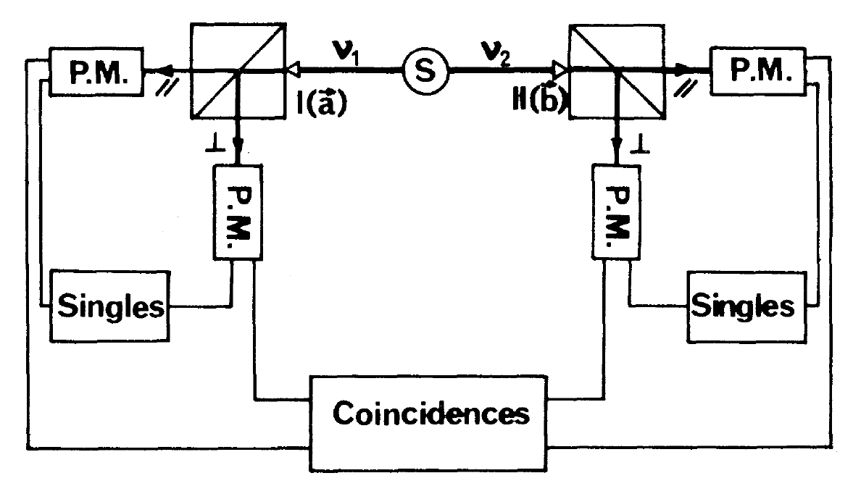
General Experimental Setup
Aspect et al., 1981, Phys. Rev. Lett. 49, 91

Slide 8
General Experimental Setup
Aspect et al., 1981, Phys. Rev. Lett. 49, 91
Notes:
Detailed explanation including problems of several devices in the next part
Source → photons are created, entangled and distributed
Beamsplitter → reflects orthogonal polarization downwards and transmits parallel polarization (separation of polarizations)
Photomultipliers → detect photons
Singles → distinguish real entangled pairs and “failed” pairs (disregard non-entangled pairs) ??exact meaning/purpose??
Coincidences → determine expectation values to evaluate Bell value

Slide 9
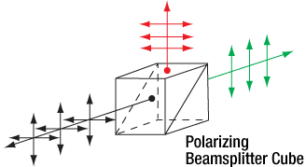
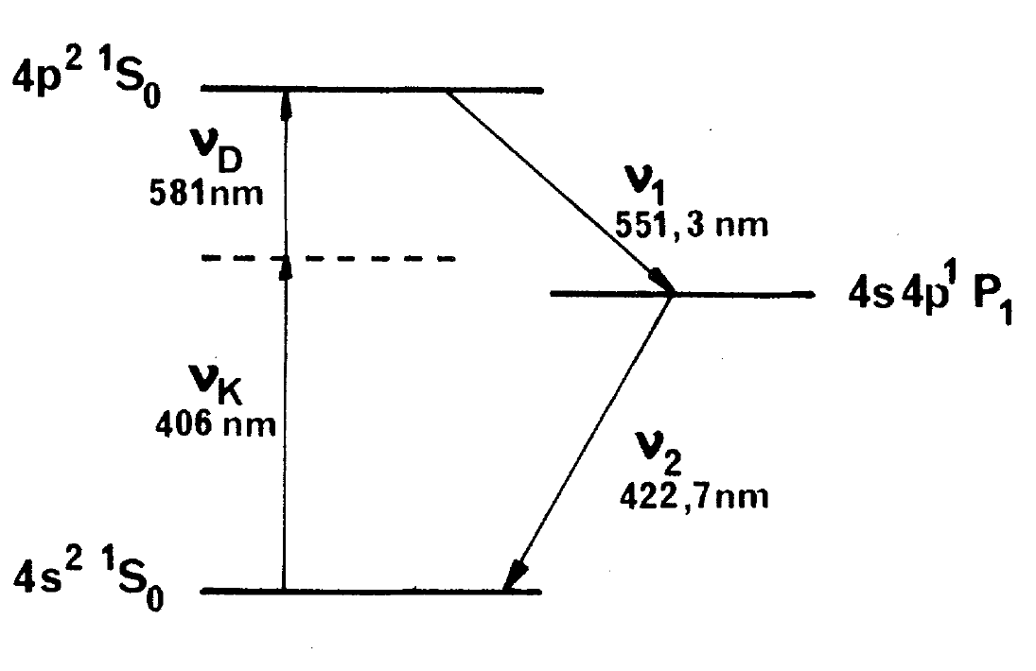
Detailed Setup and Technical Difficulties
Aspect et al., 1981, Phys. Rev. Lett. 47, 460
www.thorlabs.com

Slide 10
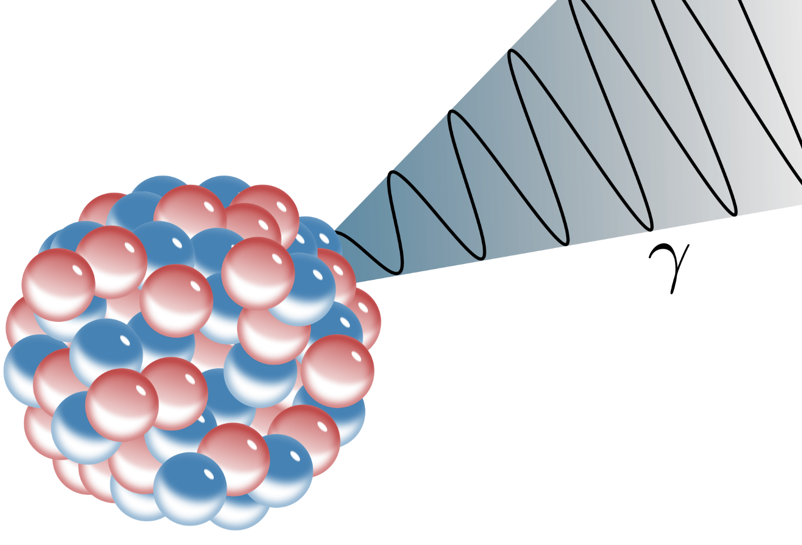
Detailed Setup and Technical Difficulties
www.wikipedia.org
Generation of Photons

Slide 11
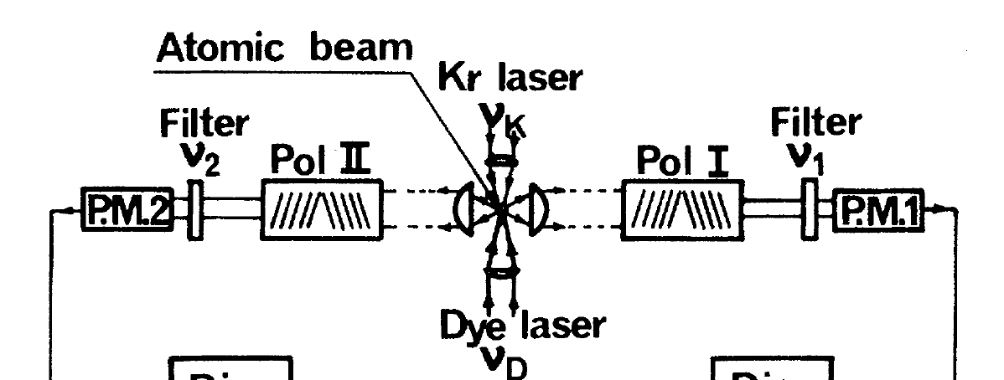
Experimental Setup – Generation of Photons
Energy levels of Calcium
Schematic of photon generation
Photon source
Aspect et al., 1981, Phys. Rev. Lett. 47, 460
Notes:
Use transition in Calcium atom for generation of polarization correlated photons (as depicted on the left)
Excite Ca atom using two separate lasers with frequencies v_K and v_D
Then atom decays and emits two correlated photons of frequencies v_1 and v_2
Experimental setup (in reference to earlier explanation of setup → where is source in setup?)

Slide 12
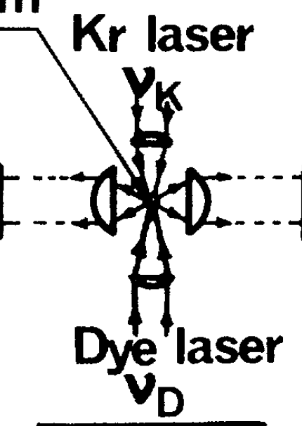
Experimental Setup – Generation of Photons
Schematic of photon generation
Beam of atoms
Two lasers
  Pump atom to upper level
  Two-photon absorption
Optical elements to focus photons
Notes:
Experimental Setup:
Have a beam of atoms (middle of picture)
Two lasers shining on interaction region (roughly a zylinder of 1 mm length and 30µm radius)
Typical emission rate of 4x10^7 per second ??but this is quite a loot, isn’t it??

Slide 13
Experimental Setup – Technical Difficulties
Isotropic emission of photons
Reflection at optical elements
“wrong” photons
Resonance trapping
Notes:
Photons are emitted in every direction → lose photons and have to wait a long time
Use anti reflection coated elements → photons go where they are supposed to
Install wavelength filters after source such that “wrong” photons are absorbed
At high beam densities trapping of resonant light can lead to enhanced lifetimes of the excited state
→ can lead to decrease in correlation → worse bell violation
→ bad for efficiency ??how does this work??

Slide 14
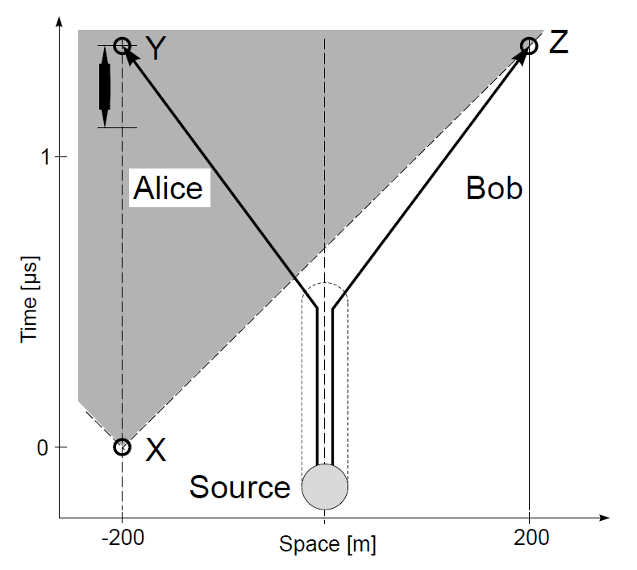
Experimental Setup – Spacelike Separation of Measurements
Enforce locality (in special relativity)
  Space-like separation of measurements
  Detection of Bob’s output outside of lightcone of generation of Alice’s input
  No influence possible
In Experiment
  Separation between measurements (~10² m)
  Fast measurement process (~µs)
Notes:
Assuming special relativity is correct → space like separation equivalent to locality condition (Bob’s meas doesn’t depend on Alice’s input and vice versa)
→ only intrinsic randomness possible (nice for some applications)
Prevent signaling from Alice to Bob (and vice versa) due to special setup; except if superluminal info transport were possible
Explanation of picture
Experiment:
Separation: difficult because of loss in fibers/depolarization (for photons) or general difficulty (e.q. sc gubits) → see later
Fast: need fast generation of “real” random numbers

Slide 15
Detailed Setup and Technical Difficulties
www.thorlabs.com
Measurement and Polarization

Slide 16
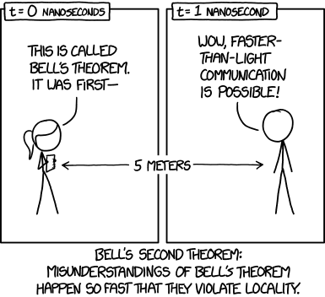
Thank you for your attention.
https://xkcd.com/1591/

Slide 17
Detection
Aspect et al., 1981, Phys. Rev. Lett. 49, 91
Notes:
We have source
Measurement and detection prozess:

Slide 18
Experimental Setup – Detection
Measurement observable:
P±±(a,b): Probability to obtain the result ±1 along a and result ±1 along b
+P––(a,b) –P_{+–}(a,b)–P_{–+}(a,b)
Aspect et al., 1981, Phys. Rev. Lett. 49, 91

Slide 19
Experimental Setup – Detection
+P––(a,b) –P_{+–}(a,b)–P_{–+}(a,b)
Repeat the measurement to get P±±(a,b)
calculate E(a,b)
Aspect et al., 1981, Phys. Rev. Lett. 49, 91
Do this for all combinations of (a,a‘), (b,b‘)
calculate S
Notes:
Measuring with respect to basis a like explained before, +1 for parallel, -1 for perpendicular

Slide 20
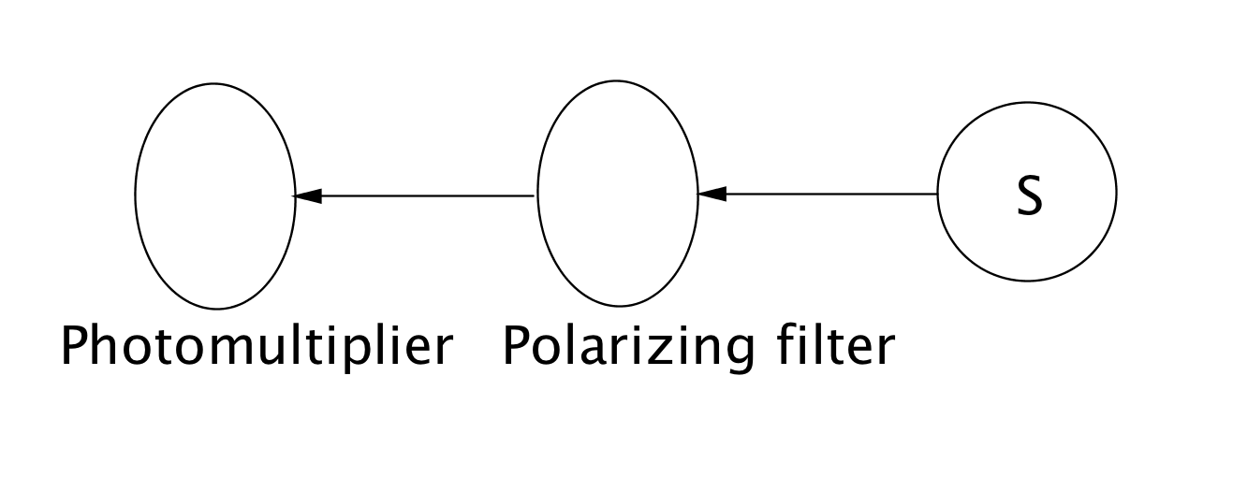
Experimental Setup – Detection
How are the measurements performed?
First attempts:
Aspect et al., 1981, Phys. Rev. Lett. 49, 91
Click: +1
No click: -1
Problem: not every photon is detected

Slide 21
Experimental Setup – Detection
Improvement:
Use a polarizing beamsplitter
Aspect et al., 1981, Phys. Rev. Lett. 49, 91
Notes:
Click of through: +1
Click of reflected: -1
Calculate coincidate rates direktly -> E(a,b) -> S
Poarization by reflection, brewster angle
Birefingent material

Slide 22
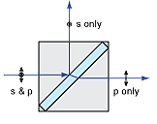
Experimental Setup – Detection
Polarizing Beamsplitter
Thin film polarizer
Faces are antirefelction coated
Photons polarized in the incident plane are transmitted, orthogonal polarization is reflected
T|| and R are close to 1, T and R|| are close to 0
Mounted in a rotating mechanism to change the measurement basis
www.semrock.com
Notes:
2 prisms stuck together with a suitable thin film inbetween

Slide 23
Experimental Setup – Detection
Photomultiplier:
Only a small subset of the emitted photons are detected
Fair sampling assumption:
Sample of detected pairs is representative for the emitted pairs.
But this assumption could be wrong
Detection loophole
Notes:
Low detection rates, because of low quantum efficiency
Wavelength filters before detectors

Slide 24
Experimental Setup – Detection
Coincidence window: 20 ns
Large compared to lifetime all true coincidences are measured
Accidental coincidence rates are infered by the single rates
R_{true}=R_{tot}–R_{acc}
Aspect et al., 1981, Phys. Rev. Lett. 49, 91
Notes:
Check if two events correspond to each other -> coincidence window
Large compared to intermediate state of the cascade 5ns
Actual values 0- 40 s^-1, accidental rates 10 s^-1

Slide 25
Results
Aspect et al., 1981, Phys. Rev. Lett. 49, 91

Slide 26
Results
Measured value: S_{exp}=2.697±0.015 strong violation of Bell‘s inequalities
QM-theoretical value: S_{QM}=2.70±0.05 because of a fidelity of 0.984
No auxiliary measurements are necessary
Non-locality loophole was ruled out by G. Weihs, T. Jennewein, C. Simon et al.
Detection loophole is still open
Aspect et al., 1981, Phys. Rev. Lett. 49, 91
Notes:
Doted line: theory

Slide 27
Outlook
Detection loophole was closed in other experiments:
D. N. Matsukevich, P. Maunz, D. L Moehring. et al. showed the violation of Bell‘s inequality with two remote atomic qubits
M. Ansmann, H. Wang, R. C. Bialczak et al. Showed the violation of Bell‘s inequality in Josephson phase qubits
Both experiments did not rule out the non-locality loophole
B. Hensen et al. reported a loophole free Bell violation using electron spins separated by 1.3 km

Slide 28
References
A. Aspect, P. Grangier, G. Roger et al., Phys. Rev. Lett. 49, 91 (1982)
G. Weihs, T. Jennewein, C. Simon et al., Phys. Rev. Lett. 81, 5039 (1998)
D. N. Matsukevich, P. Maunz, D. L Moehring. et al., Phys. Rev. Lett. 100, 150404 (2008)
M. Ansmann, H. Wang, R. C. Bialczak et al., Nature 461, 504 (2009)
B. Hensen et al., Nature 526, 682–686 (29 October 2015)

