Slide 1
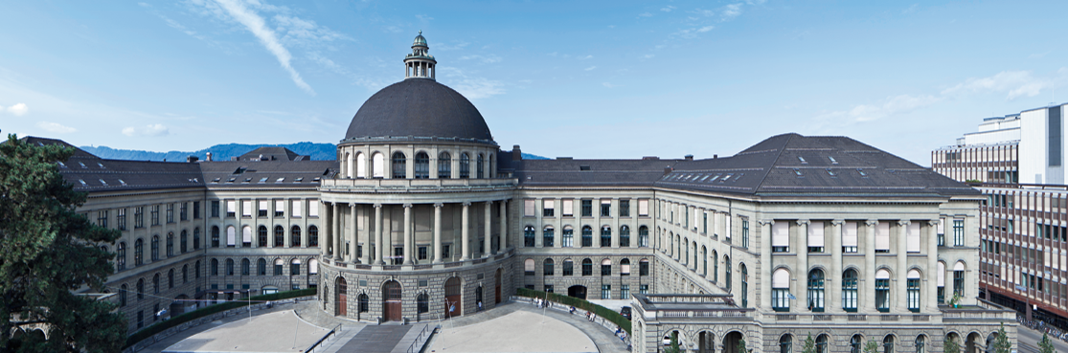
The Transmon qubit
Katharina Schneider, Robin Oswald
Notes:
problem with cooper pair box: coherence time not long enough
new qubit design
transmon achieves coherence times of 100 us

Slide 2
Outline
The Cooper pair box
  revision
  working regimes
The transmon qubit
  charge dispersion and anharmonicity
  tunability

Slide 3
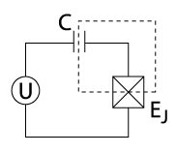
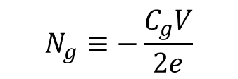




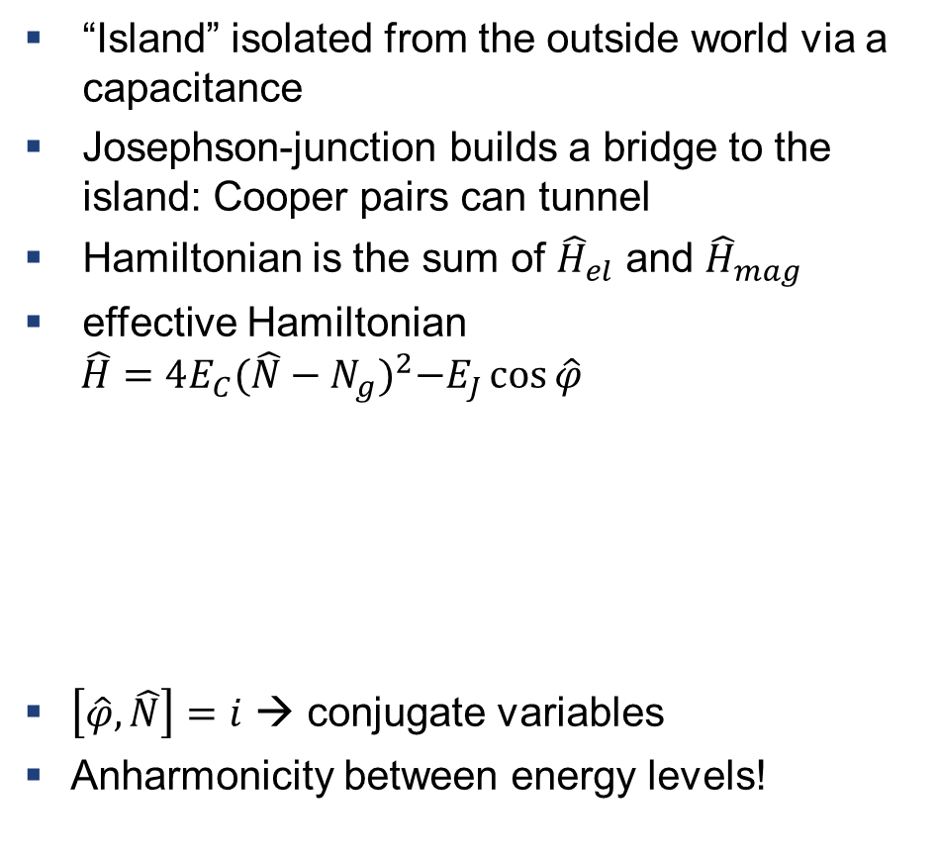

The Cooper pair box - revision
$$C_{g}$$
“Island” isolated from the outside world via a capacitance
Josephson-junction builds a bridge to the island: Cooper pairs can tunnel
Hamiltonian is the sum of ${\hat{H}}_{el}$ and ${\hat{H}}_{mag}$
effective Hamiltonian
$$\hat{H}=4E_{C}{(\hat{N}−N_{g})}^{2}−E_{J}\cos{\hat{φ}}$$
$\left[\hat{φ},\hat{N}\right]=i$ → conjugate variables
Anharmonicity between energy levels!
$$V$$
$$Φ$$
$$E_{J}$$
number of cooper pairs on the island
number of capacitor charges
$$\hat{φ}=\frac{2e\hat{Φ}}{ℏ}$$
$$N_{g}≡−\frac{C_{g}V}{2e}$$
Notes:
equivalent circuit of a Cooper-pair box
explain Ej, Voltage, flux, capacitance
cross denotes the josephson junction
The Hamiltonian is as it was before a sum of the total energy being stored in the electric and magnetic fields in the circuit elements
Coulomb energy to transfer a Cooper pair is four times larger than for a single electron
ˆn has integer eigenvalues, while ng is a continuous variable,
Ng in units of cooper pairs -→ 0.5 means a change of one electron
The parameter EJ is called the Josephson coupling energy and is a measure of the ability of Cooper pairs to tunnel through the junction.
qubit spectrum is periodic in the offset charge ng with unit period

Slide 4
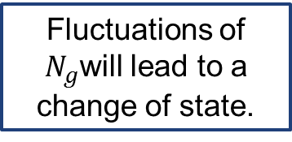



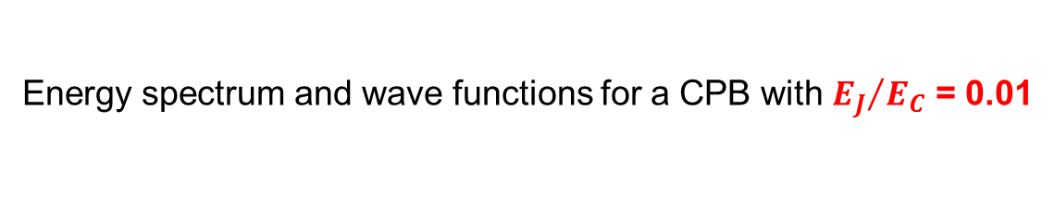

The Cooper pair box – working regimes
Energy spectrum and wave functions for a CPB with ${E_{J}}/{E_{C}}$ = 0.01
$$\hat{H}=4E_{C}{(\hat{N}−N_{g})}^{2}−E_{J}\cos{\hat{φ}}$$
$$φ$$
$$φ$$
$$φ$$
$$φ$$
Fluctuations of $N_{g}$will lead to a change of state.
charge states
coherent superposition
Notes:
Ej is so small, that the splitting is barely visible

Slide 5
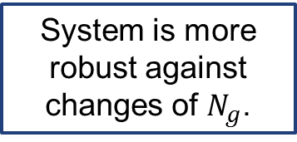

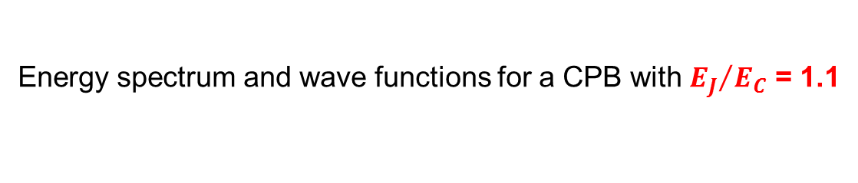
The Cooper pair box – working regimes
Energy spectrum and wave functions for a CPB with ${E_{J}}/{E_{C}}$ = 1.1
$$φ$$
$$φ$$
$$φ$$
$$φ$$
System is more robust against changes of $N_{g}$.
Notes:
When the levels are flat it becomes much more dificullt for these fluctuations to cause overlap and therefore one can with greater certainty determine the level of the system.

Slide 6
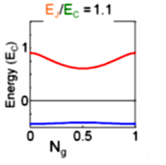
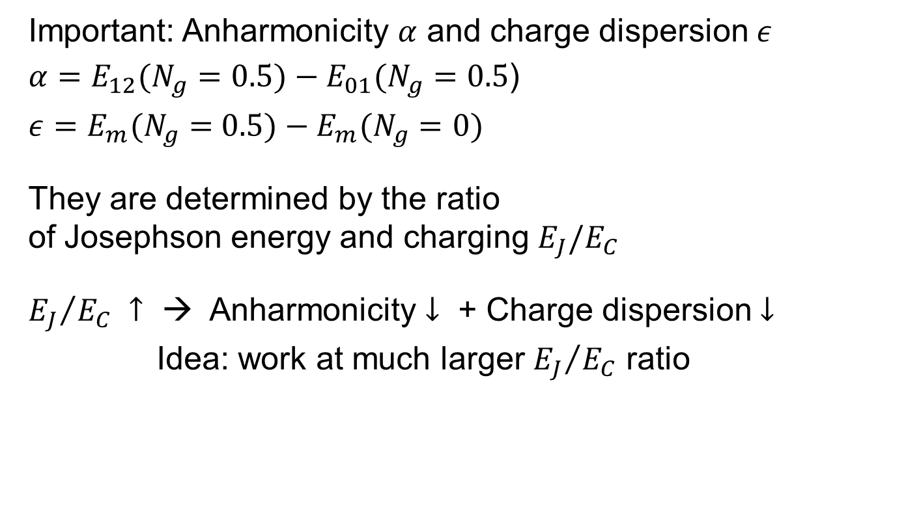

The Transmon qubit
- a Cooper pair box with $E_{J}$>>$E_{C}$
Important: Anharmonicity $α$ and charge dispersion $ε$
$α=E_{12}(N_{g}=0.5)−E_{01}(N_{g}=0.5$)
$ε=E_{m}(N_{g}=0.5)−E_{m}(N_{g}=0)$
They are determined by the ratio
of Josephson energy and charging $E_{J}/E_{C}$
${E_{J}}/{E_{C}} ↑$ → Anharmonicity $↓$ + Charge dispersion $↓$
Idea: work at much larger ${E_{J}}/{E_{C}}$ ratio
→ Transmon qubit

Slide 7
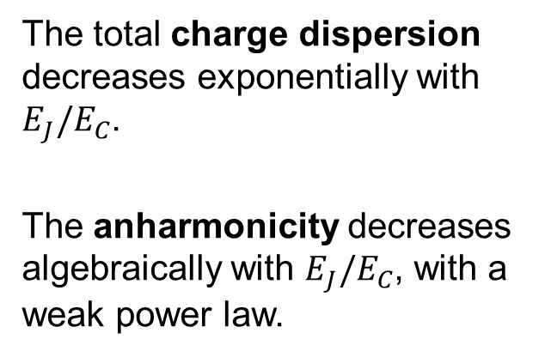
Working regime of the transmon qubit
The total charge dispersion decreases exponentially with $E_{J}/E_{C}$.
The anharmonicity decreases algebraically with $E_{J}/E_{C}$, with a weak power law.
Koch et al., “Charge-insensitive qubit design derived from the Cooper pair box”, Phys. Rev. A 76, 042319 (2007)
Notes:
When the levels are flat it becomes much more dificullt for these fluctuations to cause overlap and therefore one can with greater certainty determine
the level of the system.
Where are the transmons operated?

Slide 8
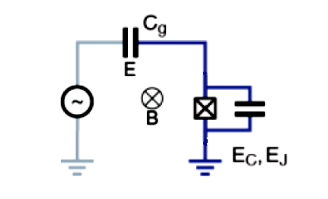
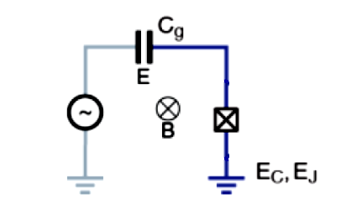





Tuning of the Junction
Relevant Parameters:
Gate charges $N_{g}$
controllable by external voltage
AC drive line instead of DC charge line
Charging energy $E_{C}$
$E_{C}=\frac{e^{2}}{2C_{tot}}$ $C_{tot}=C_{B}+C_{g}+C_{J}$
Josephson energy $E_{J}$
can be changed by engineering
→ instead change $\hat{φ}$
$${\hat{H}}_{mag}=−E_{J}\cos{\hat{φ}}=−E_{J}\cos\left(2π\frac{Φ_{ext}}{Φ_{0}}\right)$$
magnetic flux through two Josephson Junctions
V
$$Φ$$
$$V$$
$$C_{B}$$
$$C_{B}$$
Notes:
Ec is the charging energy associated with the transfer of a single electron to be
Without influencing the relative dynamics of our qubit, we may simply add more capacitors in parallel with Josephson Junction.
- The critical current is directly proportional to the ease at which Coop-pairs can tunnel through the junction. Therefore, this value can be controlled in fabrication by the surface area and the thickness of the tunnel. The larger the surface area, and the thinner the insulting layer, the larger the critical current can be
phase difference is dependent on the magnetic flux through the junction which is in principle a real time quantity we could adjust by applying an external magnetic field
the necessary magnetic fields required to have an effect on a single junction are much larger than is practical
two Josephson Junctions in parallel effectively change the dependence of the cosine term in the Josephson energy from the magnetic flux through the individual junction, to the magnetic ux of the loop of the junctions. Since the loop has a
much larger area than the individual junctions, the necessary magnetic eld is much smaller.

Slide 9
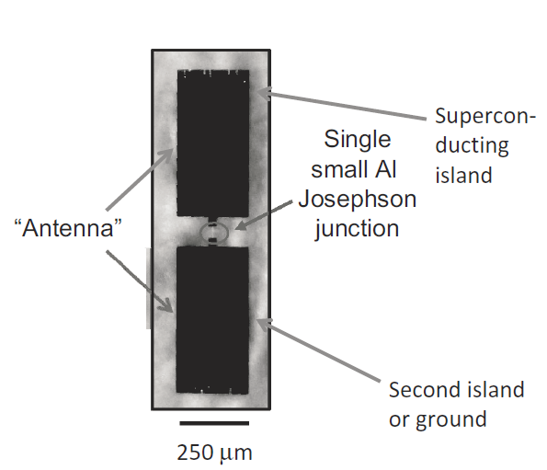
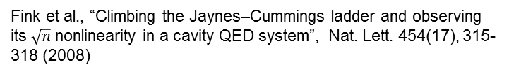
Summary
Cooper-Pair Box qubit
Transmon qubit
Fink et al., “Climbing the Jaynes–Cummings ladder and observing
its $\sqrt{n}$ nonlinearity in a cavity QED system”, Nat. Lett. 454(17), 315-318 (2008)
Thanks for your attention !
Next: Robin Oswald, Circuit QED for the Transmon
Cooper pair box qubit from R. Schoelkopf’s laboratory.
Found in S.M.Girvin, “Cicuit QED: superconducting qubits coupled to microwave photons” Lecture Notes LesHouches 2011
Notes:
transmon of Prof. Wallraffs group

Slide 10
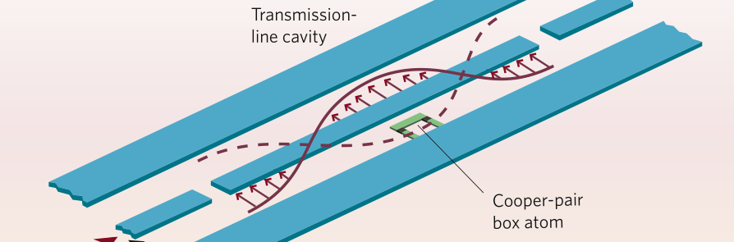
Circuit QED
with the Transmon Qubit

Slide 11
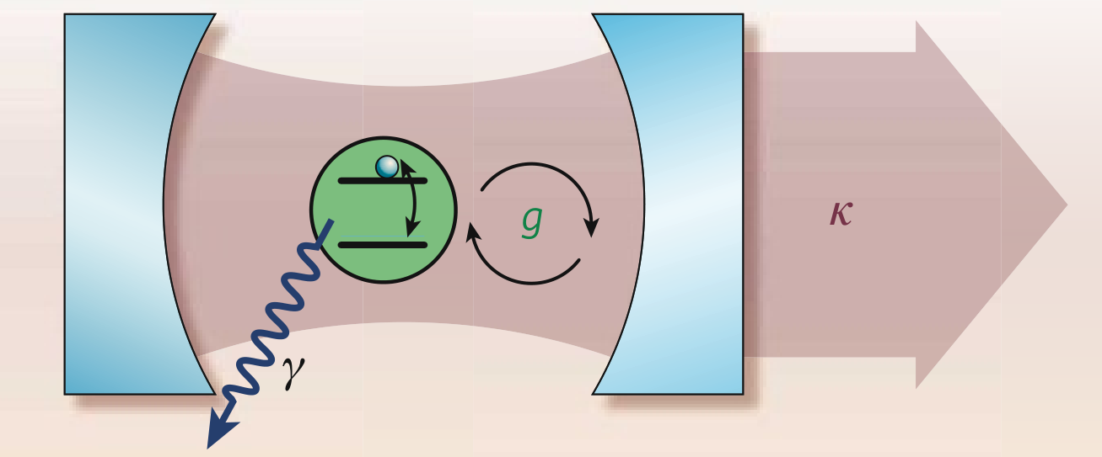
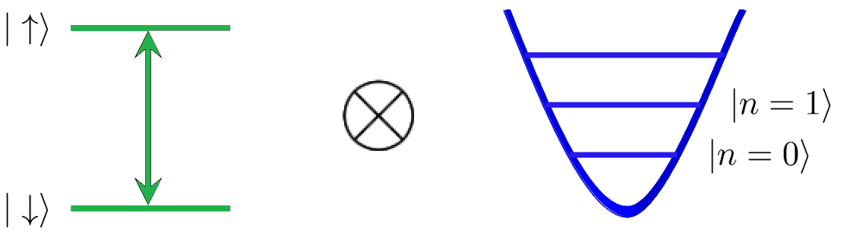
Outline
[Schoelkopf & Girvin, 2008]
Notes:
Quantum optics, cavity QED: Light + Atom (e.g. two level system)
E.g. two level system + H.O. <> couple the two simplest systems together
Goal:
Derive equivalent to cavity QED for transmon -> circuit QED

Slide 12
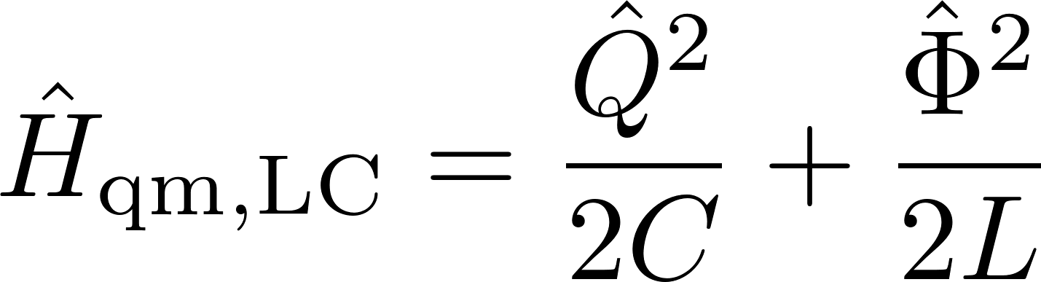
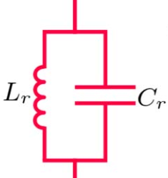
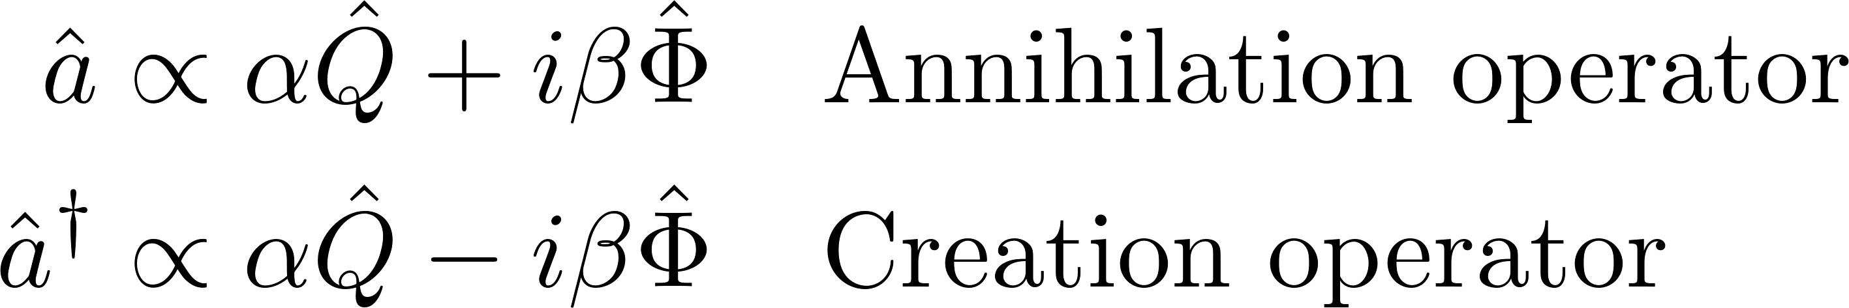
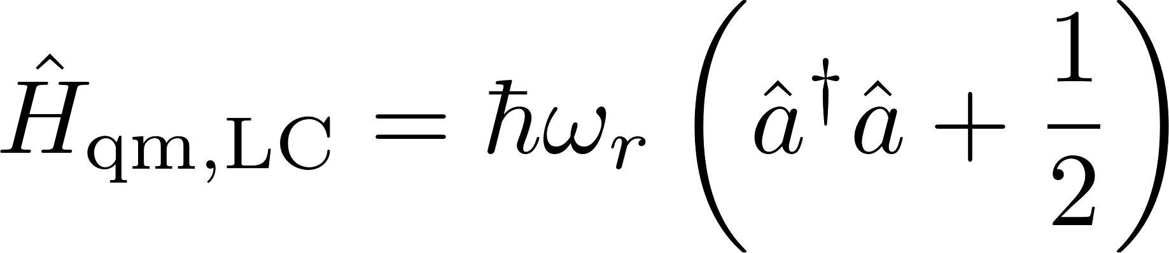
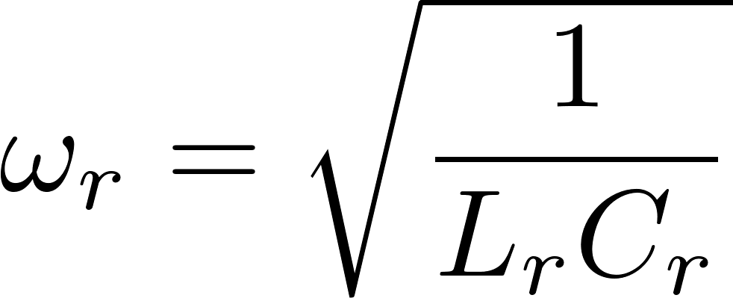
Cavity: Quantum LC Oscillator
Notes:
Atom: Transmon, derived by Katharina
Cavity: LC-Oscillator
Normal harmonic oscillator
Instead of momentum and position we have charge & flux
Define operators, etc.
Get identical Hamiltonian

Slide 13
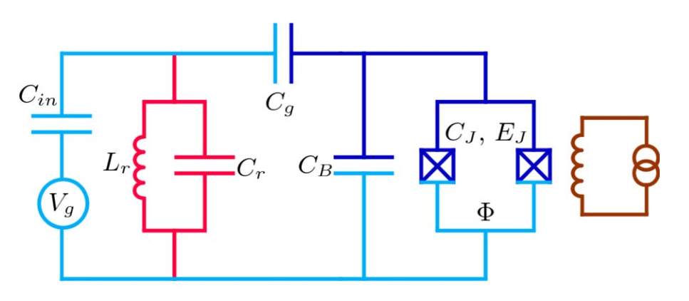
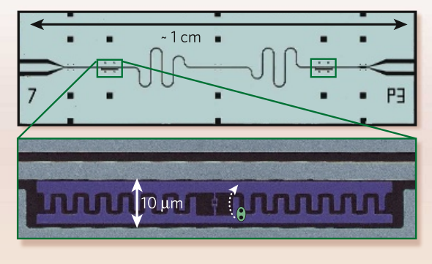
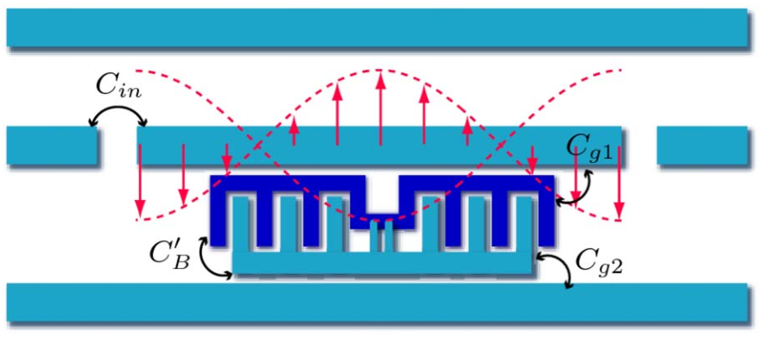
Experimental Setup
Physical realization:
[Schoelkopf, Girvin, 2008]
[Koch et al., 2007]
Notes:
Start with CPB
External magnetic field to tune EJ
CB to tone EC into oblivion
Cg to set ng, couple to cavity
Ci: input “mirror”
Transmission line:
Distributed element, but described as lumped element
Several modes, but couple only to one

Slide 14
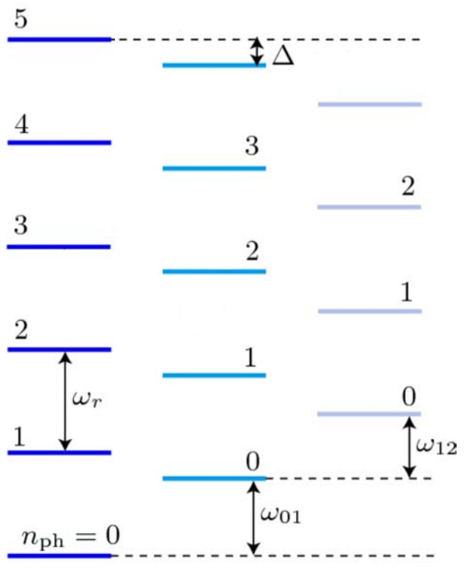
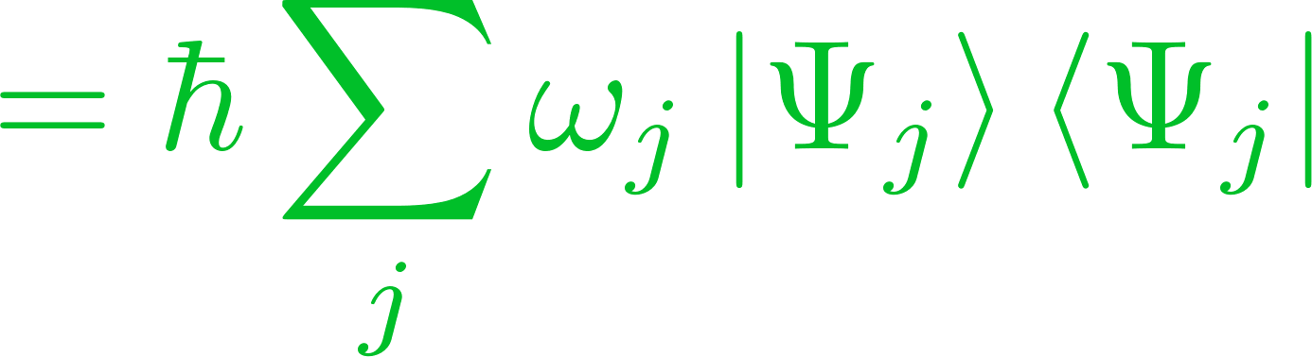
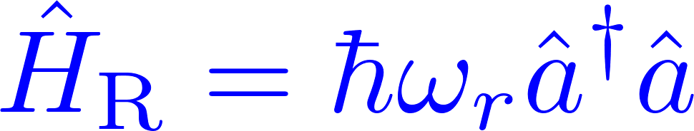
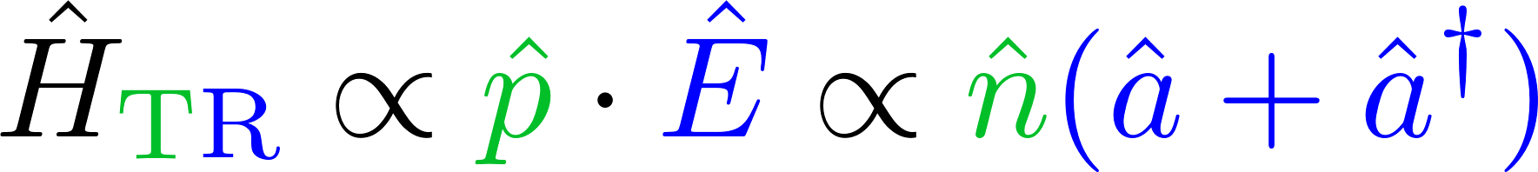
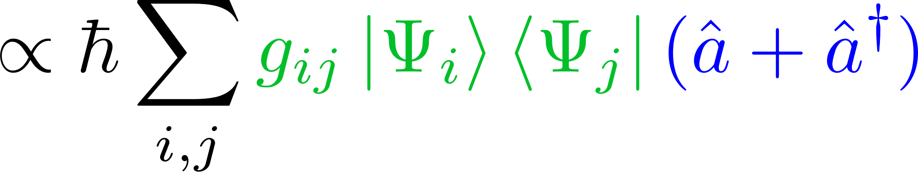
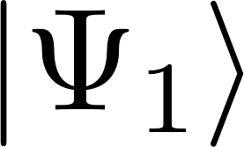
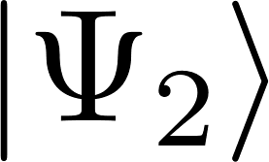
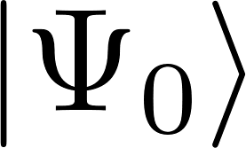
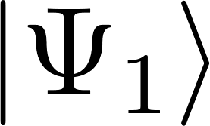
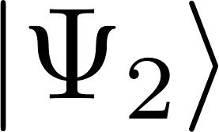
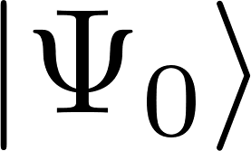
Cavity QED Hamiltonian
Notes:
Beware: nhat not number operator, but cooper pair operator

Slide 15
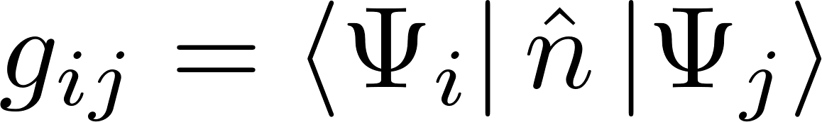
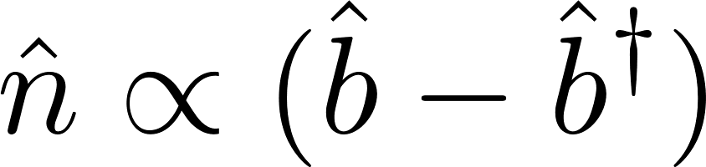
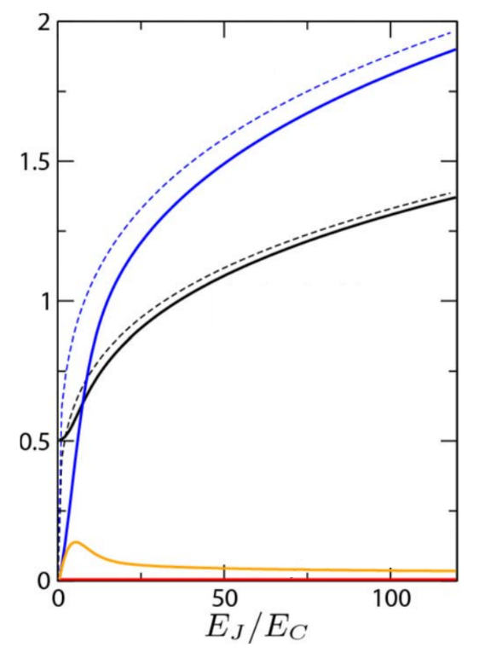
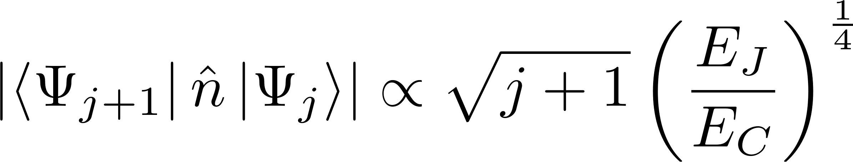
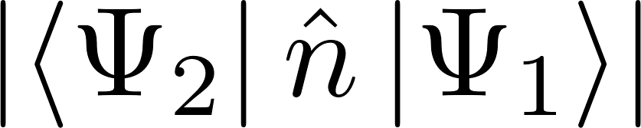
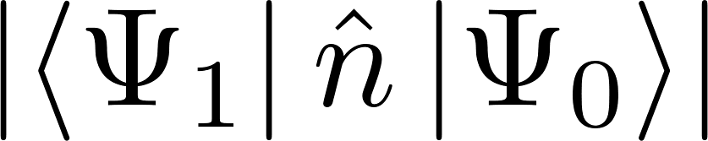
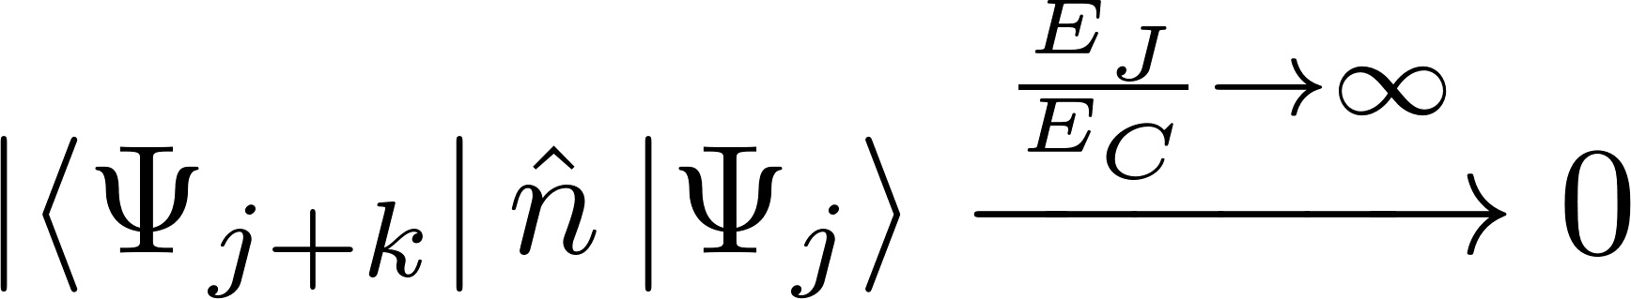
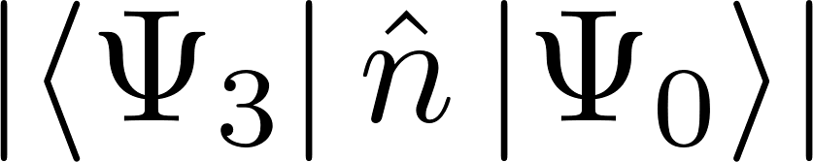
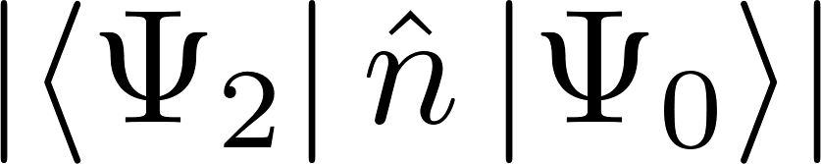
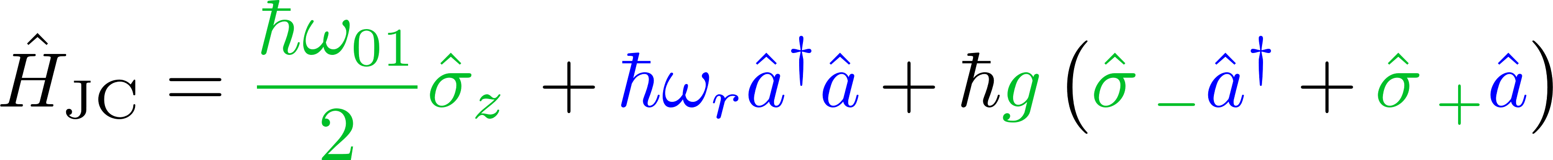
Cavity QED Hamiltonian
[Koch et al., 2007]
Notes:
Coupling: Original energy levels are somewhat perturbed up // down
Simpler to look at this in JC regime, thus neglecting

Slide 16

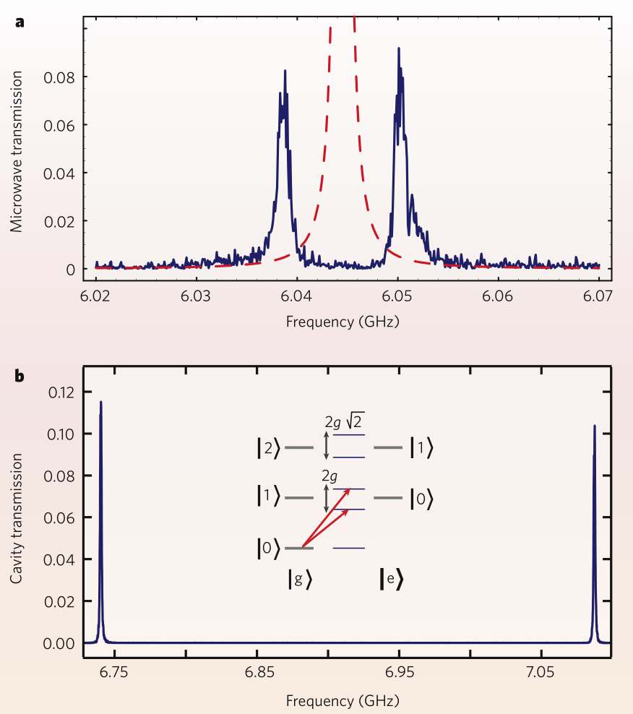



Resonant limit
Example: Vacuum Rabi splitting
[Wallraff et al., 2004]
[Schoelkopf & Girvin, 2008]
Notes:
Drive at qubit freq ->
Drive at cavity freq ->

Slide 17





Dispersive limit
Application: Qubit readout
Notes:
Drive at qubit freq ->
Drive at cavity freq ->

Slide 18
Summary
[Schoelkopf & Girvin, 2008]
Notes:
Quantum optics, cavity QED: Light + Atom (e.g. two level system)
E.g. two level system + H.O. <> couple the two simplest systems together
Goal:
Derive equivalent to cavity QED for transmon -> circuit QED

Slide 19
References
Koch et al., Charge-insensitive qubit design derived from the Cooper pair box, Phys. Rev. A 76, 042319 (2007)
Wallraff et al., Strong coupling of a single photon to a superconducting qubit using circuit quantum electrodynamics, Nature 431, 162-167 (2004)
Schoelkopf & Girvin, Wiring up quantum systems, Nature 451, 664-669 (2008)
Girvin, Circuit QED: superconducting qubits coupled to microwave photons, Oxford University Press (2014)
Any questions?

