Slide 1
Implementing gates in quantum dot spin qubits
Tomáš Bzdušek
QSIT student presentation
28th november 2011

Slide 2
Outline
Reminder
  What is a (double) quantum dot?
  What was discussed on the lecture?
The talk itself
  Energy diagram of DQD.
  Dephasing of a qubit
  SWAP operation
  Spin Echo

Slide 3
What was discussed on the lecture?
(a rather long reminder)

Slide 4
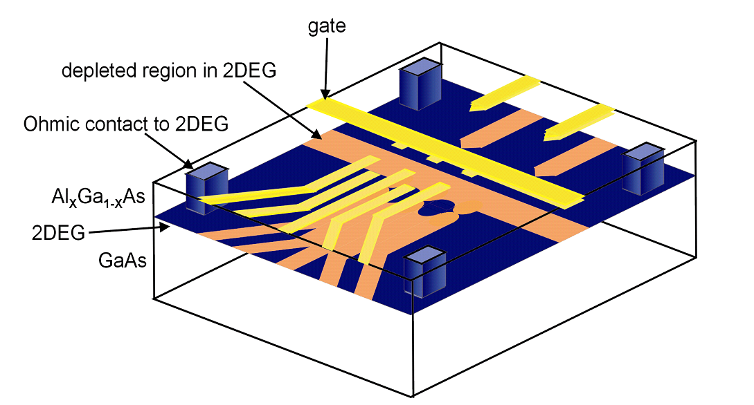
Double quantum dot
Strong magnetic field

Slide 5
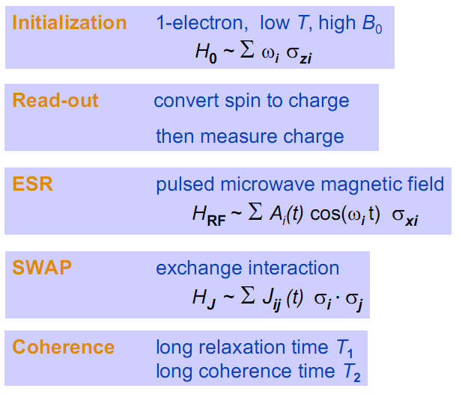
Lecture outline

Slide 6


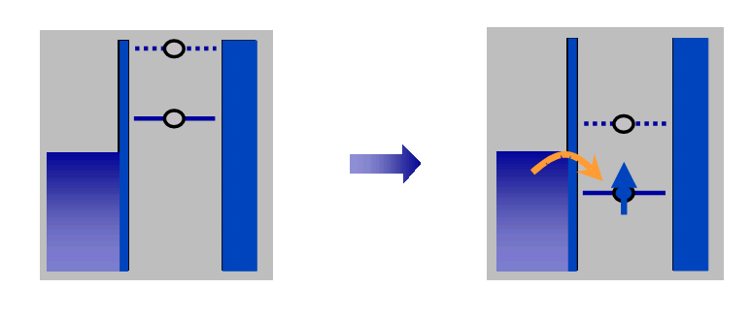
Applying
proper voltage
Fermi level

Slide 7
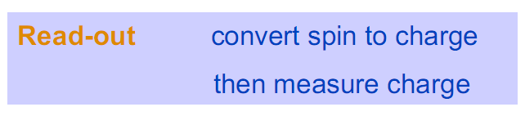
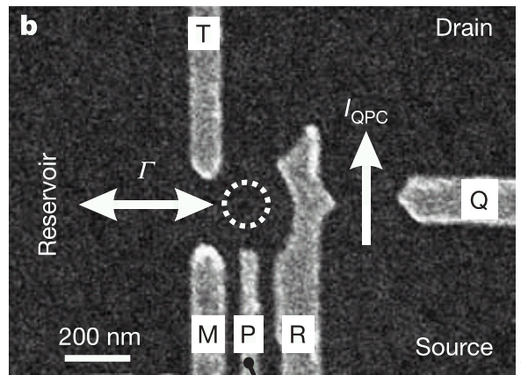
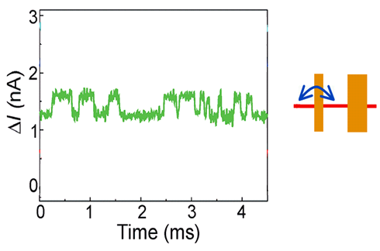
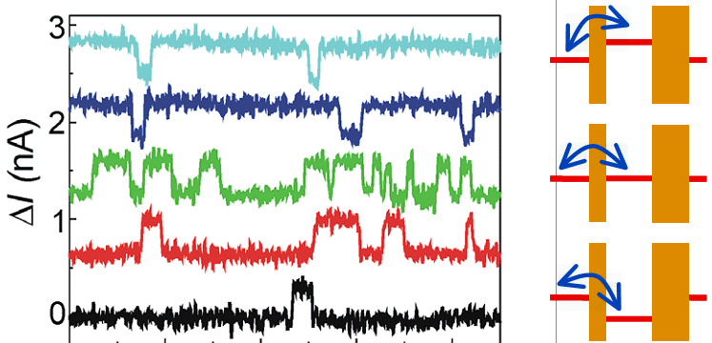

Read-out done using quantum point contact (QPC)

Slide 8
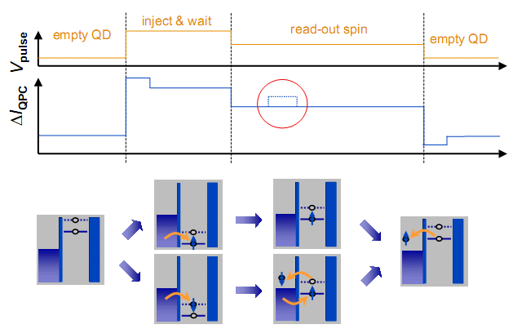

Slide 9



Lecture overview

Slide 10
Energy Diagram of a Double Quantum Dot
It brings some general ideas.

Slide 11
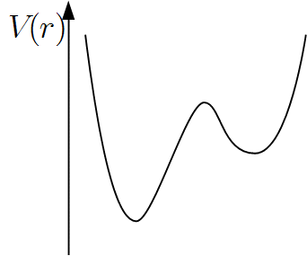
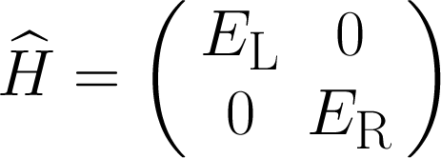
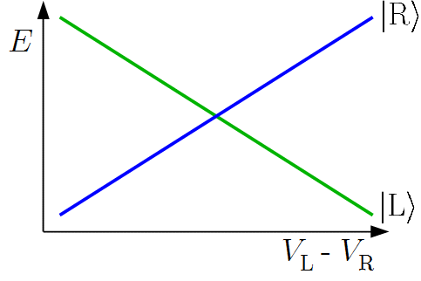


Spin-less particle in double well

Slide 12
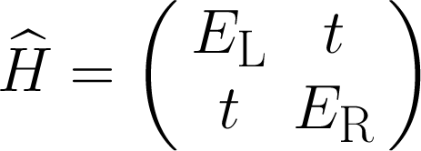
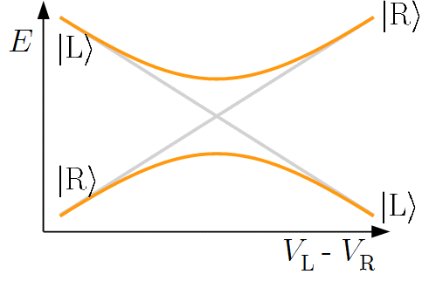
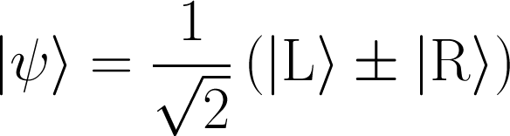
Spin-less particle in double well

Slide 13
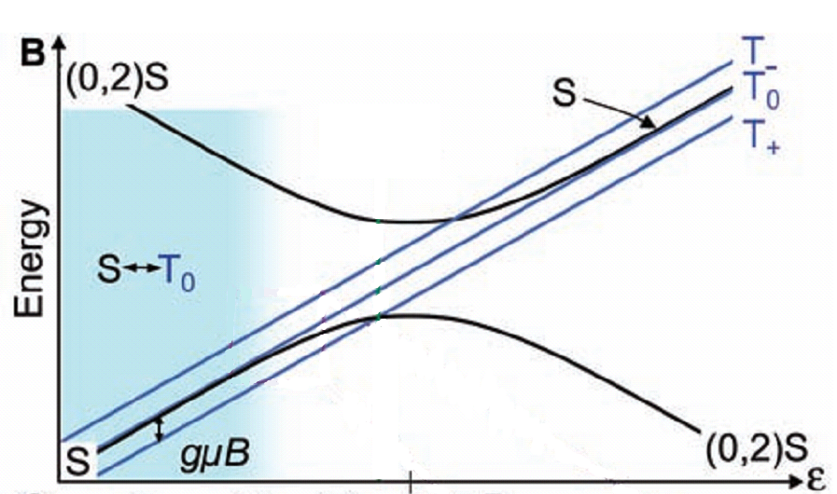
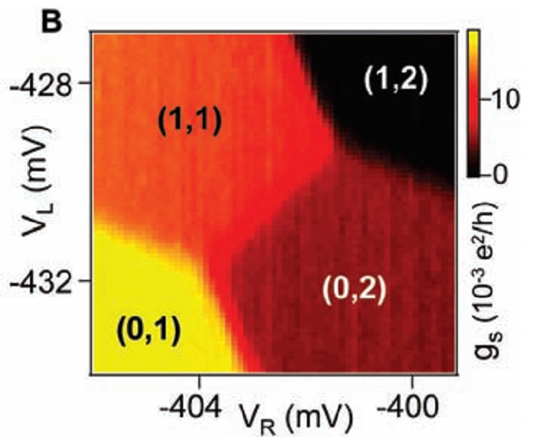
Energy diagram of a double quantum dot (1)
Singlet states are strongly coupled → gap.
Triplet (0,2) states are cut-off due to large exchange integral.

Slide 14
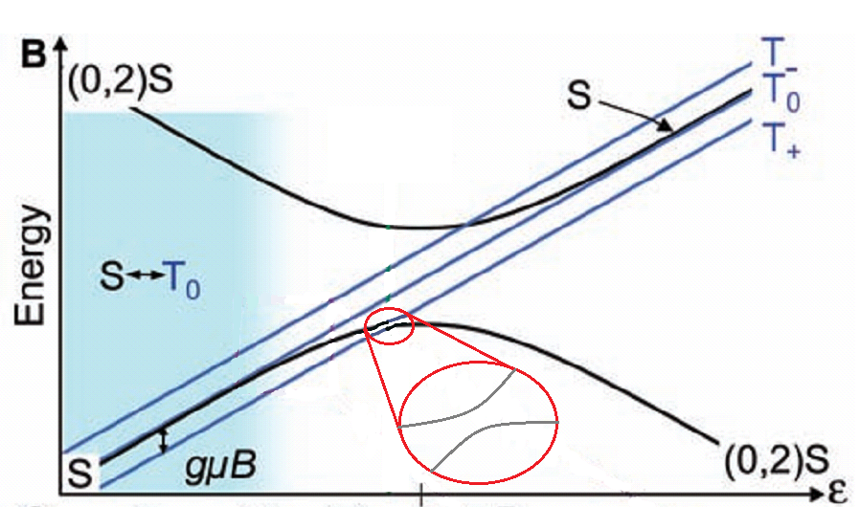
Energy diagram of a double quantum dot (2)
Weak coupling between (0,2)S and (1,1)T₊.

Slide 15
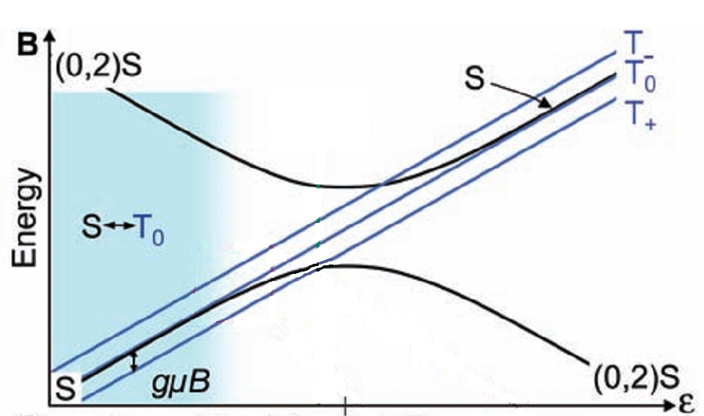
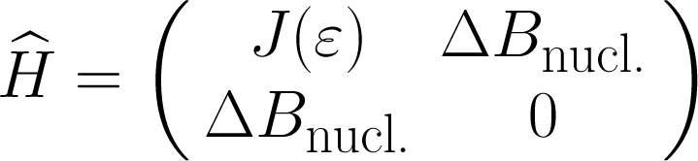
Energy diagram of a double quantum dot (3)
In this region, the state effectively described in
S – T₀ subspace,
Effective hamiltonian:

Slide 16
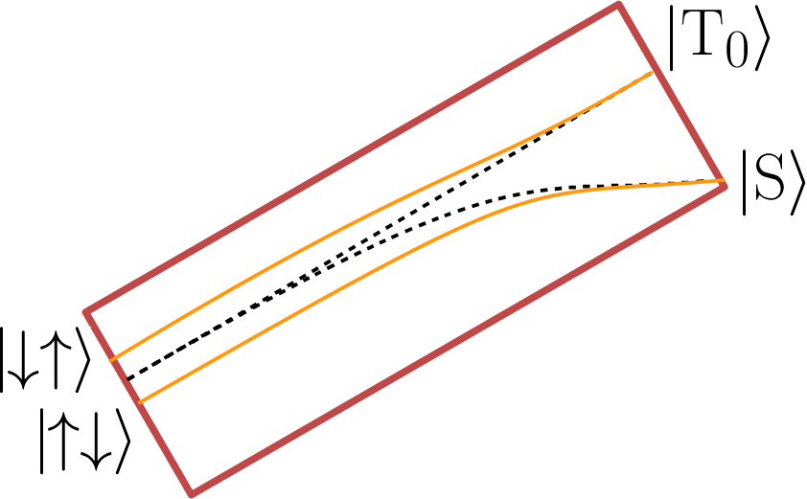



Energy diagram of a double quantum dot (3)
Far left = deep in (1,1) region, .
→ Eigenstates of subspace are and !

Slide 17
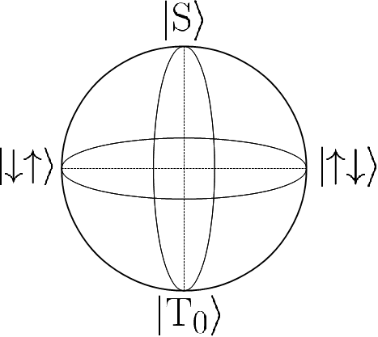
The logical qubit

Slide 18
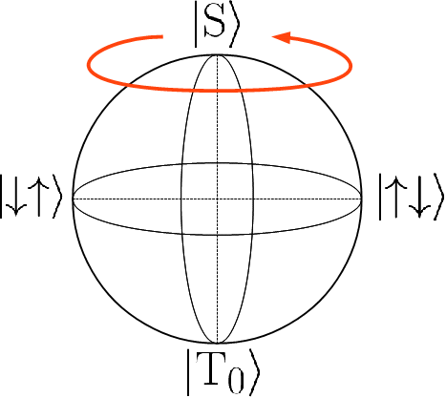
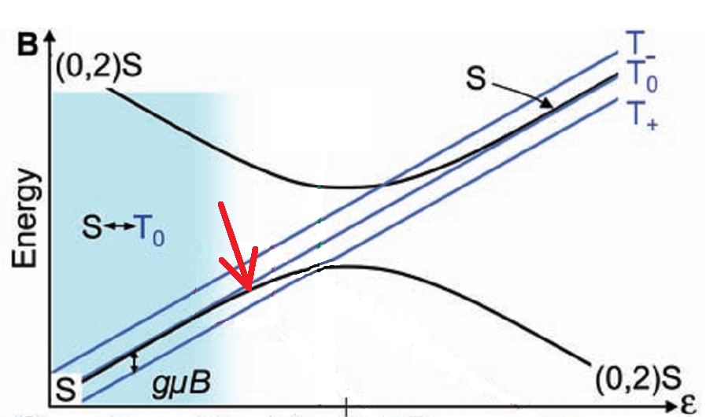
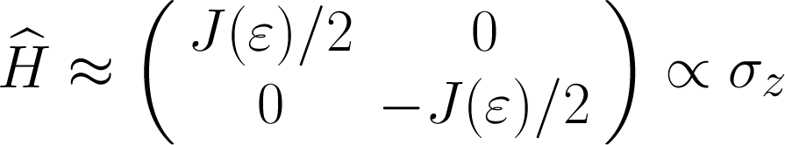
Qubit manipulation

Slide 19
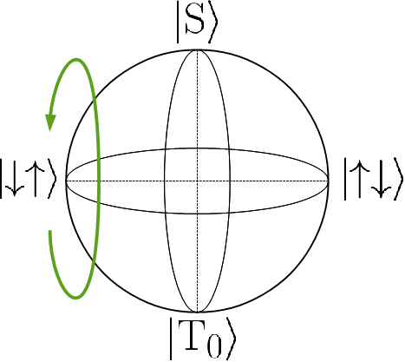
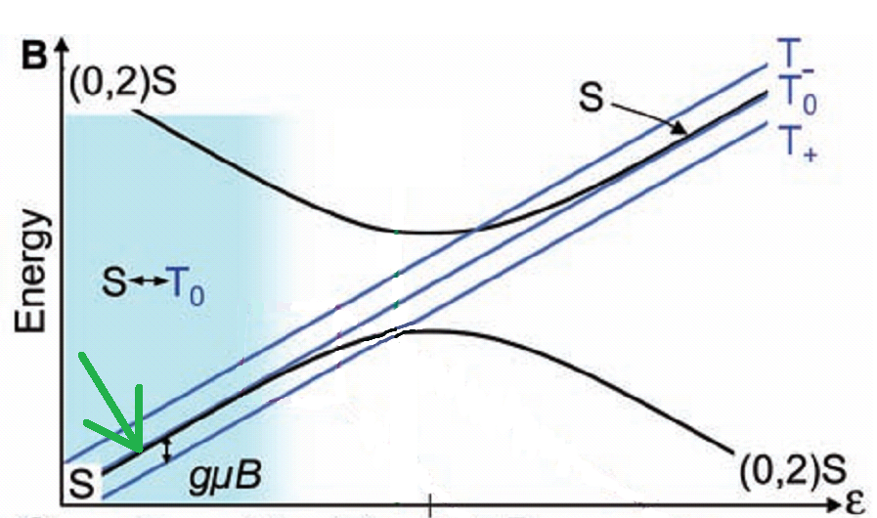
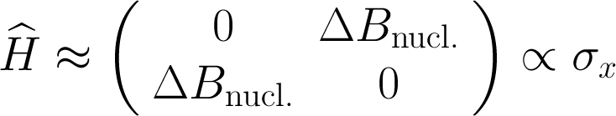
Qubit manipulation

Slide 20
Dephasing Time
Experiment #1

Slide 21
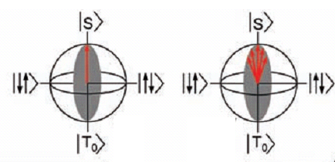
Measuring dephasing time
or... ?
fast
Fast and wait
Fast backwards

Slide 22
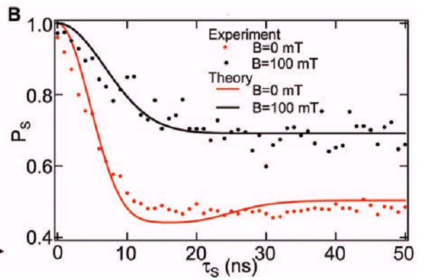
Dephasing time – Results

Slide 23
Spin Echo
Experiment #2

Slide 24
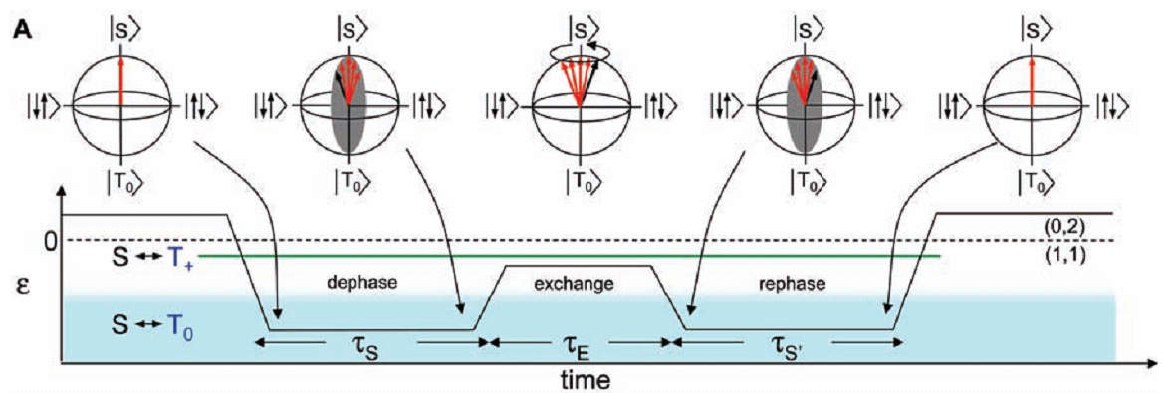
Spin Echo: State manipulation

Slide 25
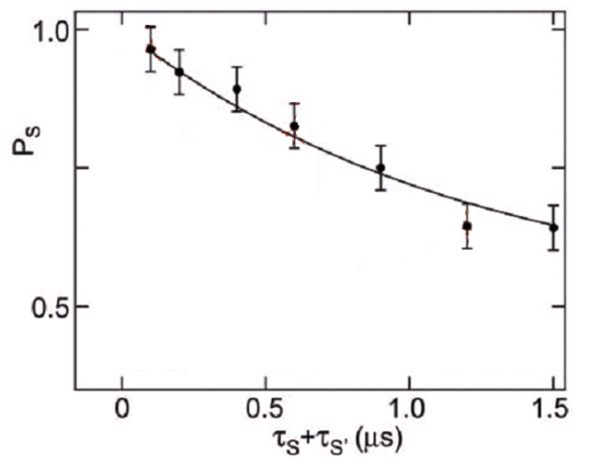
Spin Echo: Theory vs. Experiment

Slide 26
SWAP Operation
Experiment #3

Slide 27
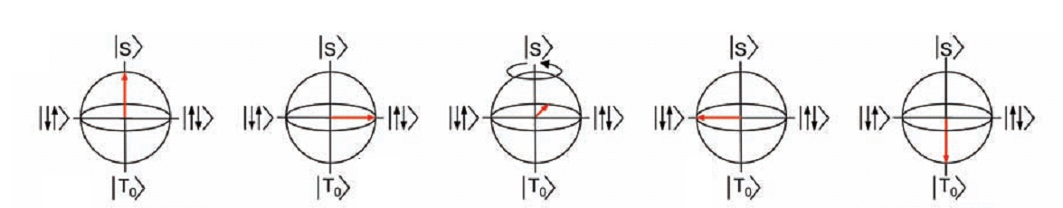
SWAP operation
fast
adiabatically

Slide 28
SWAP operation
Fast and wait

Slide 29
SWAP operation
fast
adiabatically

Slide 30
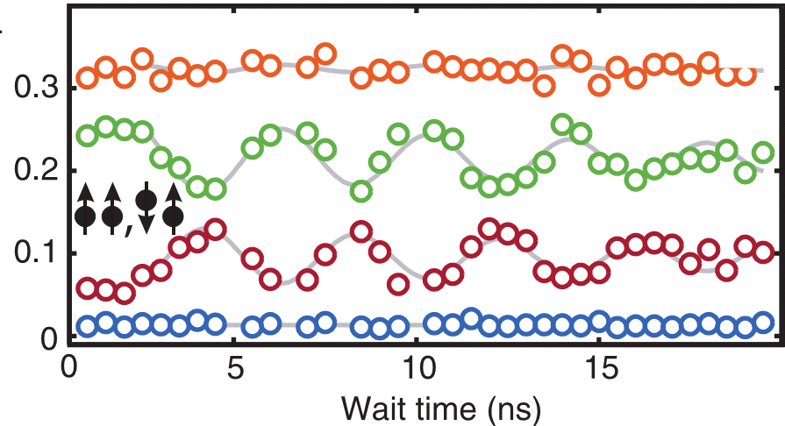
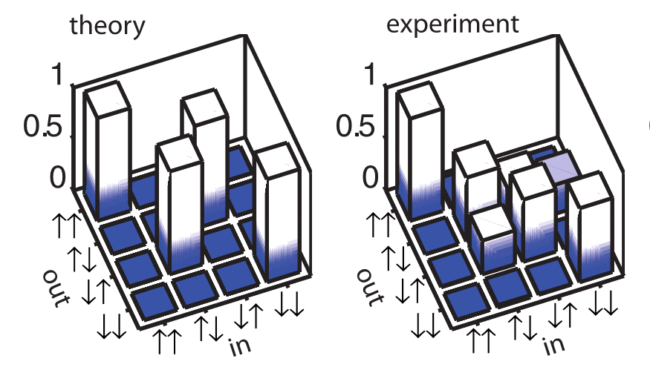
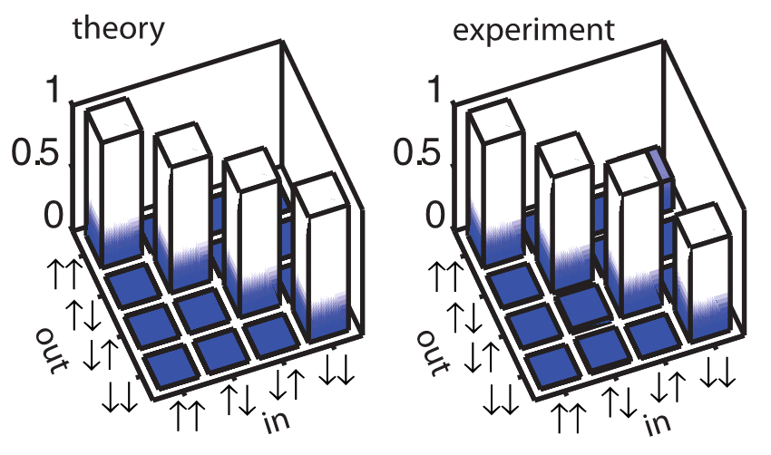
SWAP: Theory vs. Experiment

Slide 31
Summary

Slide 32
Summary
Read-out fidelity ≈ 86 %
Dephasing time ≈ 10 ns
Echo-coherence time ≈ 1.2 μs
Thank you for attention!
It’s time for your questions.

Slide 33
Used literature
Hanson, R; Kouwenhoven, LP; Petta, JR; et al.
  Spins in few-electron quantum dots
  Reviews of Modern Physics 79, 1217 (2007)
Petta, JR; Johnson, AC; Taylor, JM; et al.
  Coherent manipulation of coupled electron spins in semiconductor quantum dots
  Science 309, 2180 (2005)
Nowack, K. C.; Shafiei, M.; Laforest, M.; et al.
  Single-Shot Correlations and Two-Qubit Gate of Solid-State Spins
  Science 333, 1269 (2011)
Special thanks to Arkady Fedorov for his willing advice.

Slide 34
Final note
Hello, whoever you are!
If you got this far, please send me an email to tomas(dot)bzdusek(at)gmail(dot)com. I am really curious how many people finds this presentation useful, say, during 5 years after my talk.
However, considering ammount of words used in the slides, I think they won’t help you much, if you did not attend my talk.
I wish you good luck anyway, whatever reason has led you here. ☺
(ancient words of the author, 5th December 2011)

